Slide 1
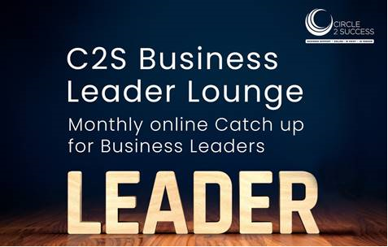
Josh Isaac & Colin Beard
WELCOME
Unlocking Sustainable Growth: The Power of Diversity, Inclusion, and Wellbeing in the Workplace

Slide 2
Introduction
Three years ago during the pandemic, we had a dream to set up a company that genuinely cared for the wellbeing of people with disabilities. Fast forward and Prosperity Care and Wellbeing have a team of holistic therapists, they run events that are attend by up to 200 people and deliver around 4000 hours per week of direct care and support to people in Gloucestershire and the surrounding counties.
They constantly buck the trend on being short staffed because of their many initiatives to support their people; and a commitment to encouraging people to bring their whole self to work.
“We are delighted to have won the Culture and Diversity Award. We are bursting with pride for this recognition. It’s a testament to the team for our unwavering commitment to creating a vibrant, inclusive, and supportive environment for the staff team and the people we support. We believe that diversity is hugely important and that everyone deserves to work in a place where they can be themselves and thrive. This award is for all the awesome individuals who contribute to our culture every day. Let’s keep spreading kindness, and celebrate uniqueness and building a stronger, more diverse community together.”

Slide 3
Agenda
Introduction
Accreditations and Achievements
Importance of equality, diversity, and workplace culture in today's organisations
Keep it simple
What are the benefits?
Strategies for promoting Equality, Diversity, Inclusion
Measuring impact
How we can support you
Q&A

Slide 4
Accreditations & Achievements

Slide 5
Testimonials
“We found the service to be well led – this means we looked for evidence that service leadership, management and governance assured high-quality, person-centred care; supported learning and innovation; and promoted an open, fair culture. Leadership of the service has been rated Outstanding. This meant service leadership was exceptional and distinctive. Leaders and the service culture they created drove and improved high-quality, person-centred care. Their vision was to enable every person who used the service and staff members to have the opportunity for personal growth and to find people's strengths and celebrate their diversity through empowerment.” -The Care Quality Commission
“My experience with Prosperity Care & Wellbeing has been truly exceptional from not only the support, guidance and work/life balance but also having the opportunity and safe space to be my complete authentic self. It’s a place where being your true self and embracing your differences is not just encouraged but celebrated.”
PCW has allowed me to bring my whole self to work, not just 50% which has created an environment where I can freely express my thoughts and feelings and empowered me to propose innovative solutions. The environment this has created has allowed me to grow both professionally and personally. I’ve found a purpose in my work and have a stronger sense of belonging.” – Staff Member

Slide 6
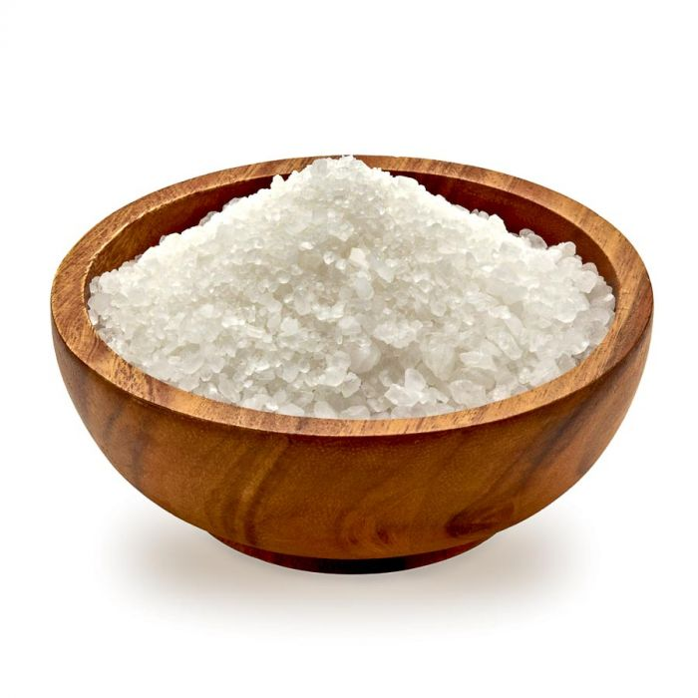
Equality, Diversity, Inclusion = Positive Workplace Culture
But what does this look like?
Notes:
Workplace culture can be compared to the subtle difference between sugar and salt. At first glance, they appear quite similar, often in the form of fine, white crystals. However, it's only when you taste them that you realise how vastly different they are.
In the same way, workplace cultures might seem similar on the surface, with shared values, missions, and even physical environments. Yet, the true essence of a workplace culture, whether it's a good or bad one, can only be authentically felt when you immerse yourself in it.
A positive workplace culture is like sugar - it adds sweetness to your professional life. It's supportive, nurturing, and encourages growth. Just as sugar enhances the flavour of your favourite treats, a good workplace culture brings out the best in employees, making them feel valued and motivated. It's a place where collaboration and innovation thrive, much like how sugar transforms plain ingredients into indulgent desserts.
On the other hand, a toxic workplace culture can be likened to salt - it leaves a bitter taste in your mouth. Like too much salt can ruin a dish, a bad workplace culture can poison the work environment, leading to stress, dissatisfaction, and disengagement among employees. It's a place where negativity, favouritism, and micromanagement prevail, leaving a trail of discontent.
Just as you wouldn't mistake sugar for salt once you've tasted them, you can discern a good workplace culture from a bad one once you've experienced it firsthand. Authenticity in workplace culture, much like the genuine flavour of sugar or salt, can't be hidden for long – it's something that employees can feel in their daily interactions and experiences. So, the next time you're assessing a workplace, remember the sugar-and-salt analogy – it's not just about appearances; it's about the authentic taste of the culture that truly matters.

Slide 7
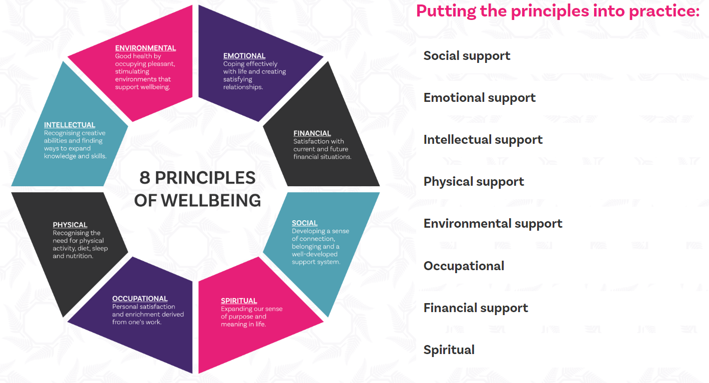
Our Approach
Notes:
Prosperity Care and Well-being adopts the 8 principles of well-being – this is applied throughout the organisation and applies to the people we support as well as staff.
How we put them into practice:
Social Support - Encouraging people to participate in social activities and connecting them with others with similar interests or experiences can promote a sense of belonging.
Emotional Support - Helping people set goals and providing them with opportunities to learn new skills or take on challenges can boost self-esteem. Providing them with tools to manage their emotions or stress, such as relaxation techniques or therapy that supports emotional health.
Intellectual Support - Providing opportunities for people to learn new skills and access education. This can promote personal growth and a sense of
accomplishment.
Physical Support - Encouraging people to engage in physical activity, eat a healthy diet, and have access to regular medical check-ups, to promote physical health and wellness.
Environmental Support - We provide housing-related support to help people with learning disabilities maintain a safe and comfortable home. We help people to learn essential life skills, with the goal of supporting people to live independently and comfortably in their own home.
Occupational - Helping people to identify their passions and goals and providing them with opportunities to pursue them. Supporting employment and career opportunities to enable people to find work and integrate into the community.
Financial Support - Helping people budget and offering advice on making informed financial decisions. Our goal is to empower individuals to become more independent and confident in managing their finances.
Spiritual - We offer a non-judgemental space to enable people to be themselves and engage in activities that nourish their spirit. We are supportive of people’s beliefs and promote diversity and equal opportunities.

Slide 8
Five main benefits of promoting Equality, Diversity, and Inclusion (EDI) in the workplace for employees
Benefit | How is this measured?
Enhanced Job Satisfaction: Embracing EDI creates a more inclusive and respectful work environment, where employees feel valued for who they are. This boosts their job satisfaction, leading to a happier and more motivated workforce. | Employee engagement Employee satisfaction surveys Retention rates and analysis with competitors
Increased Opportunities for Growth: In an inclusive workplace, employees have equal access to opportunities, regardless of their background. This promotes career advancement, skill development, and personal growth for all employees. | ‘Grow your own champions’ – Investment and promotion stats Business Growth - £,sales,jobs
Fostered Creativity and Innovation: A diverse workforce brings together varied perspectives and experiences, sparking creativity and innovative problem-solving. Employees are more likely to think outside the box and come up with fresh ideas when working in a diverse and inclusive environment. | Where have the best ideas come from? Who knows best? “You said, we did” – Jax night Engagement at board meeting level
Improved Mental Health and Well-Being: Inclusive workplaces tend to have lower stress levels and better mental health outcomes for employees. When individuals feel accepted and supported, they experience less anxiety and more overall well-being. | Reduced staff sickness / Bradford scores Commitment from employers – setting a budget, showing investment Finding the why?
Stronger Team Dynamics: Diversity and inclusion encourage collaboration and teamwork among employees from different backgrounds. This not only strengthens relationships but also leads to more effective and cohesive teams, which can ultimately boost productivity and success. | Product / sales Business reputation - Awards Advocates for the business Word of mouth Attraction of talent

Slide 9
Benefits to Business
Enhanced Innovation and Creativity: Diversity of thought, backgrounds, and experiences fosters a culture of innovation. Inclusive organisations encourage employees to bring unique perspectives to problem-solving, leading to more creative solutions and a competitive edge in the market.
Improved Decision-Making: A diverse workforce brings different viewpoints to the table, leading to more well-rounded and informed decision-making processes. Diverse teams are better equipped to anticipate various challenges and consider a wider range of potential solutions.
Increased Employee Engagement and Productivity: Inclusive workplaces foster a sense of belonging among employees. When individuals feel valued and respected, they are more engaged in their work, resulting in higher productivity, lower absenteeism, and reduced turnover rates.
Enhanced Reputation and Attraction of Talent: Organisations that prioritise EDI are viewed as socially responsible and ethical, which enhances their reputation both internally and externally. This positive image attracts top talent, making it easier to recruit and retain diverse and skilled employees.
Better Problem-Solving and Customer Relationships: Diverse teams are more effective at identifying potential problems and addressing them proactively. Additionally, they can better understand and connect with a diverse customer base, leading to improved customer relationships and loyalty.

Slide 10
Strategies For Promoting EDI
Provide a Tailored Experience
Health is a deeply personal matter, and no two individuals are on the same journey when it comes to their well-being. Each person's unique life circumstances require a approach to effectively address and enhance their individual health outcomes.
Examples – Holistic therapies programme, pain relief workshops, relaxation techniques, sleep clinics, massages, creating time out, mental health support programme.
Beyond promoting health equity, an employee wellbeing platform that enables communication across all populations supports better business outcomes. A wellbeing programme should keep employees aligned with the company’s vision and goals to encourage intrateam collaborations and reinforce social connections. By encouraging social connectivity and teamwork, organisations help foster an inclusive workplace culture.
“Get paid to get fit” – Health initiative with financial incentive

Slide 11
WHAT IS THE IMPORTANCE OF WORKPLACE WELLBEING?
The Covid-19 pandemic changed the way we work forever, bringing focus to the health and wellbeing of employees in the work place. Whether people remain working from home or are back in the office, employers are now much more aware of their responsibilities to keep people safe and to promote good mental and physical health.
Every year, businesses lose millions of working days due to ill health, work related stress, depression, and anxiety. This has a direct financial impact on the business but also contributes to staff burn out, high staff turn over, low morale within the work force or poor business reputation.
With recruitment difficulties across all sectors, staff are now looking for more than just a higher salary. There is a growing trend for staff to seek employment with businesses which offer better working conditions, and where their wellbeing is valued and considered paramount.
“Show your employees how much you care”

Slide 12
Top Tips
Promoting EDI and the promotion of a positive work place culture is bloody hard work and requires continuous commitment, investment and champions who can challenge!
No one knows your employees’ goals, motivators, personal history, and engagement styles better than they do.
Giving your people the power to guide their own wellbeing journey with the help of an inclusive, personalised, multi-faceted holistic wellness program is the best way to ensure improved health outcomes are possible for all populations.
Listen and take feedback from team
Open door – but through the right channels with boundaries

Slide 13
HOW CAN PROSPERITY HOLISTIC THERAPISTS HELP?
We have a team of therapists and wellbeing gurus who have years of experience in a variety of disciplines. We are able to assign a specific therapist to organisations, ensuring they can build relationships with staff to enable them to disconnect, relax, and unwind.
We are professional but fun. We understand therapies may not be for everyone, but everyone will benefit from holistic treatments. If you aren’t convinced, we urge you to have an open mind and give it a go!
WE ARE PROUD TO HAVE DEVELOPED A NUMBER OF SUCCESSFUL WELLBEING PROGRAMMES
Designed specifically for individual organisations. Our services provide team building sessions, mindfulness, problem solving, resilience training, taking care of each other, mental health first aid training, and more.

Slide 14
THANK YOU!
ANY QUESTIONS?
Tel: 0330 320 9144
www.prosperitycare.co.uk
info@prosperitycare.co.uk
Notes:
Questions – Does anyone have any questions that may not have been answered in today's induction?

