Slide 1
C2S National Women’s Leadership Network (Online) Talks Menopause
Sarah Taylor

Slide 2
Sarah Taylor
People & Culture Director
A Bit About Me
My Career Journey
My Journey So Far With The Menopause
1
2
3

Slide 3
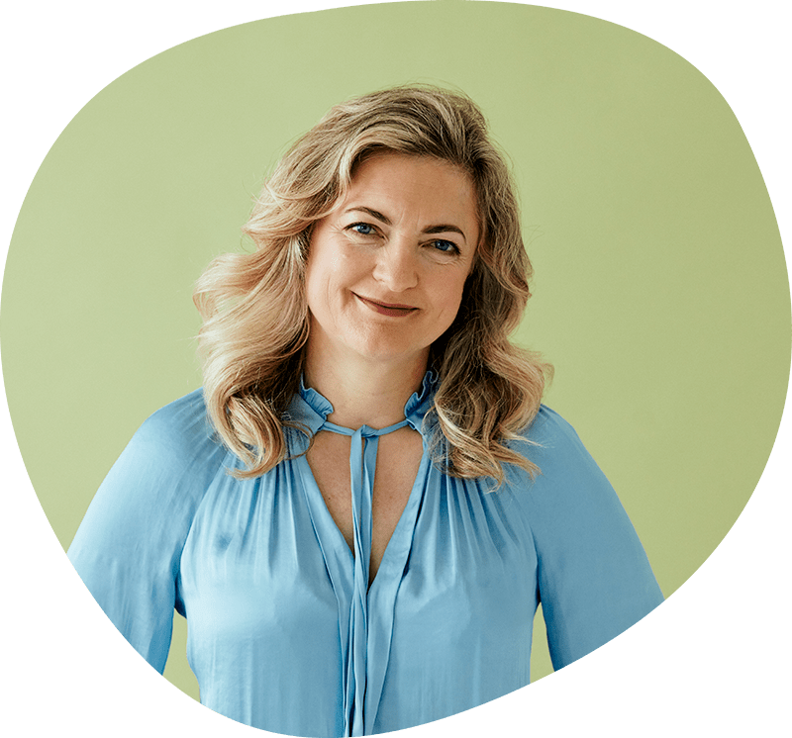
Menopause Awareness Campaign
4 events run across the week to build awareness around menopause within the company focused on towards different audiences.
Company Wide Session Run With Experts To Demystify The Menopause
Women Of The Business Came Together To Share Experience
Men Of The Business Came To Discuss There Role To Support
Giving Local Teams A Chance To Reflect

Slide 4
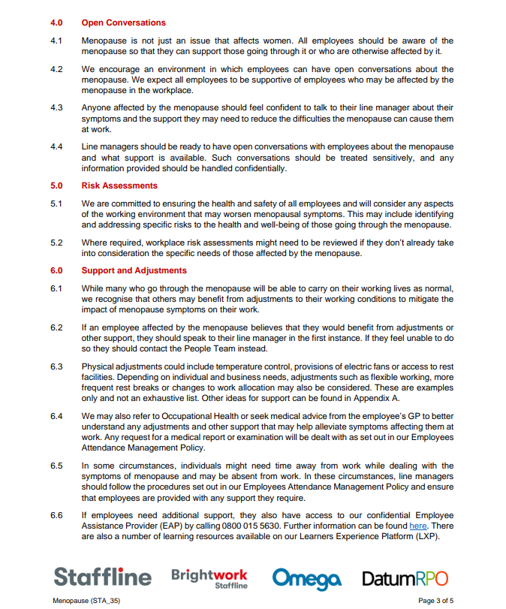
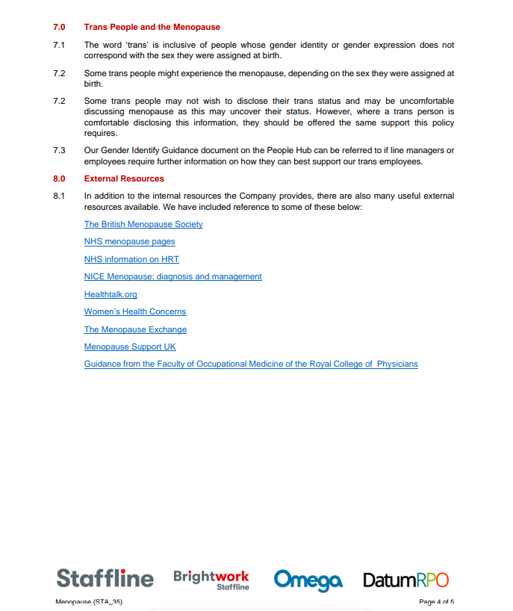
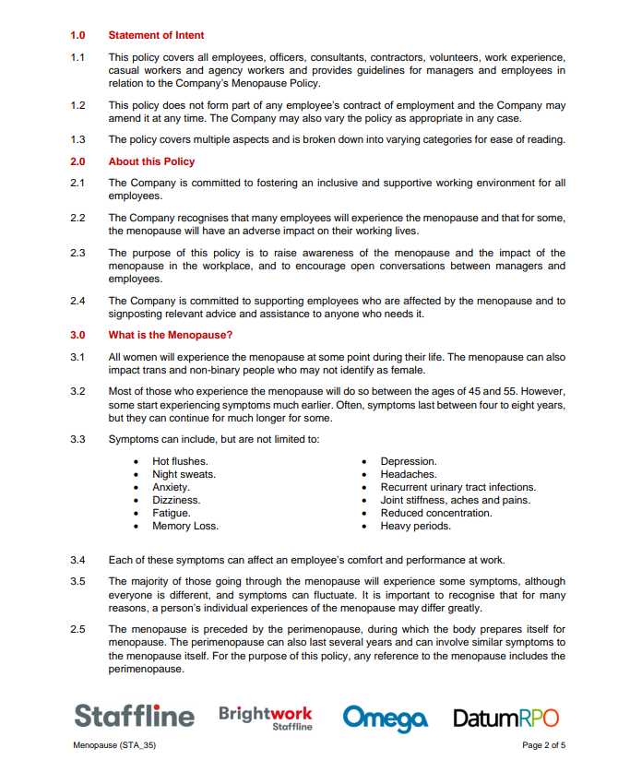
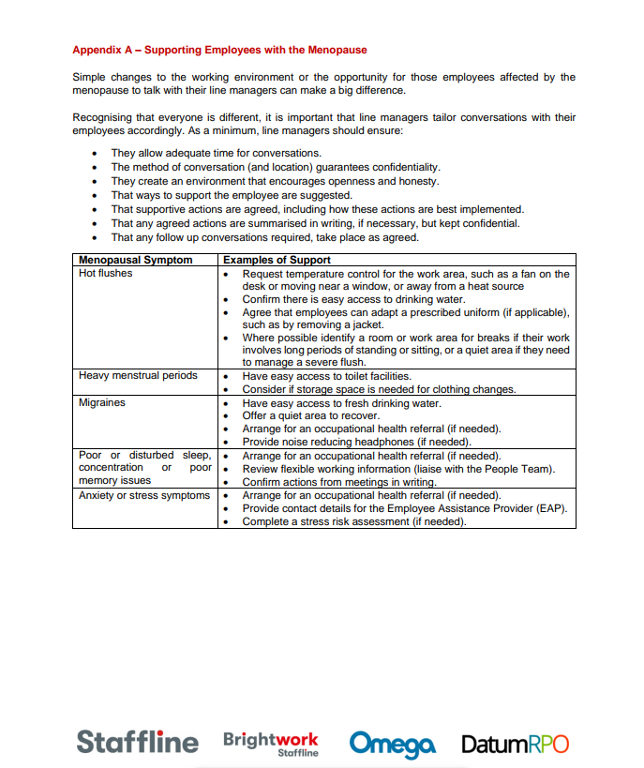
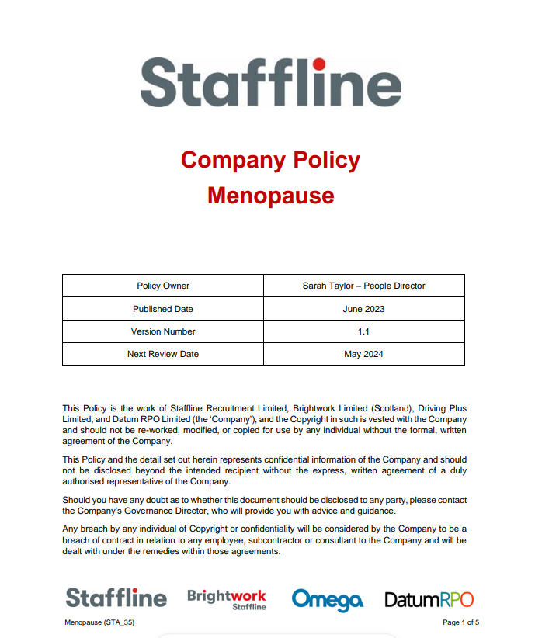
The Journey Continues
We didn’t want it to be just a weeks focus which we then moved on from. We backed up our learning with further support and a Menopause policy.

Slide 5
Any Questions?

