Slide 1
Budget Up!
Spring Budget 2023 – one week on
21 March 2023

Slide 2
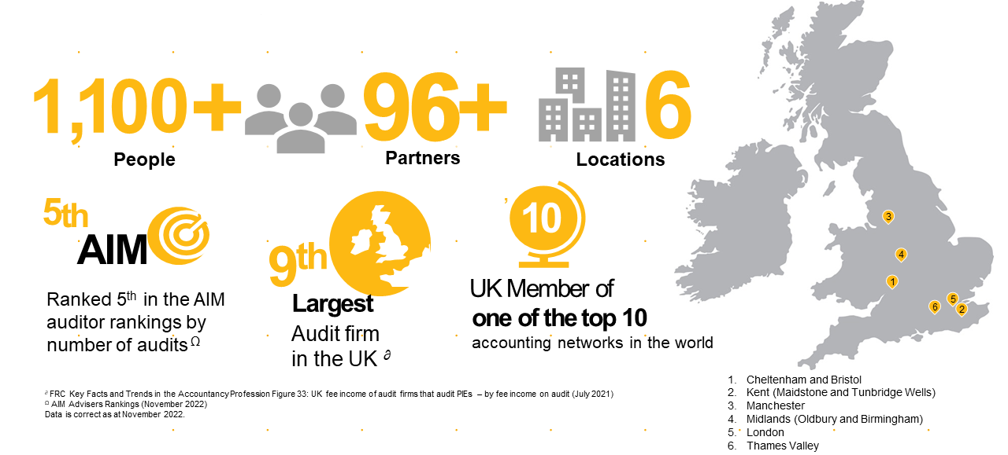
About Crowe UK

Slide 3
Today’s speakers and Agenda
Nick Latimer
Partner, Tax
+44 1242 234421
nick.latimer@crowe.co.uk
Agenda
14:00 | Introductions
14:10 | Updates for companies and businesses | Nick
14:20 | Thoughts, and how do the changes impact you? | Breakout
14:30 | Updates for individuals and financial planning considerations | Nick and Richard
14:45 | Thoughts, and how do the changes impact you? | Breakout
14:55 | Wrap up, Q&As | Chris, Nick and Richard
Richard Dean
Director, Chartered Financial Planner
Crowe Financial Planning
+44 1242 234421
richard.dean@crowe.co.uk
Chris Mould
Partner, Audit
+44 1242 234421
chris.mould@crowe.co.uk

Slide 4
Companies and other businesses
Nick Latimer, Partner, Tax

Slide 5
Companies and other businesses
Increased corporation tax rate
Full expensing of capital allowances
R&D changes
Transfer pricing
VAT – interest changes

Slide 6
Increase in corporation tax to 25%
What is the change?
Companies whose profits exceed £250k will see an increase in tax from 19% to 25%.
Who does it affect?
The £250k limit is reduced proportionately for each active associated company.
The rules on associated companies have also changed and will increase the number of associated companies
What clients need to do
How we can help
Assess the number of associated companies.
Remove unnecessary entities.
Plan future cashflows.
Ensure relevant reliefs are claimed.
Consider CFC position of subsidiaries
Advising on new associated company definitions.
Tidying up group structures.
Working on cashflow forecasts.
R&D, Patent Box claims
Assess your CFC position

Slide 7
Full expensing of capital allowances
What is the change?
Expenditure on new plant and machinery will get full relief in the year of spend.
Who does it affect?
Only applies to companies
Only benefits those that spend over £1m a year anyway.
Certain assets excluded but get 50% relief if not covered by AIA
What clients need to do
How we can help
Understand which assets qualify for which category of relief.
Consider deferred tax impact.
Keep records for future sales of the assets
Advise on capital spend, particularly in a property.
Assist with corporate tax compliance.

Slide 8
Innovation tax reliefs
What is the change?
R&D SME reliefs increased but still less than pre Autumn Budget.
Non-UK spend restriction delayed until 2024.
New reporting requirements for claims from August 2023
Who does it affect?
Everyone making an R&D claim needs to be aware of the changes.
What clients need to do
How we can help
Submit historic claims pre-August if possible.
Expect more HMRC scrutiny on claims.
Understand spend on non-UK workers and impact on claims.
Work with you to identify R&D projects.
Set up internal procedures to capture R&D data.
Prepare and submit claims to HMRC.

Slide 9
Transfer Pricing (TP)
What is the change?
Prescribed formats of documentation.
New requirement to complete a summary audit trail.
Who does it affect?
Officially, just the largest UK businesses (turnover €750m+).
But seeing increased TP activity more widely.
UK no longer a low tax jurisdiction, will HMRC respond?
What clients need to do
How we can help
Largest corporates need prescribed documentation.
All non-SME clients need to reconsider their compliance position.
Advise on TP policies and documentation, in the UK and globally.
Benchmark current margins.
Assist with international structures.

Slide 10
VAT – Interest charges
What is the change?
HMRC are charging interest on overpayments earlier
HMRC are charging interest on errors even if VAT is recoverable in full
Who does it affect?
Any VAT registered business.
Current interest rates are 6.5% and so this can be significant.
What clients need to do
How we can help
Review processes and controls to ensure VAT is accounted for correctly at the right time.
Assistance with understanding complex rules.
Advice on systems and controls.
Training key personnel.

Slide 11
Takeaways
UK is no longer a low tax jurisdiction
Focus on tax compliance
Maximise reliefs – Patent Box even more valuable now
Consider international activities
R&D process is changing – revisit your processes

Slide 12
Break

Slide 13
Individuals

Slide 14
Budget for individuals
Income tax
Remuneration planning
Capital gains and inheritance tax
Separation and divorce
Pensions and investments

Slide 15
Income Tax
What is the change?
No change – the big freeze stays.
Personal allowance fixed at £12,570, basic rate limit at £37,700 till 2026.
Who does it affect?
Fiscal drag affects all tax payers
Brings more people in to the higher rate tax bracket.
What clients need to do
How we can help
Think about your personal budget.
If you are able, be flexible with your income.
Use all family personal allowances and reliefs where possible.
Tax planning around personal income and budgets

Slide 16
Remuneration planning
What is the change?
Corporation tax and income tax rates.
Who does it affect?
Family and owner-managed businesses and entrepreneurs.
What clients need to do
How we can help
Crunch the numbers. Dividends are not necessarily the right answer anymore
We can help you calculate the right decision. Possibly across a number of options.
Consider pension contributions, rental income, interest on loan accounts and possibly bonuses.

Slide 17
Capital gains and Inheritance tax
What is the change?
Reduction in annual exemption for CGT
Freeze on IHT threshold
Otherwise no changes
Who does it affect?
Those with capital assets – property, businesses, investment portfolios.
What clients need to do
How we can help
Consider the timing of the sale of assets
Review the value of your estate
Make sure your wills are up to date.
We can help with the calculation of your IHT exposure and estate planning.
Calculate any inherent capital gains to plan the sale or transfer of assets
Liaise with your lawyer on will planning.

Slide 18
Separation and divorce
What is the change?
Extension to the no gain/no loss rule on the transfer of assets
Who does it affect?
Separating and divorcing couples after 6 April 2023
Solicitors advising these couples
What clients need to do
How we can help
Speak to you lawyer – these changes give you more time so use it if necessary.
We can help calculate the gains on the transfer of assets within a settlement either in support of your legal team, or as a jointly appointed expert.

Slide 19
Pensions and investments
What is the change?
Increase in annual allowance from £40,000 to £60,000
Abolishment of lifetime allowance.
Higher interest rates
Who does it affect?
Clients with pensions or the ability to contribute larger sums to a pension.
Those with cash savings.
What clients need to do
How we can help
Speak to your pensions advisor.
Check your interest rates.
Help with tax returns and self assessment
Help with financial planning

Slide 20
Takeaways
Crunch the numbers – think about your personal budget and investments
Remuneration planning – dividends may not be the right way so consider alternatives.
Review your estate – inflation has meant that values have increased so it may be time to do some planning

Slide 21
Financial Planning
Richard Dean, Director, Financial Planning

Slide 22
Annual allowance
What is the change?
Increased from £40,000 per year to £60,000 per year
First increase in annual allowance since 2010
Who does it affect?
Pension savers
Mid tier to high earners
What clients need to do
How we can help
Consider increasing pension funding
Ensure using carry forward allowances
Calculating unused allowances
Long term funding strategy
Cashflow modelling

Slide 23
Money purchase annual allowance
What is the change?
Increased from £4,000 per year to £10,000 per year
Who does it affect?
Workers who have already accessed their pension benefits
What clients need to do
How we can help
Consider potential benefit of additional pension funding
Calculating unused allowances
Long term funding strategy
Cashflow modelling

Slide 24
Tapered annual allowance
What is the change?
Increasing from £4,000 to £10,000
Adjusted income test starts at £260,000 (increased from £240,000)
Who does it affect?
High earners
Those with multiple income streams
What clients need to do
How we can help
Consider potential benefit of additional pension funding
Calculating unused allowances
Long term funding strategy
Cashflow modelling

Slide 25
Lifetime allowance
What is the change?
The lifetime allowance will be abolished from 6 April 2024
The lifetime allowance charge will be zero from 6 April 2023
Maximum PCLS is £268,275 (25% of current LTA, £1,073,100)
Who does it affect?
People with substantial accumulated pension savings (either DC or DB, or both)
What clients need to do
How we can help
Consider the benefits of fully crystallising to avoid the charge
Consider additional pension savings, even if in excess of the current LTA
Detailing retirement income options
Long term income planning
Cashflow modelling

Slide 26
Fixed protection
What is the change?
All pension protection models are still valid
Higher pension commencement lump sums are still valid
Who does it affect?
People who have taken out any form of pension protection since 2006
What clients need to do
How we can help
Consider the benefits of additional funding vs the protection already in place
Formal assessment of the pros and cons of additional pension funding
Cashflow modelling

Slide 27
Interaction between pensions and inheritance tax
What is the change?
No changes yet!
Who does it affect?
Individuals who are not reliant on their pension savings to fund retirement income
What clients need to do
How we can help
Work out where best to source income in retirement
Holistic financial planning
Tax efficient income modelling
Cashflow modelling

Slide 28
Questions we have been asked
“Should I restart saving into a pension?”
“Should I crystallise all of my pensions immediately after 6 April?”
“Should I maximise my lump sums?”
“Are annuities good value now?”

Slide 29
Takeaways
Don’t rush
Consider how you want your retirement to look
Take formal advice

Slide 30
Break

Slide 31
Q&A / Close

Slide 32
Crowe U.K. LLP webinars are intended for informational and educational purposes and provide guiding information about audit, accounting, tax, consulting and other topics of interest. Our webinars are not intended to provide or substitute for professional advice with respect to any particular topic. You are responsible for your use of, and/or any reliance on, the information disseminated through the webinars, and/or responses to questions or the content of other webinar materials. The information imparted through our webinars, including all contents posted by the author(s) as well as comments posted by other participants, is provided for reference purposes only and is not intended, nor should it be used, as a substitute for professional advice or judgment or to provide accounting or legal advice with respect to particular circumstances.

