Slide 1





THE ETHICAL
RECRUITMENT
COMPANY

Slide 2


Slide 3
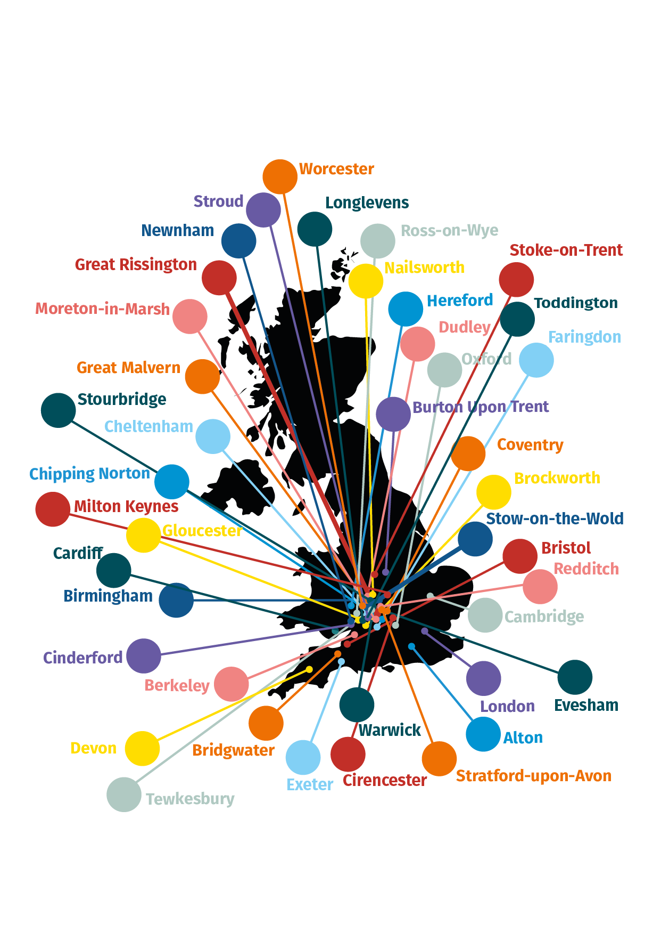

AREAS WE COVER

Slide 4
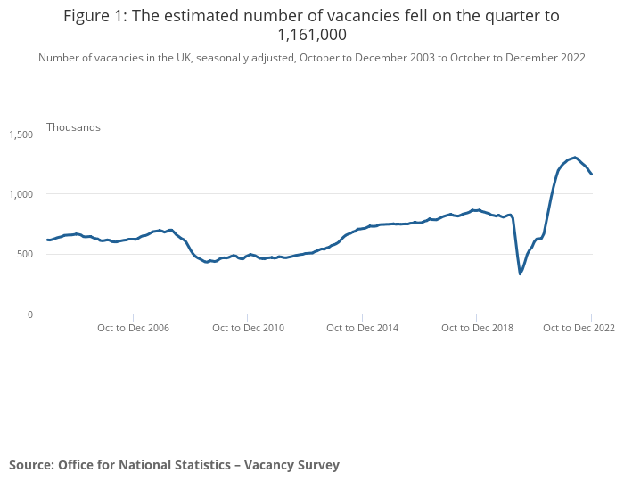
OPEN VACANCIES
Latest no of open vacancies Jobs in the UK for Q4 was 1,161,000 according to the ONS data
This is down 75,000 from the previous quarter and 85,000 from Dec 2021
Still 365,000 above pre-covid levels
Still only 1 person unemployed for every open vacancy

Slide 5
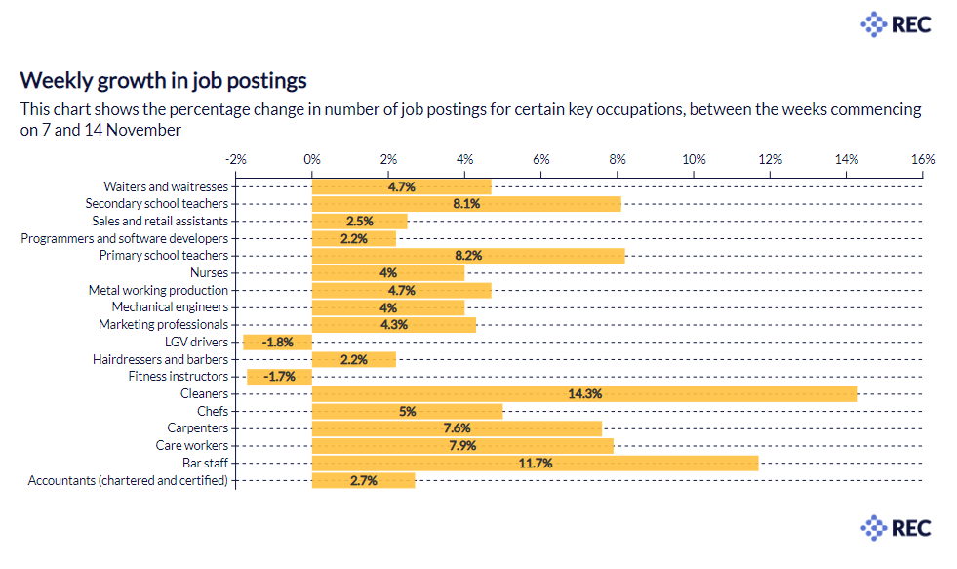

Slide 6
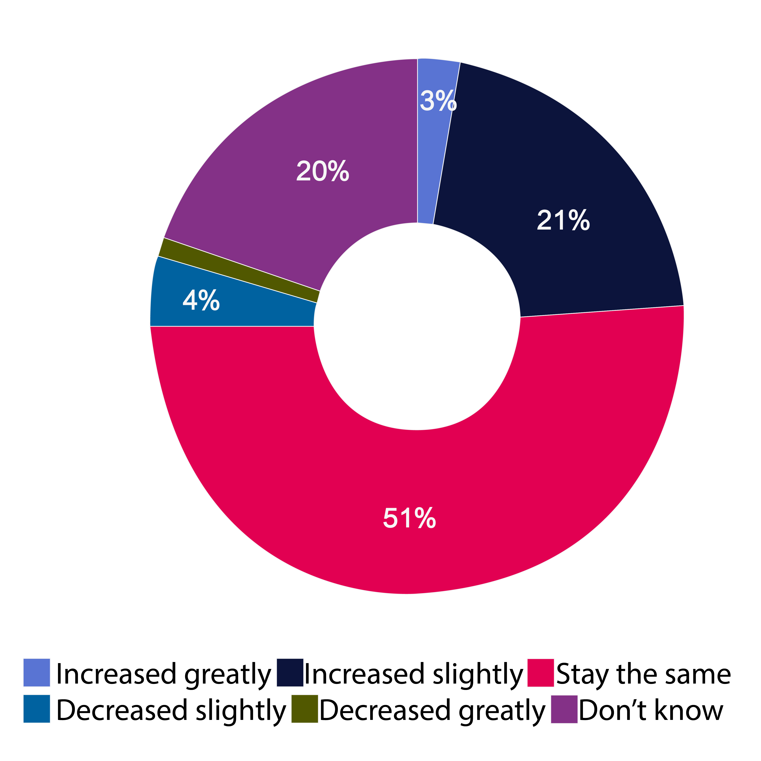
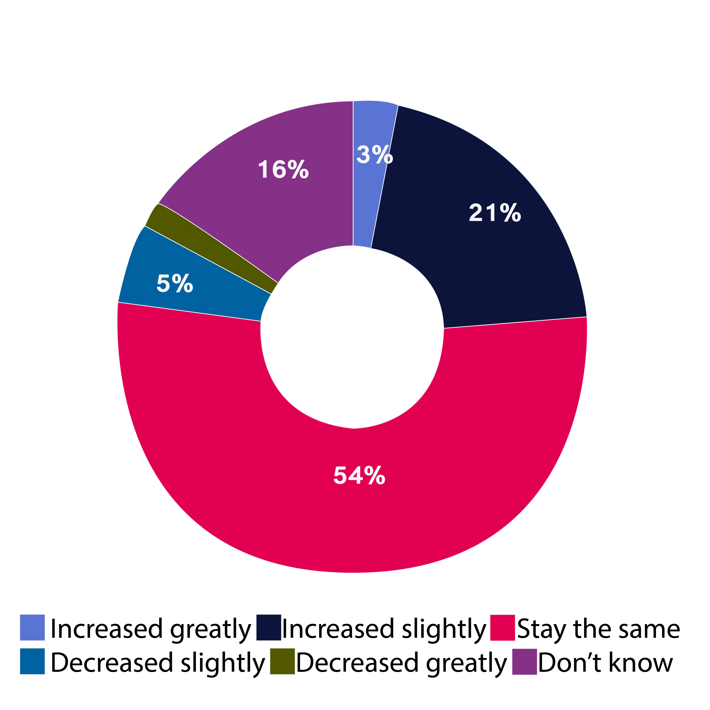

Medium term outlook
EMPLOYMENT MARKET
Quarterly growth has fallen or is stagnant in 14 out of 18 industry sectors
Optimism in the short term has taken a dip from +20 to +17
In the medium term though (4-12 months) this improves to +21 with the Midlands firms between 50-250 employees being the most optimistic
Short term outlook

Slide 7


Thank you!
Q & A
stephen@hoorayworks.co.uk
T 01242 339068 M 07899 922402
hoorayworks.co.uk

