Slide 1
Circle 2 Success November 2022

Slide 2
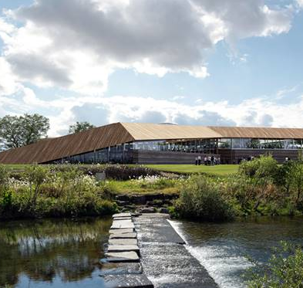
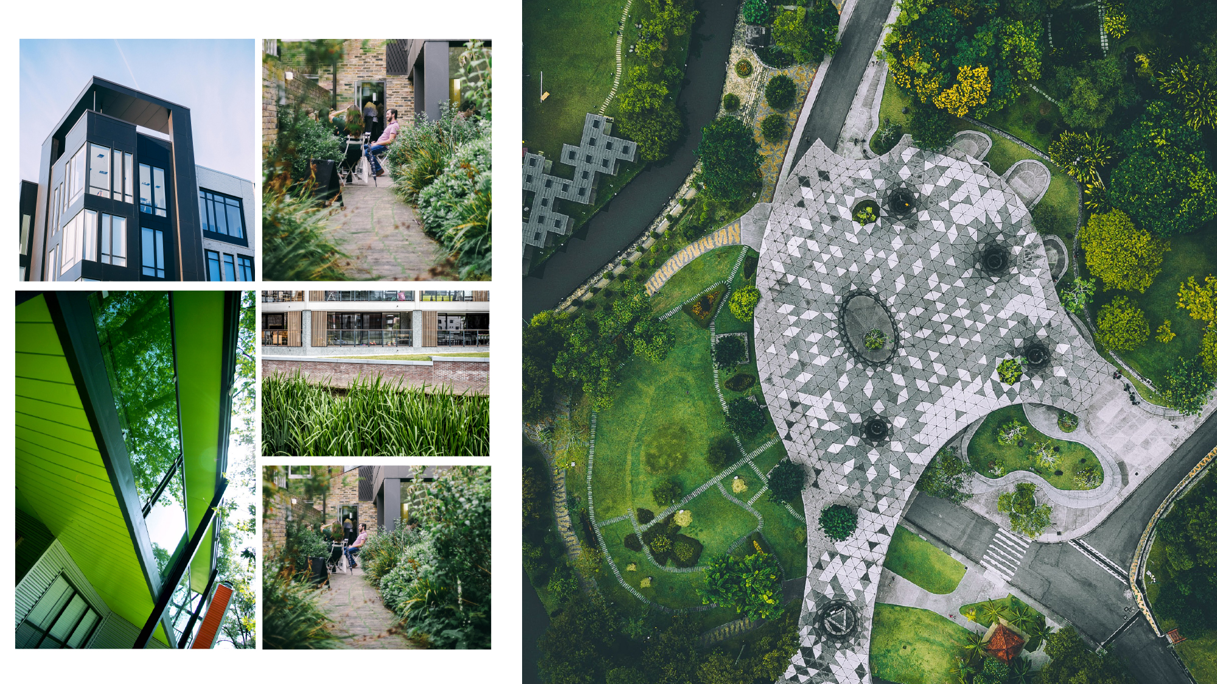
Key Information

Slide 3
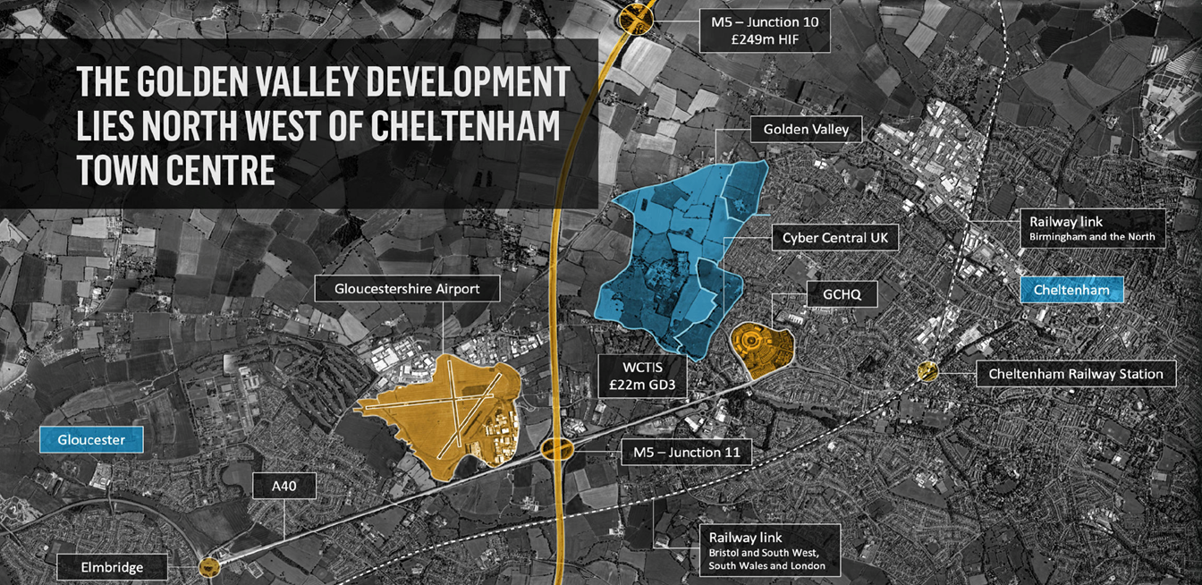

Slide 5
Scale and ambition

Slide 6
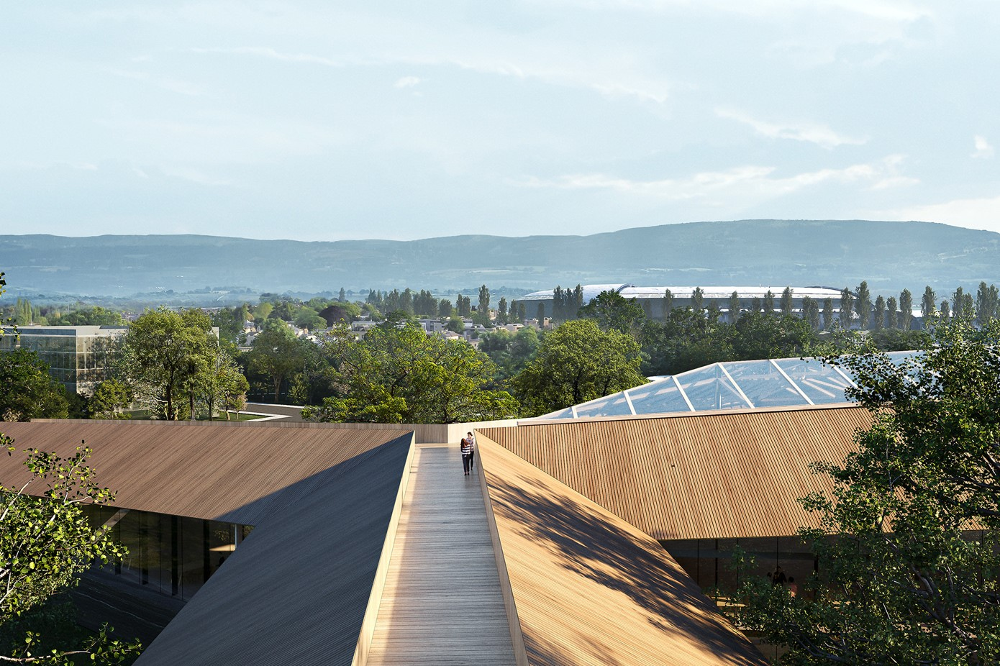
Timetable
Development Agreement with HBDxFactory signed June 2022
Overall masterplan to be drafted by end 2022
Planning forecast to be submitted Summer 2023
First phase to be delivered by 2026 – Innovation Centre
Levelling Up Fund bid submitted 02/08/22

Slide 7
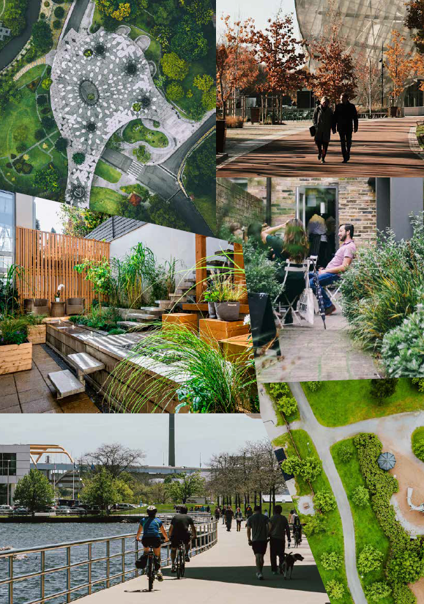
Working with the natural landscape and its features
An integrated and connected extension of West
Cheltenham
Embracing the highest standards of sustainability
A vibrant and diverse range of uses and activities,
serving existing and new communities

Slide 8
Key Contacts
Paul Minnis
Gethin Evans
Cllr. Mike Collins
Director, Major Developments & Regeneration
07744 321 7459
paul.minnis@cheltenham.gov.uk
Marketing & Communications Lead
07785 447204
gethin.evans@cheltenham.gov.uk
Cabinet Member for
Cyber, Regeneration & Commercial Income
Cllr.Mike.Collins@cheltenham.gov.uk

