Slide 1
Tech and Digital Skills Bootcamps
and Apprenticeships
The Development Manager. https://www.linkedin.com/in/derrin/

Slide 2
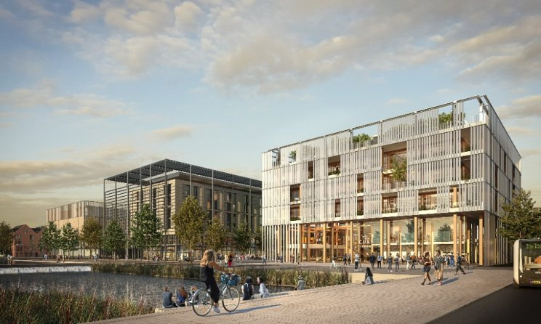
Why choose TDM?
Commissioned to serve local communities by the Department for Education (DfE)
Vision – All people can and should Do Well by Doing Good
Curriculum Intent – Genuinely Work-Based Learning, underpinned by Academic Rigour – Tech, Digital & Data Specialists
Top of the NARTs for both West Midlands and Tech & Digital
Ofsted Outstanding Quality of Education for Apprenticeships and Adult Learning (and Overall Good rating)
Multiple Award Winners and Finalists in 2022 (incl. Gloucestershire Tech Apprentice of the year)
Employer-responsive in the local regions – Offering thick local value versus thin national value

Slide 3
DfE Skills for Life – Skills Bootcamps
Recruits |  |  | Reskillers
Tech & Cyber Knowledge & Skills | Developer Knowledge & Skills | Digital Knowledge & Skills | Tech, Developer or Digital, also Employer-Responsive Programme Design for multiples of 3+ learners. Per Programme Costs: SMEs (<250 Employees) = £380 per head Large Employers (250+ Employees) = £1,140 per head
Tech & Networking | Back-end Coding | Digital Support (incl. MOS)
Cyber Security | UX/UI HTML & CSS | Digital Marketing

Slide 4
Recruit, Reskill and Retain your Local Tech, Digital and Data Talent
Subject areas | Skills Bootcamp or Qualification >>> | Level 3 >>> | Level 4 >>> | Level 5 | Level 6 >>> | Level 7
ICT Tech | Tech Skills Bootcamps Level 3 Qualification | Information Communications Technician | >>> | Digital & Technology Solutions Professional BSc (Hons): Network Engineer |  | Artificial Intelligence (AI) Data Specialist
ICT Networking |  | Network Engineer
Cyber Security |  | Cyber Security Technician | Cyber Security Technologist | Digital & Technology Solutions Professional BSc (Hons): Cyber Security Analyst
Back-end Coders | Developer Skills Bootcamps Level 3 Qualification | Software Developer |  | Digital & Technology Solutions Professional BSc (Hons): Software Engineer Business Analyst
UX/UI Developers
Digital Support | Digital Skills Bootcamps | Digital Support Technician | Applications Support Lead | Digital & Technology Solutions Professional BSc (Hons): IT Consultant
Digital Marketers |  | Digital Marketer | Marketing Executive | Digital Marketer BSc (Hons)
Data Analysts |  | Data Technician | Data Analyst | Digital & Technology Solutions Professional BSc (Hons): Data Analyst

