Slide 1
Digital Skills Bootcamps and further funded support
Tech, Digital and Coding Pathways to reskill your current workforce and recruit Apprentices, trained to your skills needs
Outstanding Coaching Support and Employability with The Development Manager.

Slide 2
The scenario for employers
Digital Transformation and workforce planning

Slide 3
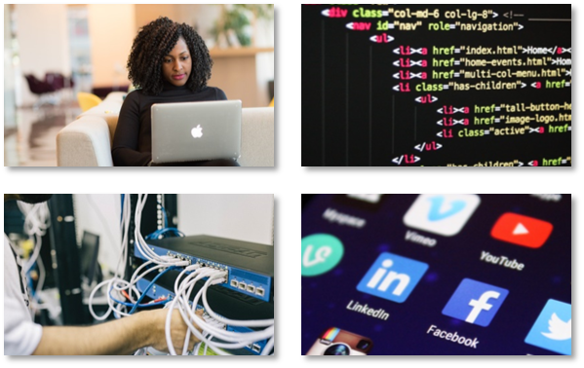
Challenges to employers
The workforce in 2030 be vastly the same as though employed today – people are living longer and staying in employment
7 million workers will be underskilled by 2030 and the most acute lack of skills will be in digital
90% of jobs will require reskilling by 2030
80% of jobs now already require digital skills
4th Industrial revolution technologies poised to create the same seismic changes as the adoption of PCs and widespread broadband access
Current recruitment challenges in the wake of the Pandemic

Slide 4
What is Digital Transformation?
Digital Transformation is how new technologies drive change in organisations, for example:
How new systems can improve efficiencies with systems and processes (e.g. online working in the wake of the COVID pandemic)
How online platforms change the way organisations engage with their customers (e.g. Tik Tok as a new social media platform)
How technologies totally disrupt an organisation’s business model (e.g. how Kodak and Blockbuster video declined with the adoption of Digital and Phone Cameras and online streaming services respectively)
Organisations must develop the skills in their workforce to effectively implement these technologies as they become adopted, or else risk being left behind by their competitors and customers.
Organisations must also be aware of the changes these technologies will drive amongst their employees, i.e. the roles that will no longer be required and new emergent roles that will appear.

Slide 5
What does Digital Transformation mean to you?
Digital transformation doesn’t just mean cutting edge technologies, it means making full use of what is available now.
Critical to the adoption of new technologies is having employees with the skills to effectively use them.
Adopting digital marketing
Moving from spreadsheets to software solutions and databases
Automating data entry
Utilising data
Moving from physical infrastructure to the cloud
Making sure your organisation has a presence on all relevant online platforms
E.g. adopting a CRM system
E.g. forms capture data and API links transfer data from one system to another, such as from a website to a CRM or database
Cleansing the data ready for a database
Using a reporting system to present critical data to internal and external stakeholders and customers
E.g. sales and marketing performance, customer insights, delivery effectiveness
Reducing the need for onsite hardware
Seeking greener credentials as an organisation
Ensuring your business appears in the top search engine rankings
Increase efficiencies, reduce double data entry and inaccuracies
Reduce the need for physical office space if employees work from home
Making full use of productivity tools and essential software
Platforms like Microsoft Teams are powerful tools to help manage workloads and facilitate project management
The success or failure of implementing these systems depends on staff engagement

Slide 6
What are Digital Skills Bootcamps?
Skills Bootcamps, which are part of the Government’s Lifetime Skills Guarantee helping everyone gain skills for life, are short, are up to 16 week programmes of coaching and training, delivered online to support adults into new Tech and Digital jobs, with a guaranteed interview – either new roles in new organisations or taking on a new role or more responsibilities at work.
Participants are assigned outstanding TDM Coaches who provide coaching and training support to secure a new Tech and Digital role.
There are x3 Pathways participants can choose from to help them achieve a new Tech and Digital Job:
Tech, Networking and Cyber Security
Coding and Web design
Digital Support and Marketing
As part of the Skills Bootcamps, participants can achieve a industry-recognised certification from organisations such as Information Technology Specialist, Google and Microsoft. Participants will also have access to a vast library of study materials from O’Reilly.
Eligibility criteria apply.

Slide 7
How to use Digital Skills Bootcamp funding
Train recruits
Hire apprentices now
Upskill your team
Develop your pipeline of apprentice recruits
Hire Apprentices who have already been trained by TDM’s Ofsted Outstanding Adult Education
Retain existing talent and prevent churn of staff
Use TDM to train recruits with the skills and to use technologies you need and soft workplace skills
Guarantee interview for Apprentice recruits
We have candidates across the region eager to start their Tech careers with you now
Upskill current staff to fully utilise technologies in your organisation
Assess commitment of your staff for further, longer-term training
Access funding for staff training rather than pay commercially
Showcase e-portfolios demonstrate skills development relevant to organisations

Slide 8
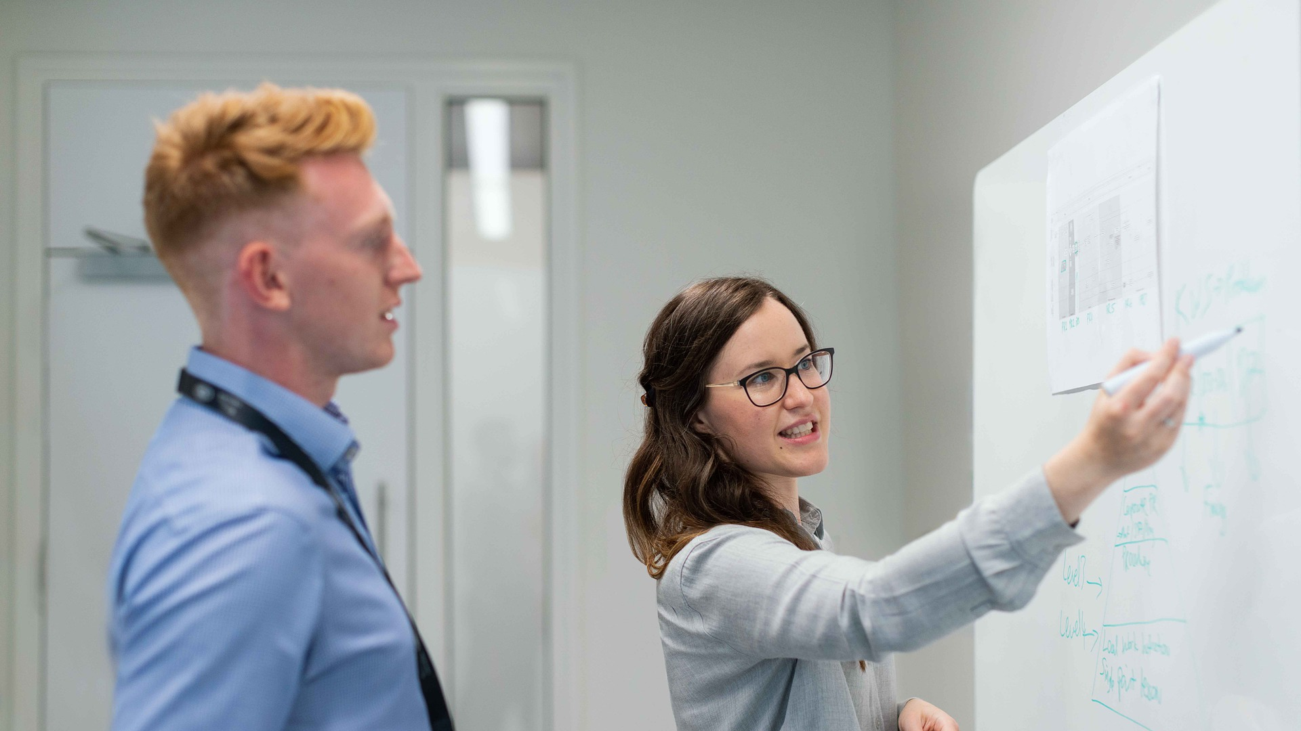
TDM’s Government-funded Tech and Digital Provision
In Coding, Digital Marketing, Data, Cyber, Tech and Networking and Digital Support

Slide 9
Why choose TDM?
We are a coaching and training Provider, specialising in Tech and Digital skills and Apprenticeships
Ofsted Outstanding
Quality of Education
Apprenticeships
Adult Education
Good Provider
We provide:
Tech and Digital Level 2 and 3 Qualifications
Skills Bootcamps
Career-Entry Apprenticeships
BSc (Hons) Integrated Degree Apprenticeships
We encourage professional skills, attitudes, behaviours, workplace productivity and British values
We work with learners to start and then develop their tech & digital careers through progression
We focus learners on developing their own tech & digital skills, readying them for and embedding them in the workplace

Slide 10
Tech and Digital Skills Development with TDM
Coding
Digital Marketing
Cyber
Data
Tech and Networking
Digital Support
Using a variety of coding languages and methodologies to develop software, apps, websites, link databases etc.
Engaging Customers online via Social Media, websites, company listings, ads and marketing campaigns
Keeping an organisation safe from the variety of threats that can compromise systems and data digitally
Maintaining the tech infrastructure e.g. devices and servers and providing helpdesk support to customers
Supporting internal and external customers use productivity tools e.g. CRMs or MS Teams
Effectively collating, cleansing and processing data to provide insights and inform better organisational decisions

Slide 11
TDM’s range of Government-funded programmes
Adult Qualifications at Level 2 and 3* |  | Skills Bootcamps |  | Level 3 Apprenticeships |  | Level 4 Apprenticeships |  | Level 6 Integrated BSc (Hons) Degree Apprenticeships
Learning about Tech and gaining a qualification |  | Support to adopt a new Tech and Digital role or into a new career |  | Front-line tech roles, applying skills |  | Technical expert roles, enabling objectives to be met |  | Initiating and Influencing Strategic Solutions
Tech and Networking |  | Tech, Networking and Cyber Security |  | Information Communications Technician Support Technician |  | Network Engineer** **From 2022/23 Academic Year |  | Digital Technology Solutions Professional
Cyber Security |  | Coding and Web Design |  | Digital Support Technician Digital Applications Digital Services |  | Software Developer |  | Cyber Security
Coding |  | Digital Support and Marketing |  | Digital Marketing |  |  |  | Network Engineer
UX / UI Design |  |  |  | Data Technician |  |  |  | Software Engineer
Digital Support / Marketing |  |  |  |  |  |  |  | Data Analyst
Data |  |  |  |  |  |  |  | Business Analyst
* Currently unavailable to learners in the WMCA |  |  |  |  |  |  |  | IT Consultant
 |  |  |  |  |  |  |  | Digital Marketer
Organisations can access Government funding on this range of programmes in a variety of ways to support their Skills Development and Recruitment and Retention Strategies.

Slide 12
The Digital Skills Bootcamp Programme
6
Coaching with TDM Performance Development Coach Employability support – CV and Interview practice Build Showcase ePortfolio GROW model of Goal Setting, Reality, Objectives (and Options / Obstacles) and Way forward (or Will) Identify actual local employers and opportunities Orientation 16 weeks 60 guided learning hours Guaranteed job interview with support from TDM Career Builder Immediate access to learning library from O’Reilly
Choice of Pathway Tech Coaching with TDM Skills and Knowledge Coach
Tech, Networking and Cyber Security ITS Networking ITS Network Security | Coding and Web design ITS Software Development ITS HTML5 Application Development | Digital Support and Marketing Microsoft Office Specialist Google Fundamentals of Digital Marketing

Slide 13
TDM Key contacts
Tommy McDonnell - LinkedIn
Learning and Development Representative – Birmingham and Solihull
tommy.mcdonnell@tdm.co.uk 07398 251558
Beth Newton - LinkedIn
Learning and Development Representative – North Worcestershire
beth.newton@tdm.co.uk 07939 530517
Louise Bullock - LinkedIn
Engagement Manager
louise.bullock@tdm.co.uk 07534 189339
To access the range of Department for Education funded programmes, TDM’s team of Learning and Development consultants can be contacted to discuss more of your skills, digital transformation and recruit, reskill and retention strategy needs.
Alternatively you can contact us on:
Email enquiries@tdm.co.uk
Phone 0333 10 100 40
Website https://thedevelopmentmanager.com/contact-us/

Slide 14
TDM Online
Via Virtual Learning Environment
TDM West Midlands
County House
St Mary's Street
Worcester
WR1 1HB

