Slide 1
Unconscious Bias
How conscious is your business?
Rachel Harber FCIPD
Organised Consulting
Rachel@organisedconsulting.co.uk
07977 516591

Slide 2
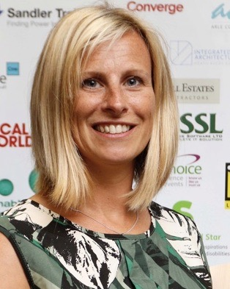
About Me
FCIPD HR Director
Independent Consultant – ‘HRD without the cost commitment'
Manufacturing, Engineering, Construction, Logistics, Professional Services, Charity, Education
Focus on people strategy - talent attraction and retention specialism
Recruitment consultancy coach / mentor
Trustee for Cogges Heritage
Rachel@organisedconsulting.co.uk
07977 516591
linkedin.com/in/rachelharber

Slide 3
Aim for today
Take away some actions to ensure your organisation has a good consideration of better awareness of unconscious bias
What is unconscious bias
Difference of Conscious & Unconscious Bias
Examples of unconscious bias
Actions for your organisation

Slide 4
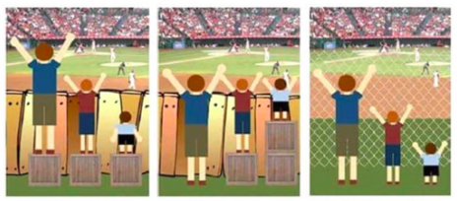
Take a step back
EDI – Equity, Diversity, Inclusion
Equality
Equity
Solution
Everyone treated equally
Support provided to be treated equitably
Addressing the barrier

Slide 5
Value of EDI
EDI – Provide and inclusive environment
Understand needs of wider range of customers
More diversity, wider range of ideas and solutions
More attractive to potential talent
Commercial risk

Slide 6
What is Unconscious Bias?
Unconscious (or implicit) bias is a term that describes the associations we hold, outside our conscious awareness and control.
It affects everyone – acknowledge this!
It’s triggered by our brain automatically
It’s influenced by our background, personal experiences, societal stereotypes and cultural context.
It has a significant influence on our attitudes and behaviours, especially towards other people.
It can influence key decisions in the workplace and can contribute to inequality, for example in selection and recruitment, appraisals, or promotion.

Slide 7
Unconscious Bias Royal Society 3min video

Slide 8
Examples of Unconscious Bias
Cross over with discrimination such as:
Gender – assumptions that one gender or another isn’t capable
Age – assumption of ability, experience, responsibility
Often Conscious bias
Things not listed as protected characteristic such as:
Height / Body weight – ability judged on someone’s appearance
Name – judged based on their name (although could be sex or race related)

Slide 9
Workplace Unconscious Bias Types of Bias
Affinity bias
The tendency to favour people who are like you in some way.
E.g. hiring people who are similar to us or seem familiar, considering them a 'good fit' for the team.
Attractiveness bias
Also known as beauty bias. Viewing attractive people as being more competent, and both unattractive and very attractive people as being less competent, at their jobs
Conformity Bias
The pressure to we feel to act due to the actions of others, not our own independent thinking
E.g. a more senior colleagues scores a candidate differently
Name bias
When we treat people with similar names as ourselves or others preferably.
Confirmation bias
‘Cherry picking’, looking for other things to validate a decision or opinion we have already made.
The halo effect
One perceived positive feature or trait makes us view everything about a person in a positive way, giving them a 'halo'.

Slide 10
Breakout
On your tables, discuss scenarios where you have:
Been subjected to unconscious bias
Witnessed unconscious bias
Been unconsciously bias

Slide 11
Welcome Back!
What can we do in our organisations to
Maximise potential
and
Mitigate risk

Slide 12
Workplace Unconscious Bias
It can influence key decisions in the workplace and can contribute to inequality, for example in selection and recruitment, appraisals, or promotion.
Selection & Recruitment
Appraisals & Promotion
Awareness
Training
Promotion
Call it out
Monitoring

Slide 13
Workplace Unconscious Bias
Selection & Recruitment
We should value diversity and be asking 'what will this person add to our team?’
Advertising multiple places
Recruiting managers to make each other aware if they notice stereotyping
Blind sifting
Telephone Interview as part of the process
More than one person involved at each stage
Standardised interview questions
Performance based on quantative evaluation
Make considered decisions, not quick ones
Keeping written records of decision making
Collect data

Slide 14
Workplace Unconscious Bias
Appraisals & Promotion
Limited performance information will increase chance of unconscious bias
Should be aware of motherhood penalty
Follow a standardised process
Performance based on quantative evaluation
More than one person involved if possible
Be fair and transparent (remember equity!)
Keeping written records of decision making
Develop clear career pathways
Advertising internally as standard
Collect data

Slide 15
Breakout
On your tables, discuss what you do already in your organisation, and one thing you feel you should be doing to prevent unconscious bias

Slide 16
Welcome Back!
Questions and Comments

