Slide 2
Sustainability Journey
Strategy
Focused initiatives (Spirax Sarco has 6 x strategic initiatives)
Clear targets for initiatives
Road map of where you are trying to get to, by when
Understanding of ‘how’ you will reach the milestones
Key metrics on ‘how’ progress can be demonstrated
Communications strategy to create engagement from all stakeholders.

Slide 4
We’re celebrating one year of One Planet
Here are some examples of what we have achieved so far

Slide 5
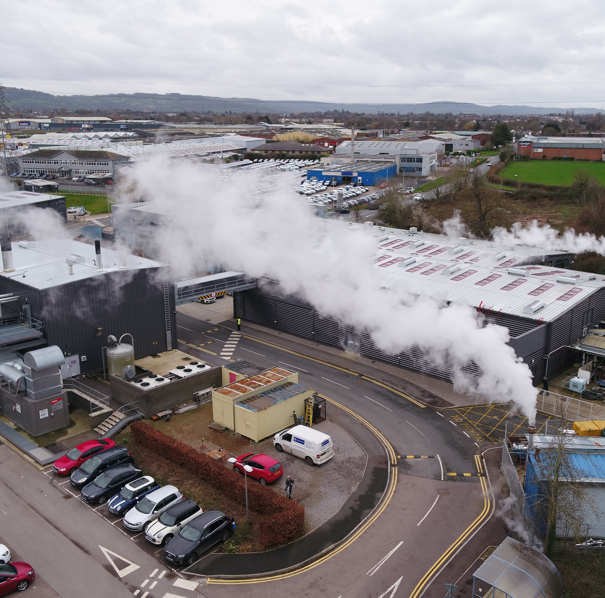
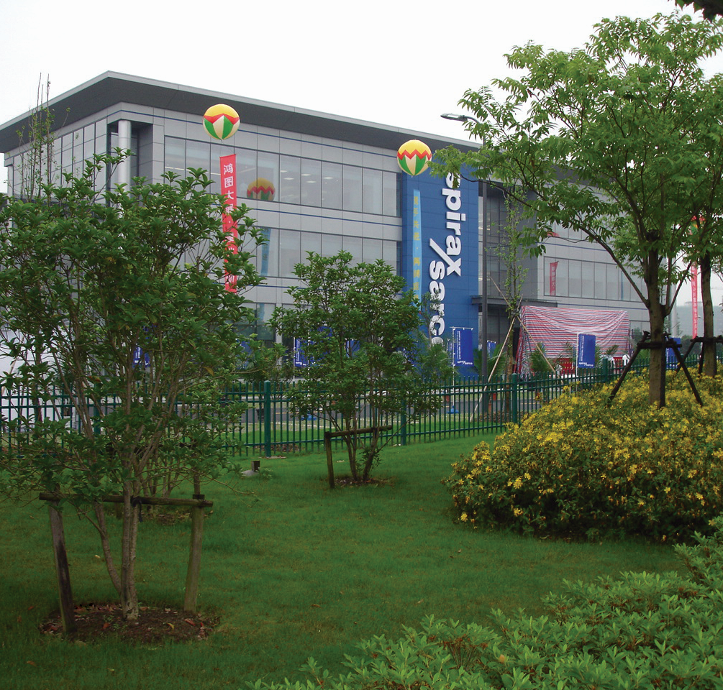
Strategic Initiative 1: Net Zero
Over 30% of our electricity is now generated from renewable energy
We’re transitioning our electricity supplies to green energy contracts
Decarbonisation of our steam system has begun at our Cheltenham UK manufacturing site

Slide 6
Strategic Initiative 2: Biodiversity Net Gain
We’ve proudly partnered with the World Land Trust...
...and delivered a 1x biodiversity offset of our global operational footprint, contributing to the creation of a new reserve in Argentina’s Somuncurá Plateau
Because of your pledges to ‘stand up for sustainability’, we’ve donated over 8,000 trees to charity One Tree Planted, with trees already planted in California, India and Kenya
Image credit: World Land Trust

Slide 7
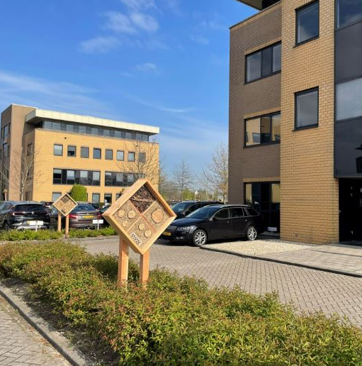
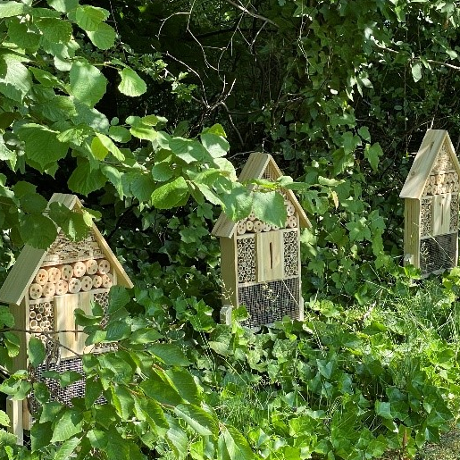
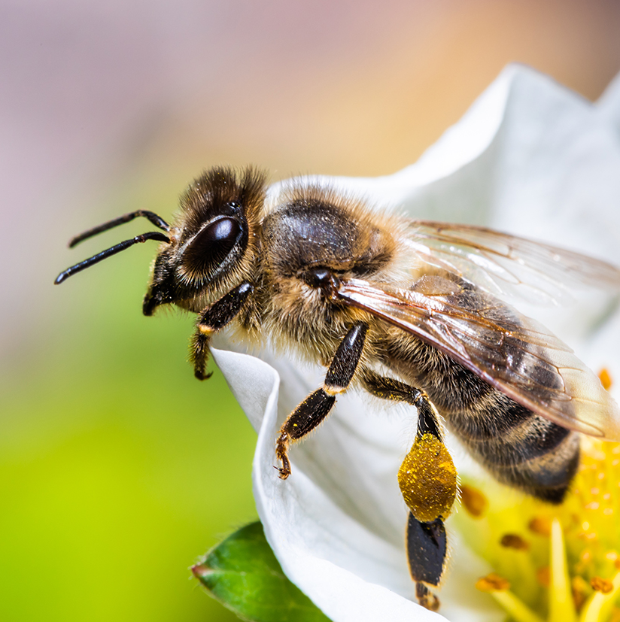
Strategic Initiative 2:
Biodiversity Net Gain
40 local biodiversity initiatives are in progress or completed
Creating or restoring habitats and providing opportunities for wildlife to thrive

Slide 8
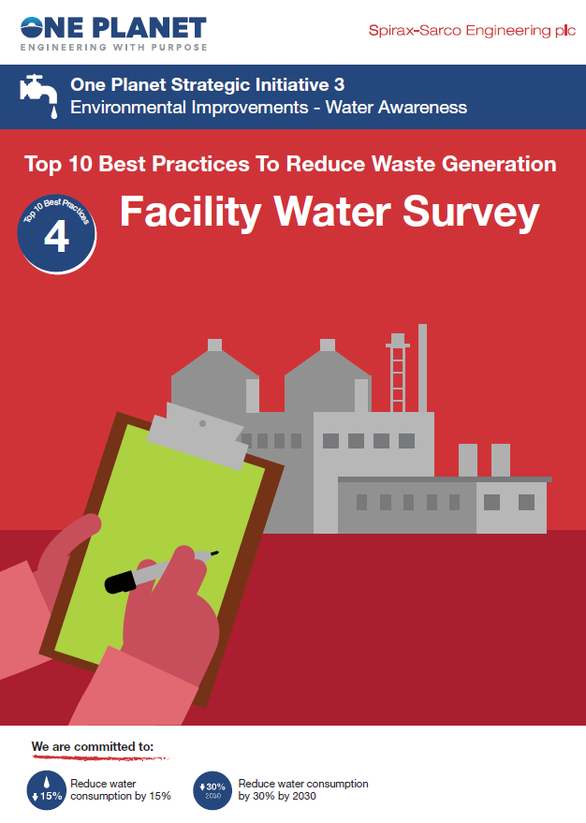
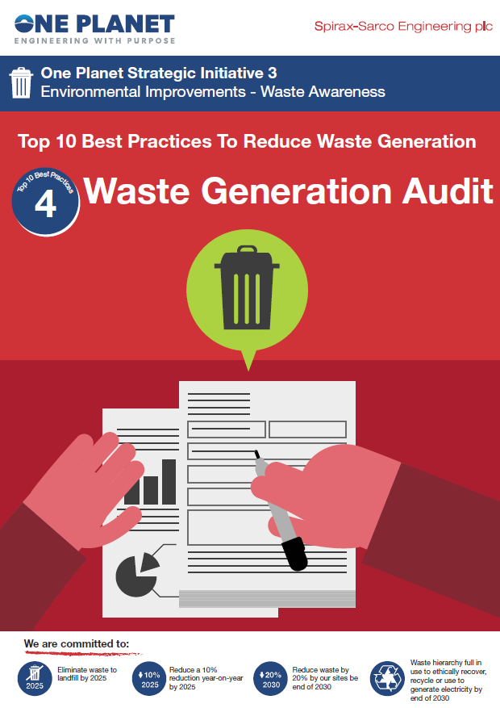
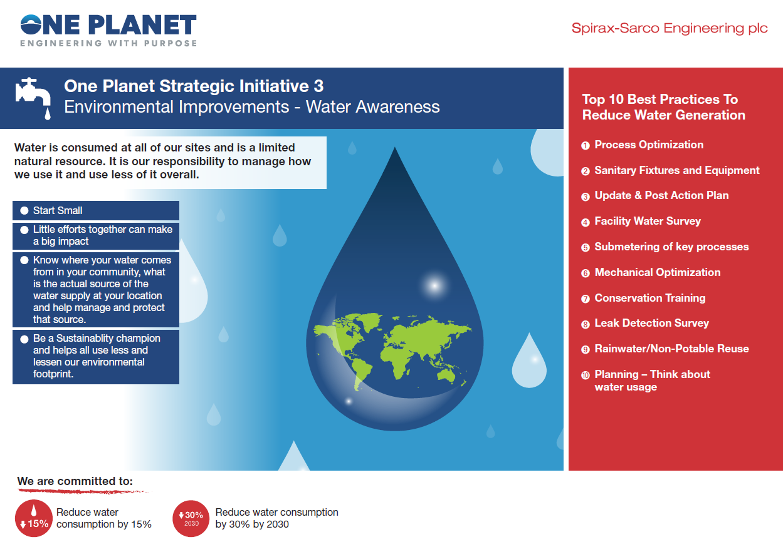
Strategic Initiative 3 – Environmental Improvements
We're rolling out water and waste action plans globally
Our water use in 2021 was 8% lower than 2019 and we're sending less waste to landfill

Slide 9
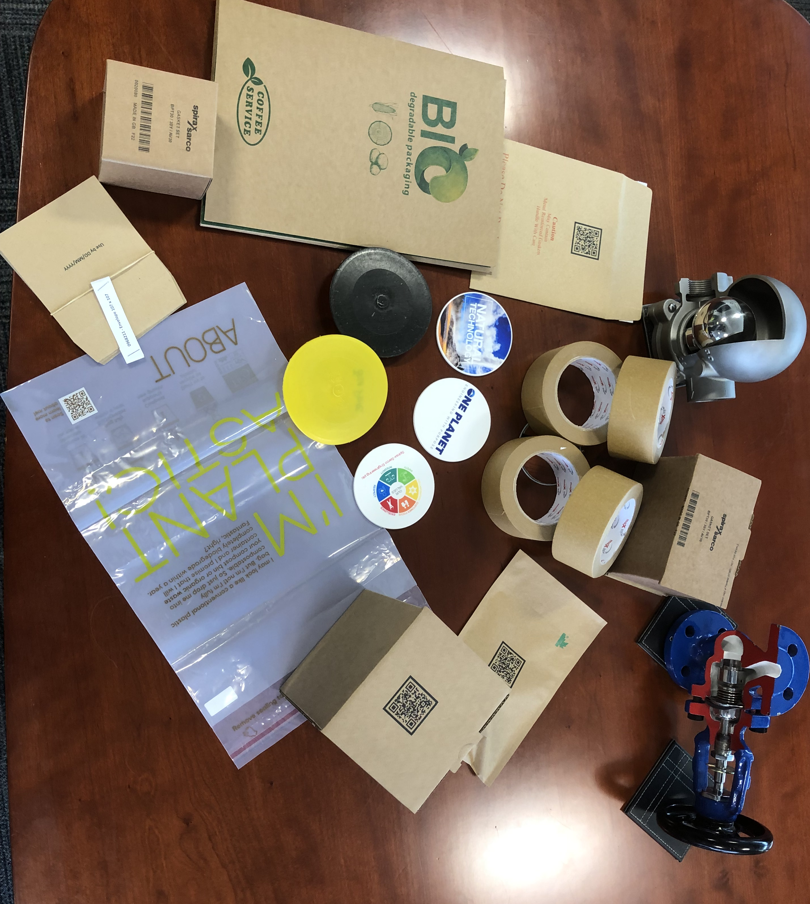
Strategic Initiative 4: Sustainable Products
Trialling of alternative packaging materials has started, to move away from plastic and find more sustainable options
We've eliminated plastic tape and document pockets from our largest manufacturing site
And are working with a partner to quantify the sustainability benefits of our products

Slide 10
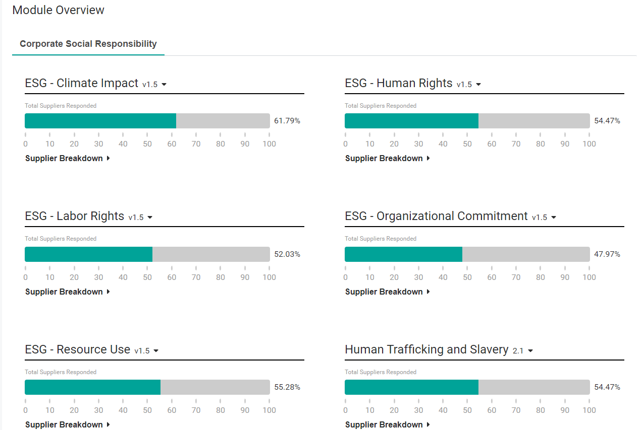
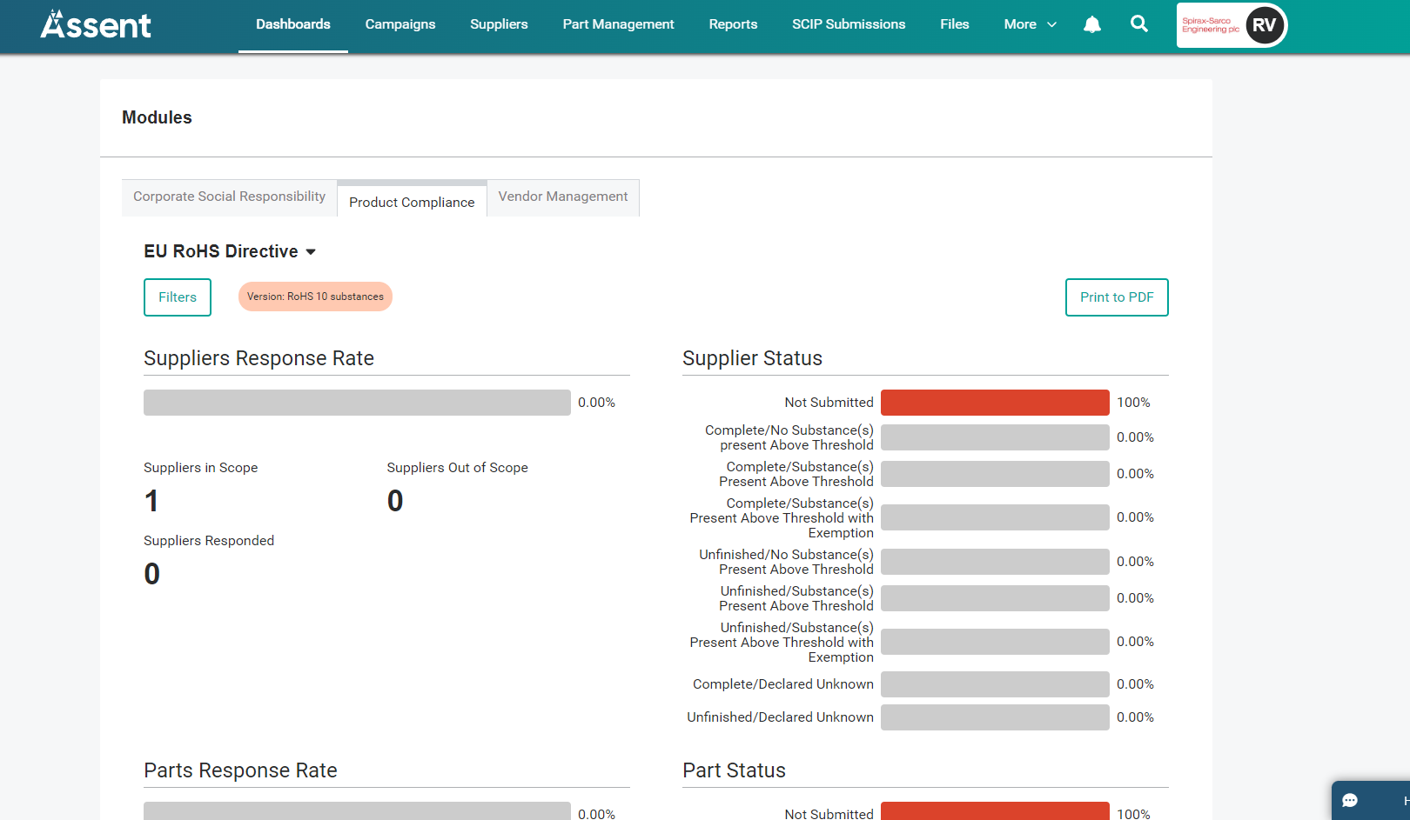
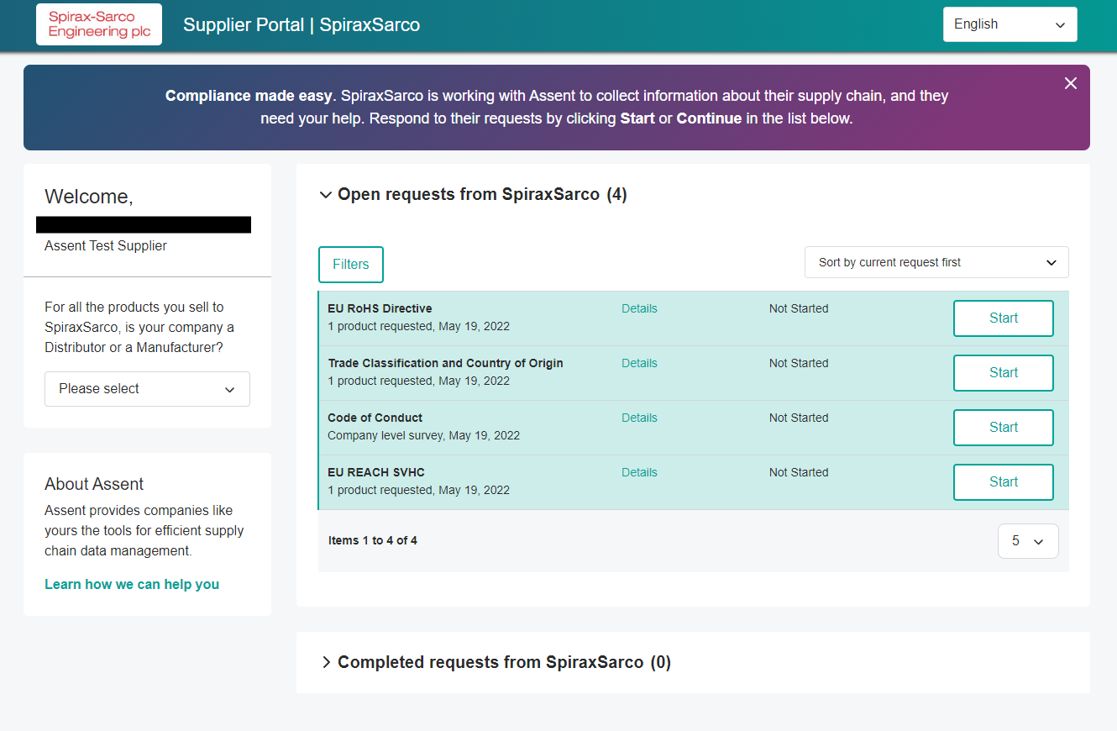
Strategic Initiative 5:
Sustainable Supply Chains
Supplier sustainability is vital to the Group’s overall sustainability performance
We’re improving monitoring of our supply chain
By rolling out a Supplier Portal and updating our Supplier Sustainability Code

Slide 11
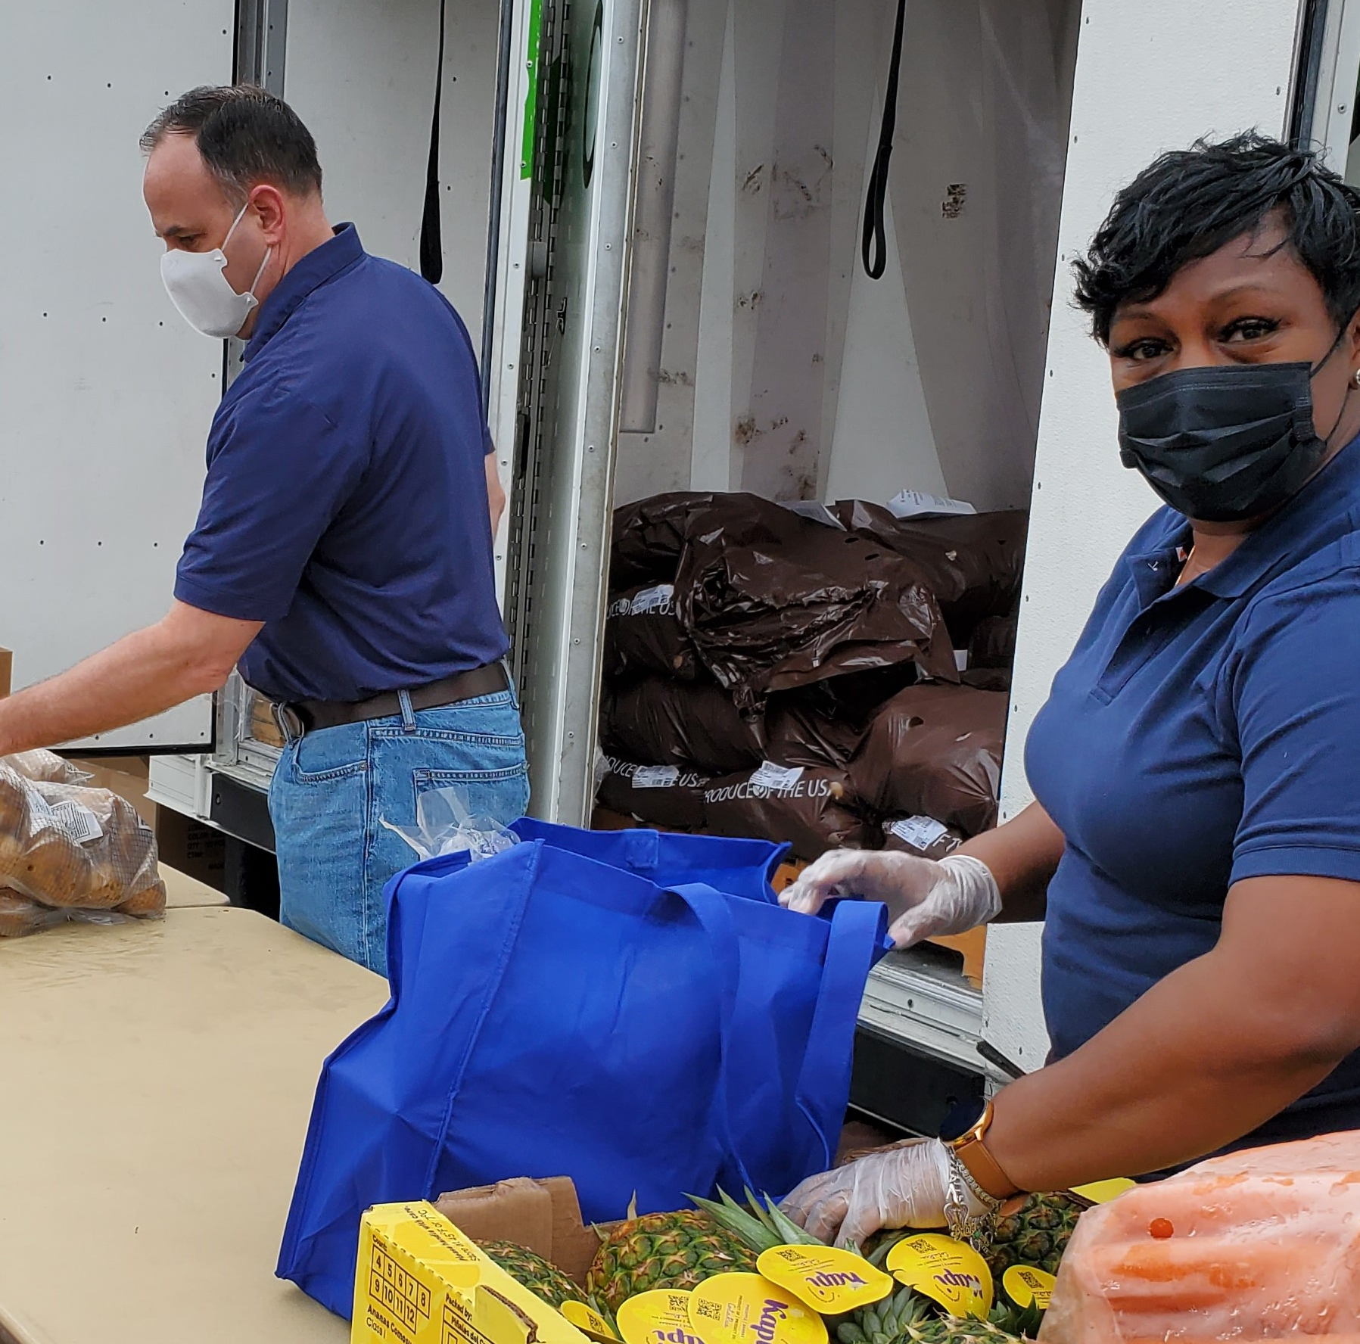
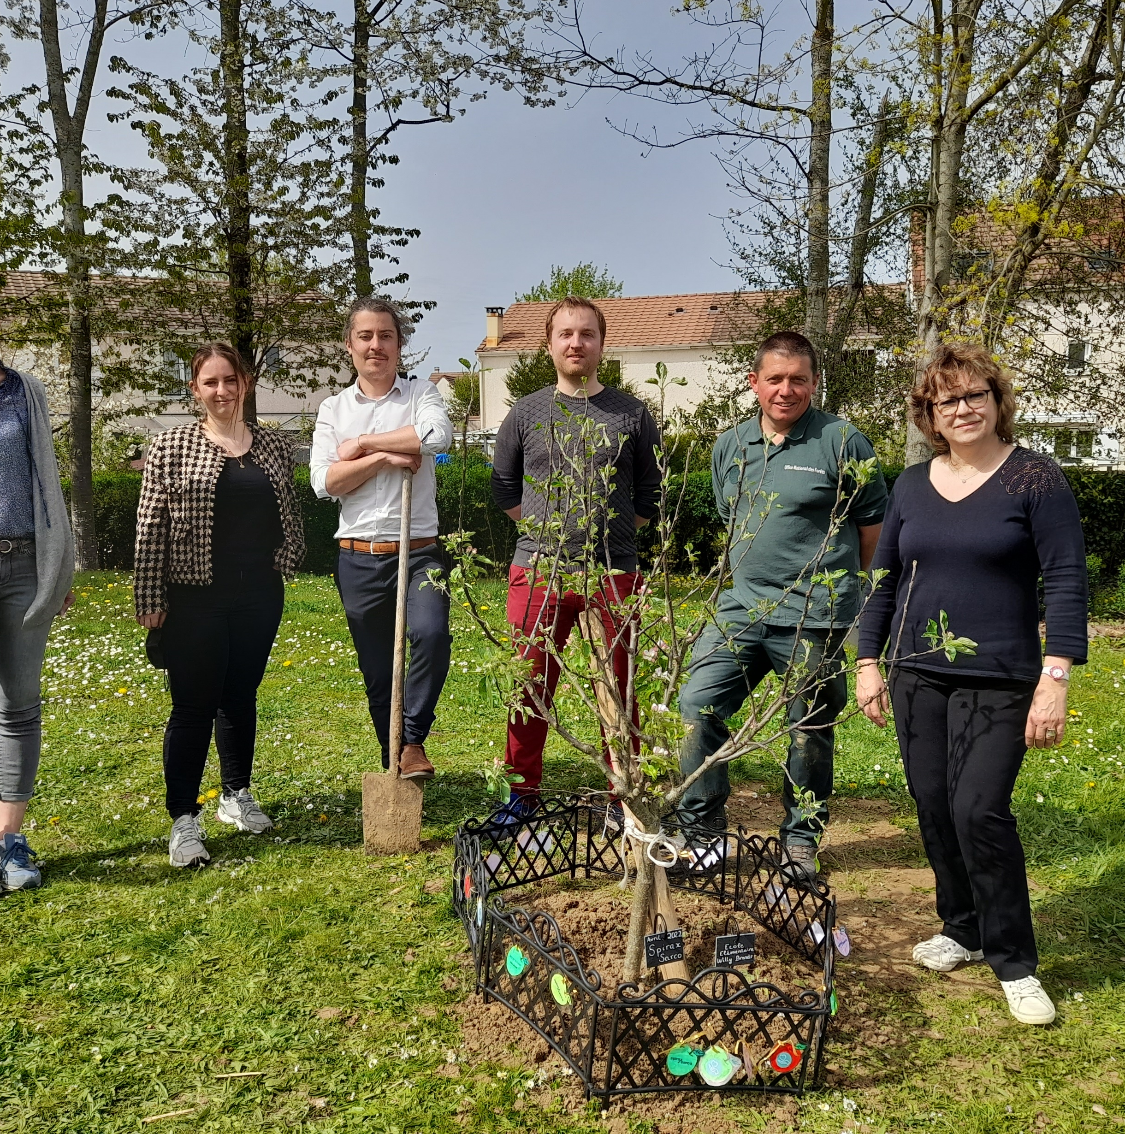
Strategic Initiative 6:
Community Wellbeing
Around the world the Group has supported hundreds of charitable causes
We've also established the Group Education Fund
Through volunteering and charitable donations we’re having a positive impact in our communities

Slide 12
Thanks to all our colleagues. Wherever you work, you are helping to create a more sustainable world

