Slide 1
Employee Engagement Owen Lee HR Champions

Slide 2
High Engagement
Performance
Productivity
Employee retention
Employee attraction

Slide 3
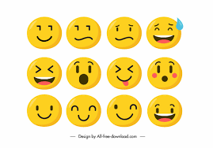
Engagement is driven by emotions – how the employment relationship makes us feel about ourselves

Slide 4
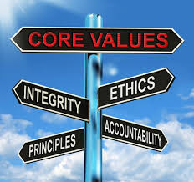
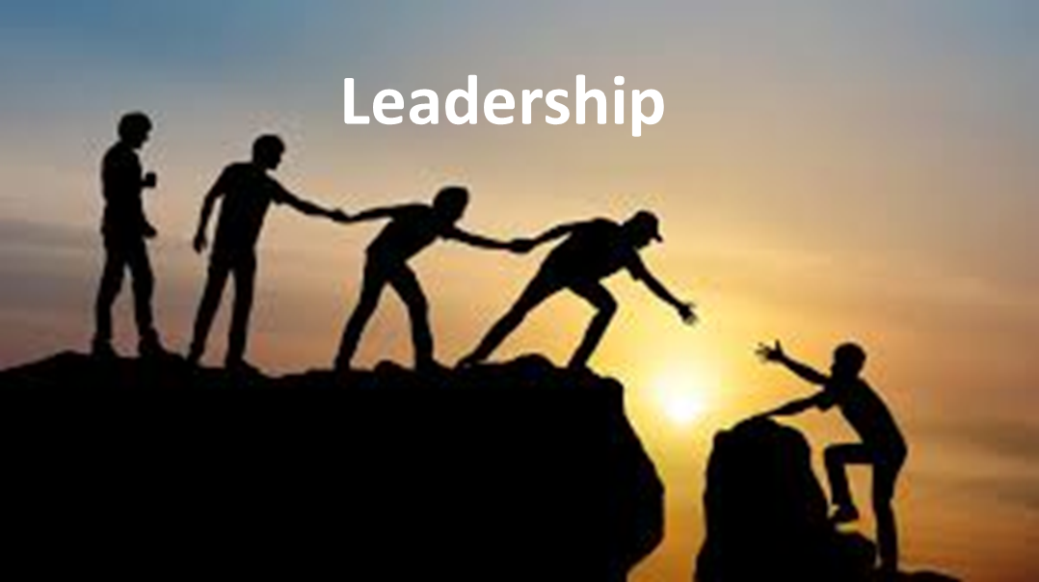
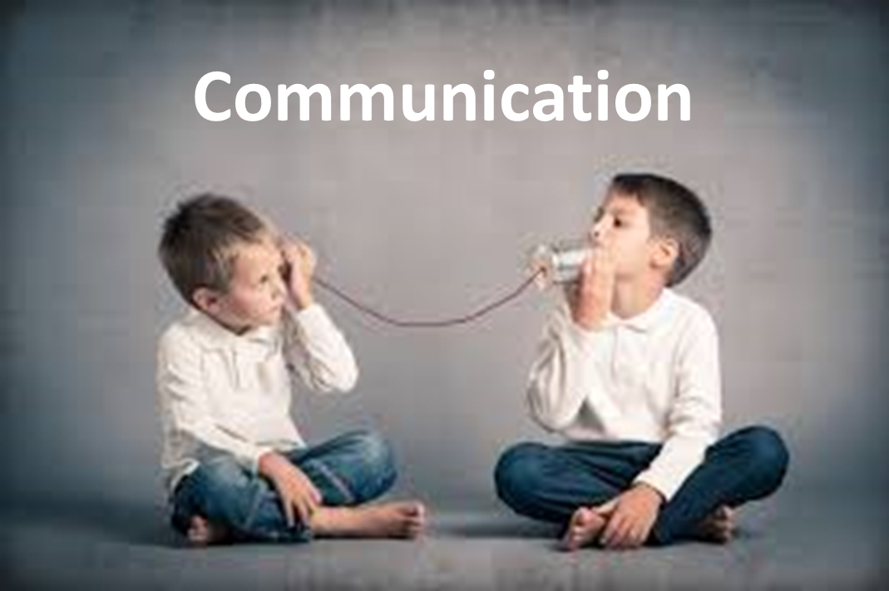
Key drivers of engagement
Wellbeing
Connected
TRUST
Notes:
A recent survey asked people if they’d rather a new manager or a pay rise. Shockingly, 72% of respondents said they’d prefer a new manager. What does that tell us? That there are a lot of terrible managers out there.
A cause of this lack of managerial talent is that workers are promoted to managerial level based on technical ability and not given the training to bring their people management skills up to speed. There’s nothing better for harming morale than poor management, so make sure to provide training in people management for all your managers.

Slide 5
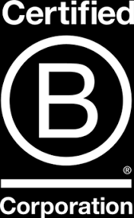
Businesses today are finding that doing good also means doing well.
Mark Weinberger,
Global Chairman and CEO, EY
Need a purpose beyond the balance sheet: one that contributes a positive impact in the wider world e.g.
Societal benefits
Sustainability
Climate change
Notes:
A business with high engagement is one that has a clear purpose which is expressed beyond mere words. That means real-world action on the issues that are important to the company
Companies with an established sense of purpose – one that’s measured in terms of social impact, such as community growth, and not a certain bottom-line figure – outperformed the S&P 500 by 10 times between 1996 and 2011.”
In the context of the corporation, this mindset essentially reflects a growing desire by stakeholders at all levels in organizations to have a purpose beyond the balance sheet: one that contributes a positive impact in the wider world
6 reasons why purpose is becoming more important
The idea of corporate purpose is not new but has reentered public discourse in recent years and even begun to eclipse related topics like ‘sustainability’. A study conducted by EY and Oxford University Saïd Business School found public conversation about purpose increased fivefold between 1995 and 2014.
Of the recent global changes that have led organizations to reflect on and reintroduce purpose into the corporate lexicon, six forces in particular are challenging companies’ old sense of identity and operating models — forcing them to rethink value and how it is created.
1. The Trust deficit
One legacy of the 2008 banking crisis is a dwindling sense of public trust in corporations, across geographies and generational lines, with the distribution of wealth and opportunity being increasingly perceived as unequal and unfair. Younger generations in particular tend to trust business less than their predecessors. In addition, trust in CEOs as individuals is also in decline. “In the past decade, the top 1% of earners have seen a disproportionate amount of wealth accumulation. That’s not sustainable,” says Weinberger. “Since economic growth is largely driven by consumption, if we expanded income and opportunities to the broader population, we’d see far more robust global economic growth.”
2. Sustainability
With climate change currently high on the societal agenda, more companies are under public and regulatory scrutiny about their environmental impact. Such pressure is forcing executives to re-evaluate how they produce, consume and supply goods and services, to mitigate risks and make operations, supply chains, products and services more socially and environmentally sustainable. And businesses are also seeing the importance of acting from an economic perspective, with evidence mounting that climate change could severely damage the global economy – one study predicting global losses of as much as $72 trillion.
3. Social inequality
The world is getting richer, but inequality across the globe is on the rise – currently at an historic high in fact. Of the world’s population, 1% now controls more than 50% of the planet’s wealth. The pay gap between corporate executives and employees is also widening. Peter Drucker, the late management thinker, once warned that a CEO-to-worker pay ratio of more than 20 to 1 would “increase employee resentment and decrease morale.” In some US organizations, as of 2014, that ratio was 350 to 1.
This has not gone unnoticed, with anger at this inequality being expressed at ballot boxes around the world. “The economic inequality message has been clear,” says Beth Brooke-Marchiniak, Global Vice-Chair – Public Policy, EY. “In the aftermath of 2016, we have societies pulling apart, finding it hard to resist trends toward nationalism and a rejection of those who are different. We need to listen. We need to act.”
4. Diminishing brand control, rising social media
In recent years businesses have lost some control over their brands to customers and the wider public. The public has proven adept at harnessing social media to propagate their influence and opinions on unfulfilled brand promises around the world in seconds – faster and more effectively than any news organization could. The ease with which opinions can be expressed makes creating a positive first impression more important than ever.
5. Demand for longer-term thinking
The public is now asking for more from companies than a commitment to short-term profitability. A growing number believe that companies have an obligation to address long-term global environmental and social challenges – the so-called Triple Bottom Line. Executives are also trying to consider long-term consequences despite many short-term pressures: one report indicated that 40% of CEOs surveyed said short-term shareholders constitute the greatest threat to corporate values. After all, says Weinberger, “much of a company’s actual value is tied into things like brand, talent, and intellectual capital – the assets that are crucial to creating value in both the short and long term.”
6. Digitization – threats and opportunities
It took over a decade for mobile broadband to reach two billion people. By 2021 that number could almost quadruple to 7.7 billion. This instantaneous interconnectedness between stakeholders and the increase of powerful, real-time data analysis will create new opportunities for businesses to know and serve customers better. But it will also bring in new ways for customers to spot any gaps between a company’s image and its actions in reality. “As data and digital technology affect every sector, businesses are under tremendous pressure to innovate, says David Jensen, Global Disruptive Innovation and EY wavespace (TM) Leader, EY. “Predicting the future is impossible, but when an organization can articulate and activate a higher purpose it has a better opportunity to shape the future of itself and its marketplace.”
Combined, these six forces mean that many employees, customers, investors, communities and other stakeholders are asking profound questions about the structure of society and the role of the corporation within it. And while change is a perpetual feature of life and business, technology and science are pushing the pace and extent of change like never before.
Instead, grasping the core reason an organization’s existence and seeing how that sits within the wider world can be a more constructive way to address disruption

Slide 6
Those who offer hope and positivity spread these throughout the workplace
Vision
Plan
Clarity
Understanding & empathy
Prioritise people over process
Asks, doesn’t tell
Contextualises employee mindset
Creates transparency
Express Gratitude
Leadership
Notes:
Autocratic, blood and thunder leaders are of the past
A recent survey asked people if they’d rather a new manager or a pay rise. Shockingly, 72% of respondents said they’d prefer a new manager. What does that tell us? That there are a lot of terrible managers out there.
A cause of this lack of managerial talent is that workers are promoted to managerial level based on technical ability and not given the training to bring their people management skills up to speed. There’s nothing better for harming morale than poor management, so make sure to provide training in people management for all your managers.
Express thanks and demonstrate gratitude – James Timpson – sends out handwritten letters of thanks and have reward scratch cards with small financial prizes

Slide 7
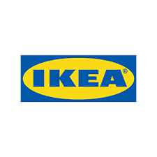
Well chosen, positive values that are meaningful and people relate to.
Togetherness
Caring for people and planet
Cost consciousness
Simplicity
Lead by example
Give and take responsibility
Renew and improve
Different with meaning
Notes:
IKEA Values
Togetherness
At the heart of the IKEA culture. We are strong when we trust each other, pull in the same direction, and have fun together.
Caring for people and planet
We want to initiate positive change. We have the possibility to make a significant and lasting impact, today and for the generations to come.
Cost-consciousness
As many people as possible should be able to afford a beautiful and functional home. We constantly challenge ourselves and others to make more from less without compromising on quality.
Simplicity
A simple, straightforward, and down-to-earth way of being is part of our Småland* heritage. It’s about being ourselves and staying close to reality. We are informal, pragmatic, and see bureaucracy as our biggest enemy.
Renew and improve
We are constantly looking for new and better ways forward. Whatever we are doing today, we can do better tomorrow. Finding solutions to almost impossible challenges is part of our success and a source of inspiration to move on to the next challenge.
Different with a meaning
IKEA is not like other companies and we don’t want to be. We question existing solutions, think in unconventional ways, experiment, and dare to make mistakes, always for a good reason.
Give and take responsibility
We believe in empowering people. Giving and taking responsibility helps us grow and develop as individuals. Trusting each other, being positive, and forward-looking inspire everyone to contribute to development.
Lead by example
We see leadership as an action, not a position, and look for people’s values before competence and experience. People who walk-the-talk and lead by example. It’s about being our best selves and bringing out the best in each other.

Slide 8
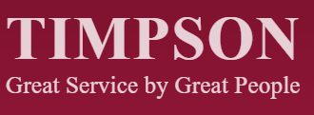
UPSIDE DOWN’ MANAGEMENT
At Timpson, all of our colleagues have total authority to do whatever they need to do to amaze our customers. We call this ‘upside down’ management and everybody else who works in the business is there to support our branch colleagues to best serve our customers. We trust our colleagues to run our business as they see fit.
TRUST
Notes:
James Timpson’s Business column in Sunday Times

Slide 9
Communicate effectively
Listen & respond
Two-way
Employee opinions valued
Communication
Notes:
A team needs a clear sense of plan and direction, and they look to management to provide this. So make sure you’ve communicated the plan effectively and more importantly, listened to feed back from your employees. Communication should go two ways, employees should feel heard and that there opinions are valued.

Slide 10
Connected
Employees being able to connecting and bonding with each other beyond work &
business.
Notes:
Need to help create these opprotunities

Slide 11
Beyond homeworking.
About give and take, building goodwill.
Notes:
Working life has recently had to mould and adapt to the pressures of social distancing and home working. Significant numbers of employees reportthat they do not want to go back to the old of doing things, it looks like increased flexibility will stay with us. This means that you should start planning for a future in which remote working remains part of your organisation in some form

Slide 12
Wellbeing
Be pro-active
Recognise signs
Act early
Offer support & Signpost
Manage holiday
Provide time & space

