Slide 1
Circle2Success
Wednesday 9th March 2022

Slide 2
BARNWOOD
200 employees
Multiple stakeholders
1000's supply chain partners
Recognise the need for change

Slide 3
CHANGE THE GAME
12 month programme
Led by MEPC
Facilitated by Julia Muir
Industry peer group

Slide 4
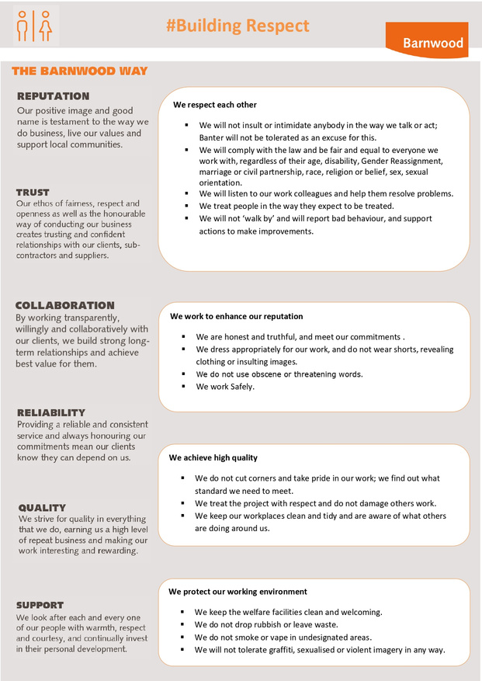
CODE OF CONDUCT
We respect each other
We enhance our reputation
We achieve high quality
We protect our environment

Slide 5
DIVERSITY & INCLUSION BUSINESS PLAN
Know your data
Leadership
Recruitment
Supply chain

