Slide 1
How can you help
’break the bias’?
Rachel Harber FCIPD
Organised Consulting
Rachel@organisedconsulting.co.uk
07977 516591

Slide 2
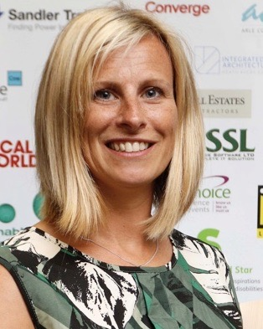
About Me
FCIPD HR Director
Independent Consultant
Manufacturing, Engineering, Construction, Logistics, Professional Services, Charity
Focus on strategic talent attraction and retention
Recruitment consultancy coach / mentor
‘Minimise Risk, Maximise Potential, Strive for Efficiency’

Slide 3
Aim for today
Break the bias by taking away some actions to ensure your organisation has a good consideration of the benefits of Diversity, Equity (Equality) and Inclusion

Slide 4
Why is DEI important?
Diverse Talent
Help attract new talent within the organisation. Diversity brings different perspectives, increase creativity and enables a productive working environment.
76% of job seekers and employees said that a diverse workforce is an important factor when considering who to work for (Glassdoor).
Competitive Advantage
Better able to understand the needs of a wide range of customers and can interact with a broad client base. Helps retain staff in a competitive market as they are made to feel welcome.
Companies with gender diverse executive teams are 25% more likely to have above average profitability (Glassdoor)
Commercial Risk
If a case went to an Employment Tribunal, one of the first things they would check is whether the organisation had such policies and procedures in place and that they had been followed. Failure to comply can cost the company a great deal should someone file against them for discrimination.

Slide 5
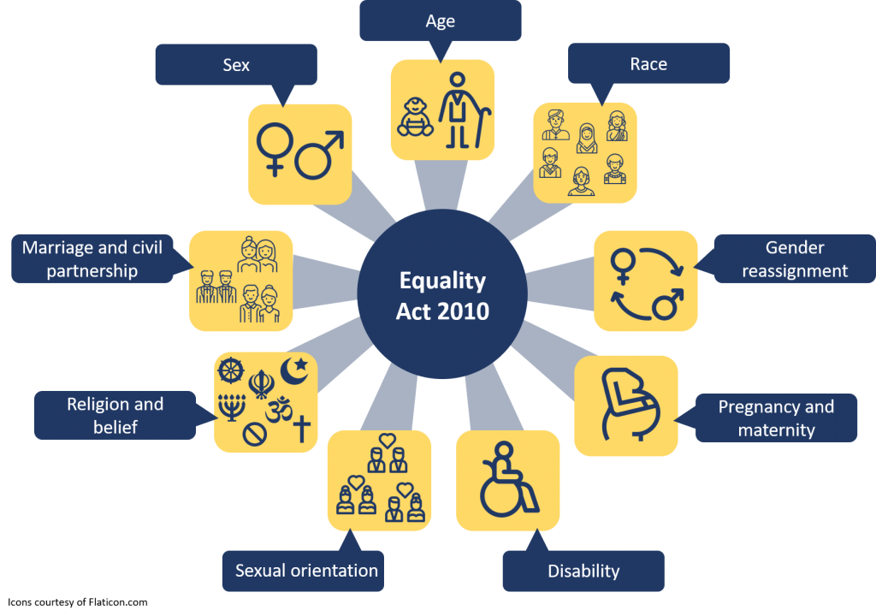
Minimise Risk Nine Protected Characteristics

Slide 6
It can be confusing!
“Despite the prevalence of the Black Lives Matter conversations over the last 12 months, 40 per cent of working professionals are also still afraid to say the word ‘Black’ in relation to race and ethnicity in the workplace” (thehrdirector.com - May 2021)
What terminology is socially acceptable? BAME (Black, Asian & Minority Ethnic), a is no longer ‘acceptable’. Constantly evolving
What is LGBTQ+ (Lesbian, Gay, Bi-sexual, Transgender, Questioning (Queer)) explanation video
Gender pronouns – he/him/his - she/her/hers – they/them/theirs (explanation video)

Slide 7
Scenarios we may have come across…..
Changes to an employee health which require adjustment but do not prevent them completing their duties
Banter – not just those directly in the conversation
Adverts stating amount of years experience
Some women specific
Roles requiring a ‘strong person’ to manage the team
Imbalance of board level gender balance to that of the wider workforce
Lack of promotion because they may decide to have children
Exceptions –gender related scenarios (gender specific carers)
Link to 10 scenarios of dual discrimination

Slide 8
Tick list Risk Minimisation
Review equal opportunity policy ACAS link
Implement Diversity and Inclusion policy ACAS link
Diversity survey example
Diversity monitoring form ACAS link
Diversity and Inclusion awareness and training
Pick up and challenge incorrect language
Ask people to share experiences

Slide 9
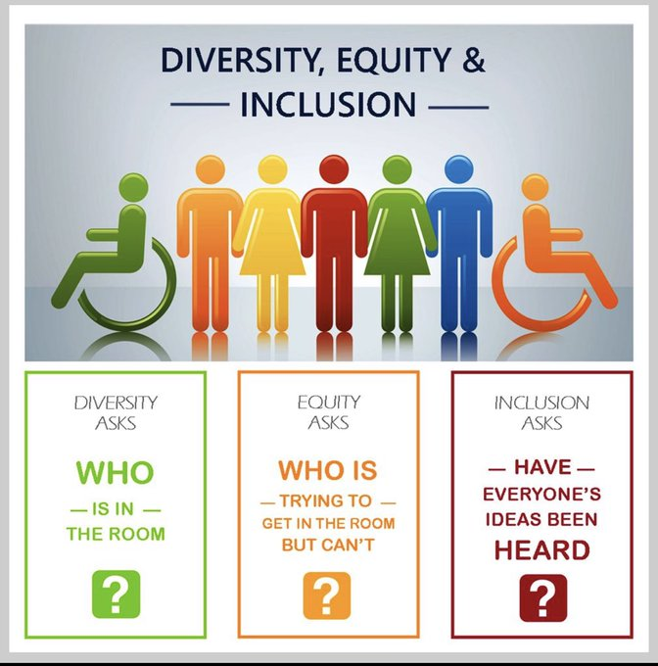
Maximise Potential Diversity Equity Inclusion

Slide 10
Unconscious Bias Royal Society 3min video

Slide 11
Tick list Diverse Talent & Competitive Advantage
Promote your culture – review website images and wording
Advertise in more places – diversity job boards
Inclusive adverts – gender decoder
Unconscious bias test – project implicit
Unconscious bias training
Anonymised CVs / Panel interviews (beware conformity bias)
Development – performance review, mentoring, promotions
Retain – EVP, well-being, reward, culture, safe environment

