Slide 1



Worcestershire Plan for Growth: 2020-2040
C2S event
21 January 2022

Slide 2

Recognising Achievements…
Worcestershire has seen exciting economic development since 2015 – as a result of a single county-wide economic strategy with local consensus on key priorities, opportunities and challenges
Skills
AgriTech Research Centre, Pershore
HoW Duckworth Centre of Engineering, Worcester
Centre of Vocational Excellence, Worcester
Engineering Training Academy, Evesham
North Worcestershire Engineering Academy, Redditch
Inclusive Skills Base Centre, Redditch & Worcester
Centre of Digital Engineering, Worcester
Careers & Enterprise Company Careers Hub, county-wide
Infrastructure
Worcestershire 5G Testbed
Worcestershire Parkway Rail Station
Kidderminster Rail Station
Superfast Broadband rollout
Hoobrook Link Road, Kidderminster
A38 improvements, Bromsgrove
Worcester Southern Link Road
Flood Alleviation – Worcester and Upton
Pershore Northern Link improvements
Churchfields, Kidderminster
Business Environment
The Kiln, Worcester
Phase 5 development at MHSP, Malvern
Worcester Six Business Park development
Redditch Gateway development
Vale Park, Evesham
Cathedral Square, Worcester
BetaDen, Malvern

Slide 3

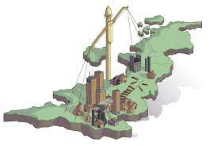

What are our key challenges…
COVID Recovery
Huge economic impact globally
Has accelerated a number of trends – online retail and demand for digital
Changing where and how we work
Need to revitalise city and town centres
Levelling Up
Support our businesses to improve productivity
Need to tackle health inequalities and social mobility challenges across the county
Champion inclusion and diversity across our work
Climate Change
Need to decarbonise our energy and transport systems
Tackling the challenges we face around flooding and water availability
Champion a green recovery and environmental sustainability in our county

Slide 4
Evolution not Revolution…
WLEP’s strategic economic targets (to 2025) are on track or had been achieved based on pre-COVID data – the strategy is working:
£2.8 billion increase in GVA against target of £2.9 billion
38,000 more jobs against a target of 25,000
16,810 new homes against a target of 21,500

Slide 5
Worcestershire 2040 Vision…
“A connected, creative, dynamic economy for all”
Connected
Future is digital
Investment in FTTP and gigabit-capable infrastructure is key
Will revolutionise productivity potential of our businesses
Strategic location – makes the county increasingly attractive for professionals and entrepreneurs embracing remote / hybrid working
Creative
Opportunity to transform our skills base
Attract and retain skilled young workers
Upskill / reskill opportunities for all ages
Future-proofing with a focus on digital skills for all sectors
Creating the conditions for fulfilling jobs and careers and provide flexible working opportunities
Dynamic
Innovation drives competitive advantage
Stimulate investment in R&D activity and cultivate an innovation ecosystem
Aim to create a reputation for new technology and digital capability to enable businesses to trade globally
Embracing responsible and sustainable growth for future

Slide 6
Our Key Strategic Objectives…
Improving Worcestershire’s strategic Connectivity and our infrastructure – physical, digital and energy
Supporting a Creative future-fit Worcestershire workforce
Stimulating investment in R&D and innovation to create a Dynamic Worcestershire business environment
Revitalising our Town and City Centres

Slide 7
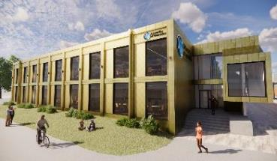
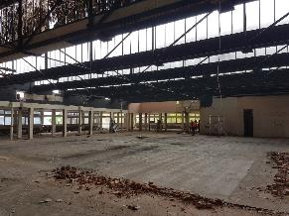
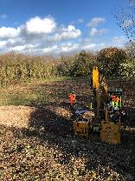
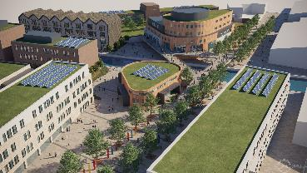
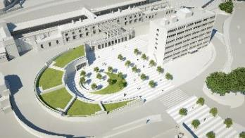
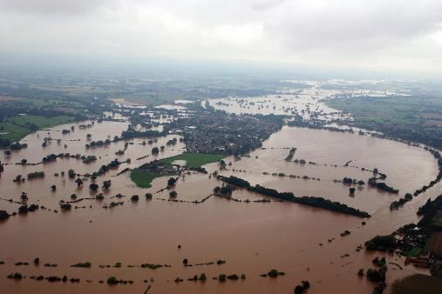
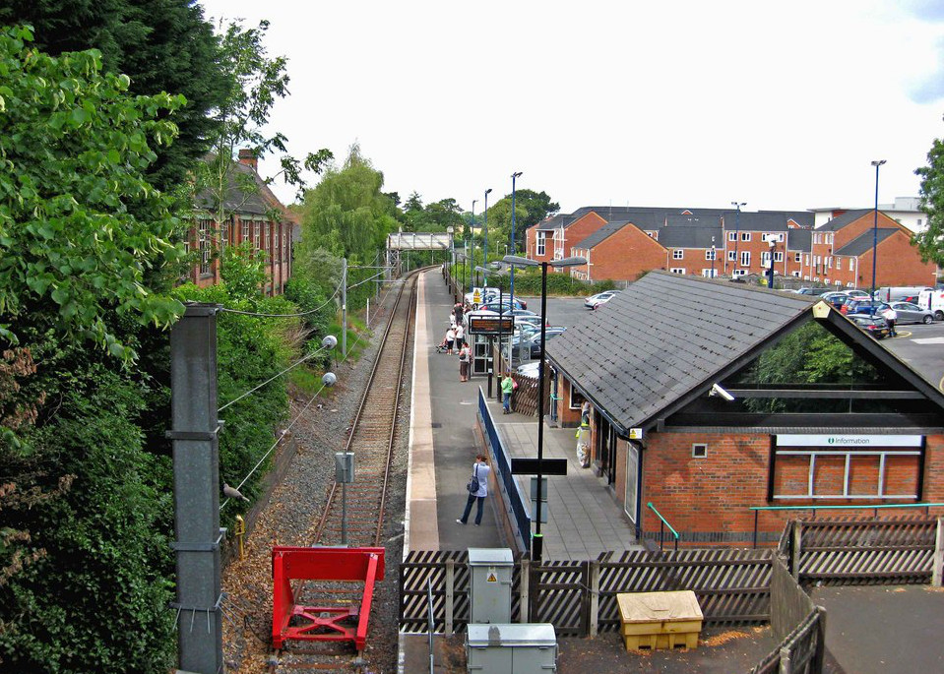
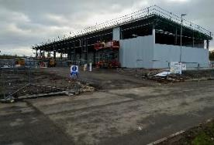
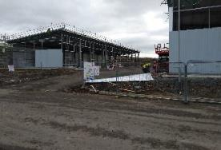
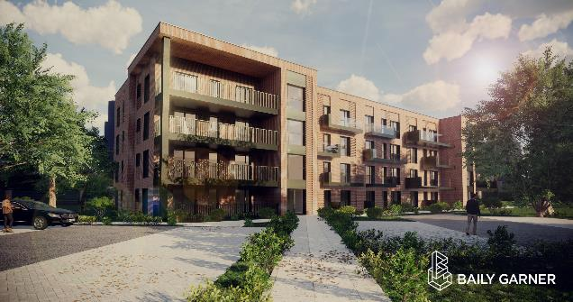
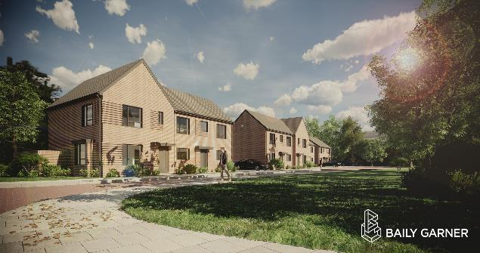
GBF investment programme…
Health, Wellbeing & Inclusive Sport Centre
Kepax Bridge
Worcester Shrub Hill Quarter & Station Masterplan
Tenbury Wells Flood Alleviation Scheme
Redditch Interchange
Vale Business Park Development
Low Carbon Housing Bromsgrove

Slide 9
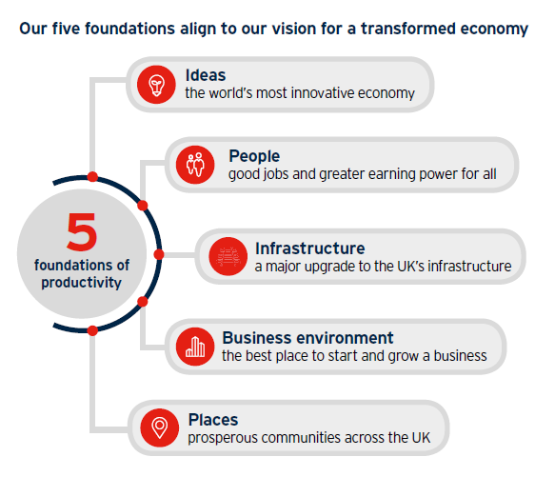
All about economic growth and productivity…

Slide 10





Ideas & Innovation

Slide 11


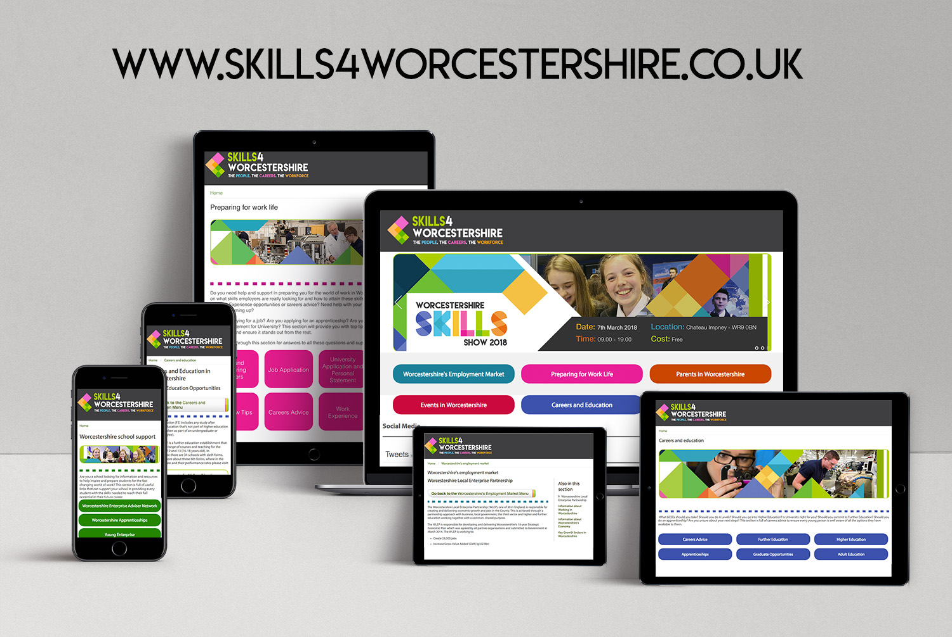

People & Skills

Slide 12






Infrastructure

Slide 13




Business Environment

Slide 14







Places

Slide 16

Worcestershire 2040 Vision:
“A connected, creative, dynamic economy for all.”
Contact:
gary.woodman@wlep.co.uk
Chief Executive
Worcestershire Local Enterprise Partnership

