Slide 1
Brewin Dolphin – Socially Responsible Investing
Thursday 29th July 2021

Slide 2
Introduction to Socially Responsible Investment
Hugely topical area at the moment
Customer demand is on the rise – not just charities and millennials
Assets under management in ethical funds almost tripled from £10.2bn in April 2015 to £27.4bn in December 2020
ESG funds – total assets globally rose to nearly $1.7trn last year, up 50% on 2019
Greater awareness of the effects of climate change – protests, boycotts, etc
Greater focus on good corporate behaviour following the 2008 financial crisis
Doing what is right but also a great investment opportunity

Slide 3
The History of Ethical Investing
Religious Movements – avoidance of ‘sinful’ business activities that conflicted with their religious beliefs
18th Century – founder of Methodism, John Wesley: “We ought to gain all we can gain…but we ought not to gain money at the expense of life, nor at the expense of our health”
Pax Fund was launched in 1971 – Methodists did not want to support the Vietnam War
Steady increase in interest and demand and now it’s taken off!
Environmental issues – Paris Agreement 2016 – 190 countries, 90% of CO2 emissions. Aims to hold increases in global average temperatures to “well below 2°C above pre-industrial levels while pursuing efforts to limit increases to 1.5°C”

Slide 4



What is ESG Investing?
The consideration of environmental, social and corporate governance factors alongside financial factors in the investment decision-making process.
Environmental
Concerns how companies take account of issues like climate change and the impacts of their operations and products on the living world
Social
How a company operates in its community covering matters such as working conditions, health and safety and employee relations
Governance
Company leadership in issues such as executive pay, bribery and corruption and board diversity

Slide 5
The Investment Case for ESG
Companies integrating ESG practices within their wider strategy are not just focusing on their shareholders, but multiple stakeholders
Companies are generally better run if they’re not just thinking about short-term profits
Higher diversity within corporate structure helps innovation and creativity
A trustworthy company attracts loyal customers but also the best quality employees
The Green Recovery – hundreds of billions are being committed to overcome environmental problems
Strong returns + doing what is better for the world (“doing well while doing good”) – these are not mutually exclusive goals

Slide 6
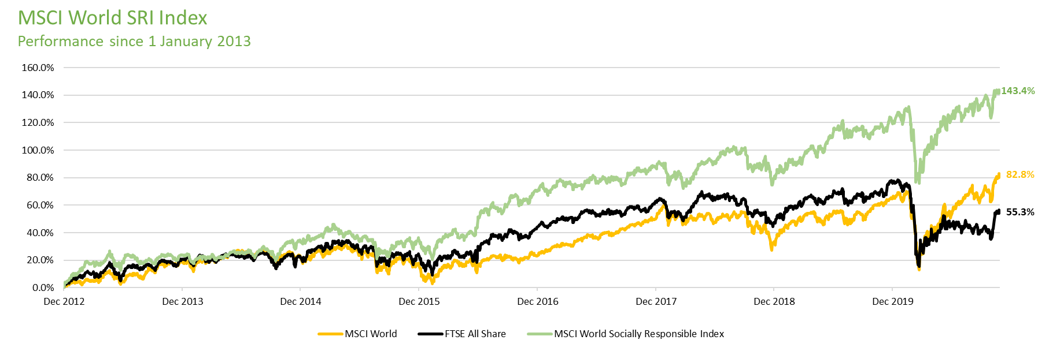
Can I get a healthy return investing this way?

Slide 7
How do we invest ethically?
Negative Screening
Excluding companies engaged in certain activities
Tobacco
Alcohol
Pornography
Gambling
Armaments
Nuclear Power
Animal Testing
Fossil Fuels
Child Labour
Best-in-class
Identify companies that are the best in terms of ESG within their respective sectors
- Watch out for ‘greenwashing’
Sustainable Funds
- Wide range of funds to choose from
Sustainable bonds
Green Bonds
Social Bonds
Blue Bonds
Positive Screening
Actively looking to invest in ‘good’ companies
Renewable energy

Slide 8







Examples of good corporate behaviour

Slide 9
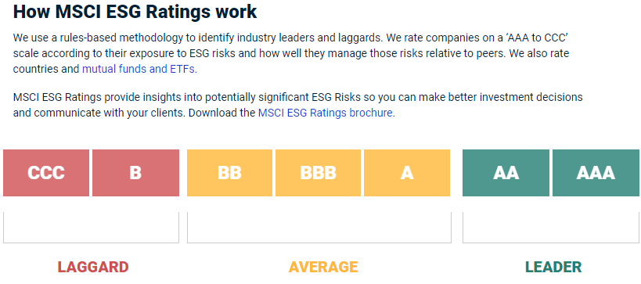
Brewin Dolphin’s approach to Responsible Investing
Brewin Dolphin are rated
AA

Slide 10



Brewin Dolphin’s approach to Responsible Investing
For ethical investing to be more extensively adopted by the financial sector, it will need to be taken up by the likes of Brewin Dolphin and other wealth managers.
ESG Integration for Fund Research
Direct Equities and Sustainalytics
Stewardship

Slide 11
ESG Integration for Fund Research
Our fund “buy list”
Considers and embraces ESG issues
Making efforts to report and be transparent
Our SRI fund “buy list”
Embedded SRI/ESG culture and high degree of ESG resource
Industry leading ESG integration and engagement
Very strong reporting and transparency

Slide 12

ESG Integration for Fund Research
Brown Advisory US Sustainable Growth Fund

Slide 13

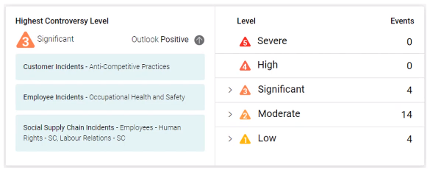
Direct Equities and Sustainalytics
Risk Rating Score
Controversy Report

Slide 14
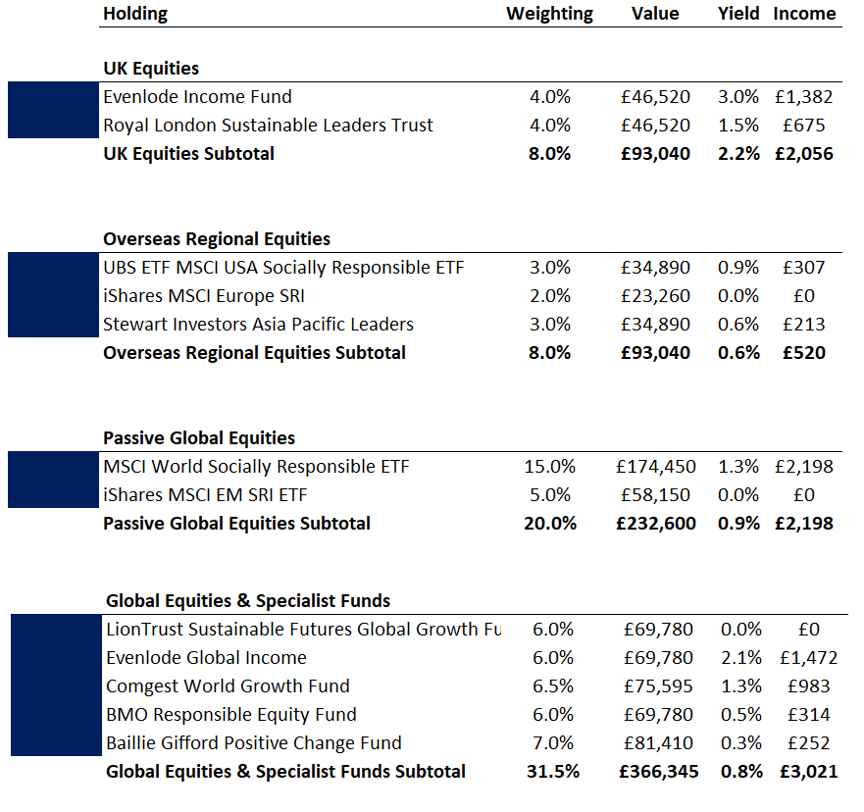
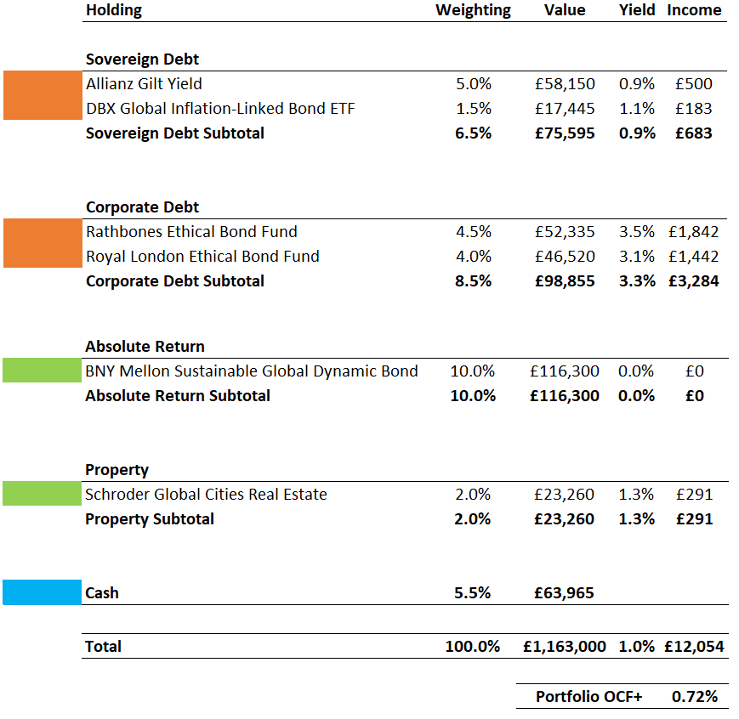
Sample Portfolio: A Global Approach
Risk Level 6 (Medium Investment Risk)

Slide 15
Conclusions
ESG is no longer a ‘nice to have’. It’s been a huge contributor to performance and it’s here to stay
ESG considerations are a growing area of interest for many investors around the world
This is a personal choice. Investor interests need to be fully understood
Huge investment opportunity whilst also doing what is ‘good’
We hope that in the future ‘ESG investing’ will just be known as
‘investing’ because these issues will be ingrained in every
corporation and there will be no tolerance for non-compliance

Slide 16
Disclaimer
This publication is for FCA authorised individuals only and should not be distributed in whole or in part to retail clients.​
​
The value of investments can fall, and you may get back less than you invested. The value of investments and any income from them can fall and you may get back less than you invested. ​
​
Past performance is not a guide to future performance.​
​
We or a connected person may have positions in or options on the securities mentioned herein or may buy, sell or offer to make a purchase or sale of such securities from time to time. In addition, we reserve the right to act as principal or agent with regard to the sale or purchase of any security mentioned in this document. For further information, please refer to our conflicts policy which is available on request or can be accessed via our website at www.brewin.co.uk​
​
The information contained in this document is believed to be reliable and accurate, but without further investigation cannot be warranted as to accuracy or completeness.​
If you invest in currencies other than your own, fluctuations in currency value will mean that the value of your investment will move independently of the underlying asset.​
​
The opinions expressed in this publication are not necessarily the views held throughout Brewin Dolphin Ltd.​
Brewin Dolphin Limited is a member of the London Stock Exchange and is authorised and regulated by the Financial Conduct Authority (Financial Services Register reference number: 124444). Registered office: 12 Smithfield Street, London, EC1A 9BD. Registered in England and Wales – company number: 2135876. VAT number: GB 690 8994 69​

Slide 17
2nd Floor, St James House, St James Square, Cheltenham, GL50 3PR
Tel: 01242 577 677
​
Email: thomas.barton@brewin.co.uk
​
Brewin Dolphin Limited is a member of the London Stock Exchange and is authorised and regulated by the Financial Conduct Authority (Financial Services Register reference number: 124444). Registered office: 12 Smithfield Street, London, EC1A 9BD. Registered in England and Wales – company number: 2135876. VAT number: GB 690 8994 69​

