Slide 1
Financial Wellbeing
from
Brewin Dolphin
Empowering your employees with financial skills for life
Date 14 April 2021

Slide 2
Financial Wellbeing
from
Brewin Dolphin
Agenda
Who we are
Why focus on financial wellbeing?
Financial wellbeing in the workplace
How might employee financial stress be impacting your organisation?
How we can help

Slide 3
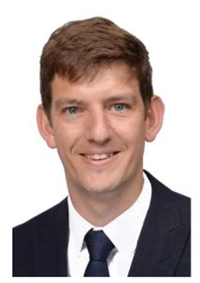
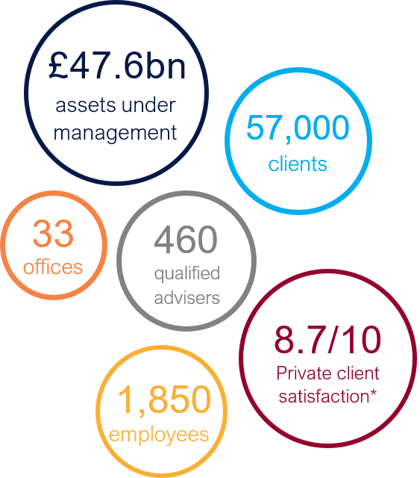
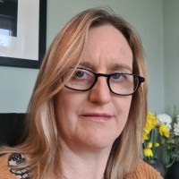
Brewin Dolphin – Who we are
Financial Wellbeing
from
Brewin Dolphin
Brewin Dolphin Group
Providing investment management and financial planning services through our network of offices around the UK and Ireland
Your local financial wellbeing team
Philip Peat DipPFS
Financial Advisor
T 0117 9689 543
E Philip.peat@brewin.co.uk
Helen Farley-Higgs Chartered FCSI
Chartered Wealth Manager
Divisional Director
T 01242 577677
E helen.farleyhiggs@brewin.co.uk
*Source: Scorpio survey comprising c.1,600 client responses, July 2020
Brewin Dolphin | Financial Wellbeing

Slide 4
Why focus on financial wellbeing?
Financial Wellbeing
from
Brewin Dolphin
Physical wellbeing
A growing amount of research is now corroborating the link between financial wellbeing and physical and mental health.
Through various means, employers are increasingly providing support to employees in relation to physical and mental health.
However, financial wellbeing support frequently remains neglected, often due to employers either not appreciating the role it plays in general wellbeing, or not wanting to be seen as delivering financial advice.
Mental wellbeing
Financial wellbeing
Brewin Dolphin | Financial Wellbeing

Slide 5
Financial wellbeing in the workplace
Financial Wellbeing
from
Brewin Dolphin
According to recent surveys of UK-based employees…
65%
believe that they are not saving
enough for long term plans¹
31%
often feel that their finances control their life³
94%
stated that their finances caused them some degree of stress¹
1 in 5
employees report
that they are “just about managing” financially²
41%
are concerned that the money they have now or will save will not last³
¹Financial Wellbeing for the legal profession (February 2020), Brewin Dolphin
²Overstretched, Overdrawn, Undeserved: Financial difficulty and mental health at work (May 2017), Money and Mental Health Policy Institute
³Financial wellbeing and productivity: A study into the financial wellbeing of UK employees and its impact on productivity (October 2018), Centre for Economics and Business Research
Brewin Dolphin | Financial Wellbeing

Slide 6
Financial Wellbeing in the Legal Sector
Financial Wellbeing
from
Brewin Dolphin
Financial Wellbeing in the Legal Sector
A Brewin Dolphin survey conducted in association with The Lawyer magazine
Some key
findings…
94%
of respondents stated that their finances caused them some degree of stress
only 35%
of respondents believe that they are saving enough for their
^{long term plans}
A survey of almost 500 employees in the legal sector
28.5%
are either frequently or constantly stressed by personal finance issues
Source: Financial Wellbeing for the legal profession (February 2020), Brewin Dolphin
Brewin Dolphin | Financial Wellbeing

Slide 7
The consequences for your organisation
Financial Wellbeing
from
Brewin Dolphin
According to recent research¹, employees who are suffering financial stress:
Are almost fifteen times more likely to have sleepless nights
Take one sick day per year due to financial stress
Are almost thirteen times more likely to be unable to complete daily tasks
Are more likely to have troubled relationships with colleagues, and be looking for a new job
The consequences
Productivity
Employee engagement
Employee collaboration
Attrition
Replacement hiring costs
Consider that 36% of UK employees have financial worries
For a firm of 1,000 employees, Due to financial stress, 360 employees may:
Take one additional sick day per year;
Struggle to complete daily tasks;
Struggle to collaborate with colleagues;
Be actively considering leaving the organisation.
¹The Employers Guide to Financial Wellbeing 2019-20, Salary Finance (2019)
Brewin Dolphin | Financial Wellbeing

Slide 8
How we can help

Slide 10
Financial Wellbeing
from
Brewin Dolphin
Financial education seminars
Actual data consolidated across all Brewin Dolphin financial education seminars
How useful did you find the content?
What changes do you intend to make to your finances as a result of this seminar?
Not useful at all
8.3
Extremely useful
Average
“There has been a noticeable uplift in the amount that many of our employees are now contributing to their pensions”
HR Director, Financial Services Company
Maybe
How much did this change your perception of your own financial security?
Would you be interested in attending additional education sessions with Brewin re Financial Wellbeing?
“Explained really well and clearly. Nice to be given the key points of information in a succinct way”
Employee, Communications & PR Consultancy
No
Yes
Not
at all
5.9
A HUGE wake up call
Average

Slide 11
Solutions to support your people at every stage of their career journey
Financial Wellbeing
from
Brewin Dolphin
Self-invested to Personalised wealth solutions
Brewin Portfolio Service
WealthPilot
Wealth management
Make your money work harder for you.
To make the most of your money, you need more than investments. You need advice.
Personal financial advice and investment management.
START INVESTING FROM £500
Making Brewin Dolphin’s investment expertise more accessible.
SELF-INVEST IN YOUR CHOICE OF PORTFOLIOS
With a range of six portfolios to choose from you will find one that matches your own attitude to risk and return.
QUICK AND SIMPLE
Open a secure online account in just a few easy steps. View your investments 24/7 via the online portal.
ADVICE SERVICE OVER THE PHONE AND FACE TO FACE
Enjoy personalised financial planning for straightforward requirements.
INVESTING MADE SIMPLE
Access to Brewin Dolphin’s managed portfolio service.
CLEAR CHARGES
A simple and competitive fee structure.
DESIGNED FOR YOUR NEEDS
Financial plans and portfolios that reflect your individual ambitions.
ADVICE FOR LIFE
Supporting the broader conversations that underpin the decisions about your wealth.
HUMAN TOUCH
Direct access to a relationship manager.
Senior Leadership & Management, Executives & Partners
Early career
Mid-Career / Management
Information is provided only as an example and is not a recommendation to pursue a particular strategy. The value of investments can fall and you may get back less than you invested.
Brewin Dolphin | Financial Wellbeing

Slide 12
Disclaimer
Please note that this document was prepared as a general guide only and does not constitute tax or legal advice. While we believe it to be correct at the time of writing, Brewin Dolphin is not a tax adviser and tax law is subject to frequent change. Tax treatment depends on your individual circumstances; therefore you should not rely on this information without seeking professional advice from a qualified tax adviser.
Past performance is not a guide to future performance. The value of investments and any income from them can fall and you may get back less than you invested. No investment is suitable in all cases and if you have any doubts as to an investment's suitability then you should contact us.
We or a connected person may have positions in or options on the securities mentioned herein or may buy, sell or offer to make a purchase or sale of such securities from time to time. In addition we reserve the right to act as principal or agent with regard to the sale or purchase of any security mentioned in this document. For further information, please refer to our conflicts policy which is available on request or can be accessed via our website at www.brewin.co.uk
The information contained in this document is believed to be reliable and accurate, but without further investigation cannot be warranted as to accuracy or completeness.
If you invest in currencies other than your own, fluctuations in currency value will mean that the value of your investment will move independently of the underlying asset.
The opinions expressed in this document are not necessarily the views held throughout Brewin Dolphin Ltd.
Brewin Dolphin Ltd is a member of the London Stock Exchange, authorised and regulated by the Financial Conduct Authority No.124444.
Brewin Dolphin | Financial Wellbeing

