Slide 1
Base a low investment, high return technology strategy on the Microsoft Power Platform

Slide 2
Agenda
First Solution Group overview
Why innovation is difficult
Microsoft Power Platform
Customer case study – Ralph Coleman

Slide 3
First Solution Group
Award winning managed service company, providing proactive IT and cyber security management and technology strategy consultancy, to help customers achieve their desired business outcomes through the effective use of technology.
Technology transformation through the delivery of low investment, high return technology, turning great ideas into impactful solutions, helping businesses to innovate and overcome their challenges and meet their objectives.
Providing an associate network of individuals and companies ensuring customers have the right leadership, operational and technical skills to support business transformation through the use of technology.

Slide 4
Challenges in building business applications
Only so many problems can be solved by standard software
Custom software development
Everything else is a missed opportunity to digitally transform your business

Slide 5
Innovating carries risk of failure – nothing to be afraid of
Whenever we try new things, we rarely get them right first time.
If we accept that as truth, what can we do?
Look to fail quickly and often so we can correct our path
Failing fast is actually failing cheaply and intelligently

Slide 6
Microsoft Power Platform
One low-code platform that spans Office 365, Dynamics 365, Azure and standalone applications
Power BI
Business analytics
Power Apps
Application development
Power Automate
Workflow automation
Power Virtual Agents
Intelligent virtual agents
Dataverse
Data connectors
AI Builder

Slide 7
Fail fast using the
Microsoft Power Platform
Feedback loops
The build / measure / learn loop. If we want our bad ideas to fail quickly, then we’d be wise to intentionally and regularly create quick prototypes that we can test.
Iterative Design
Quickly and cheaply come up with several designs or prototypes and test them in order to get rapid feedback

Slide 8
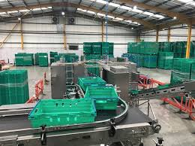
Food logistics business
7 Depots
250 Staff
25 million turnover
300 million transactions per year
Profitability on last 10% of output

Slide 9
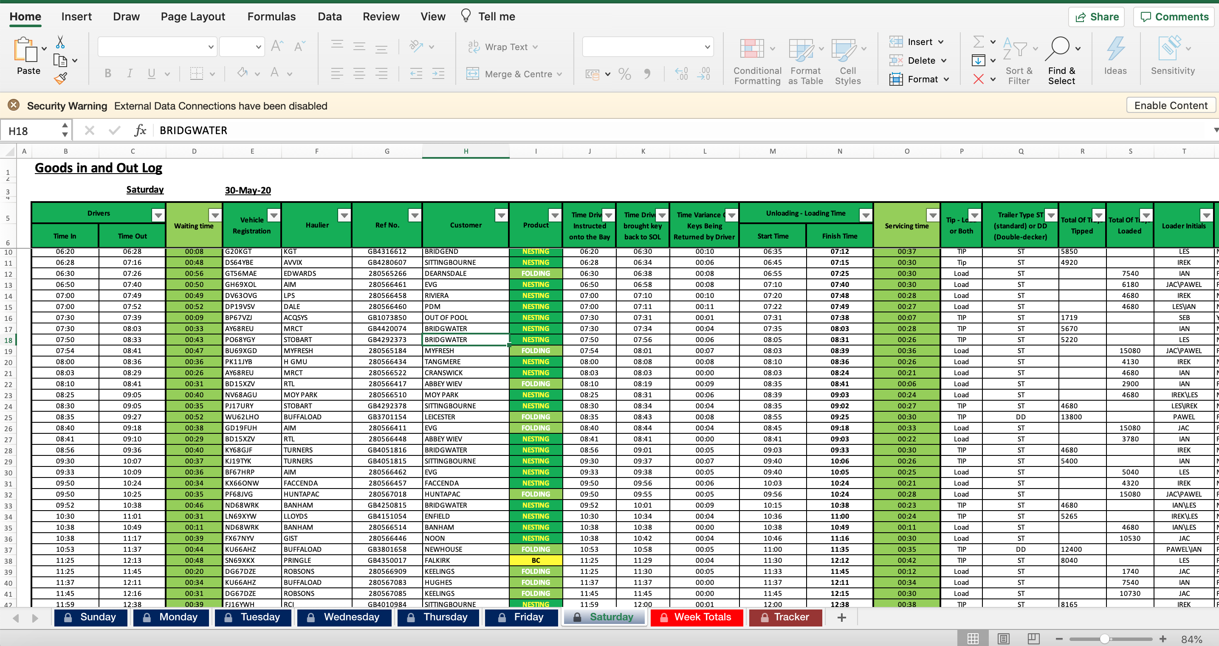
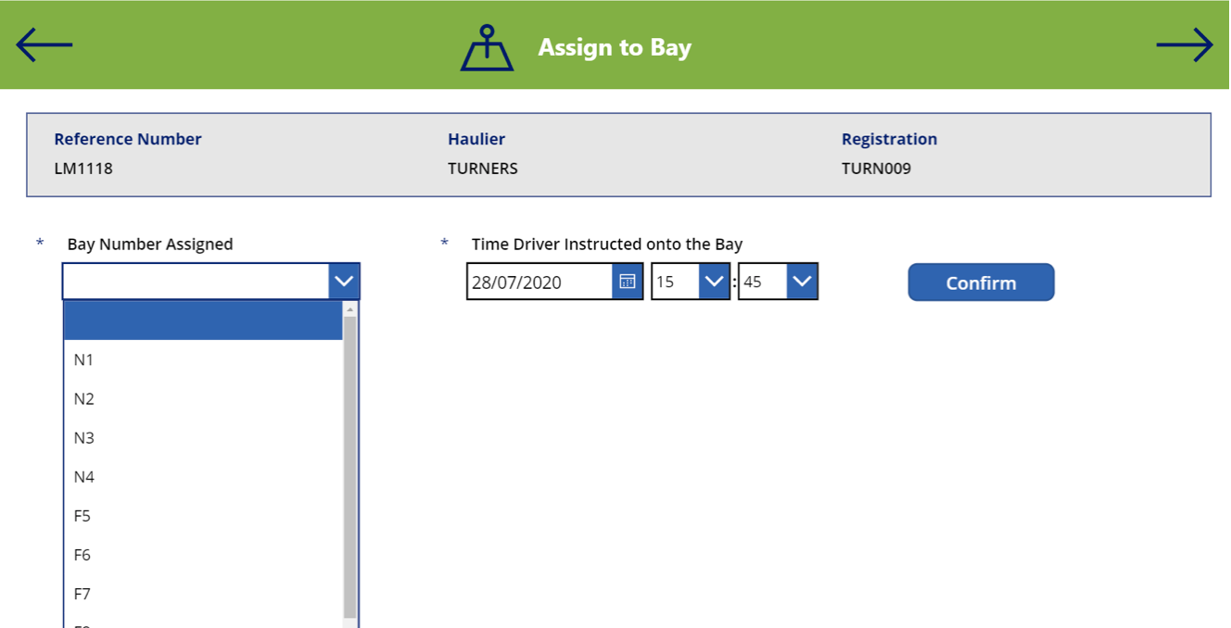
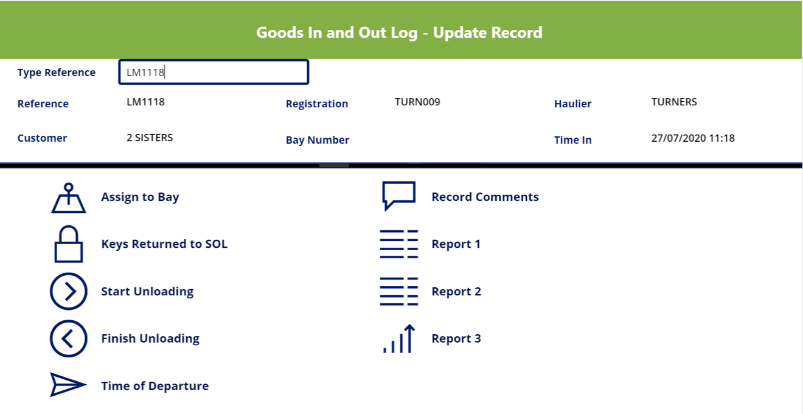
Example – Lorry In Process
Automating a time consuming Excel spreadsheet that is prone to human error
Into a speedy, accurate data entry point for logging goods in

Slide 10
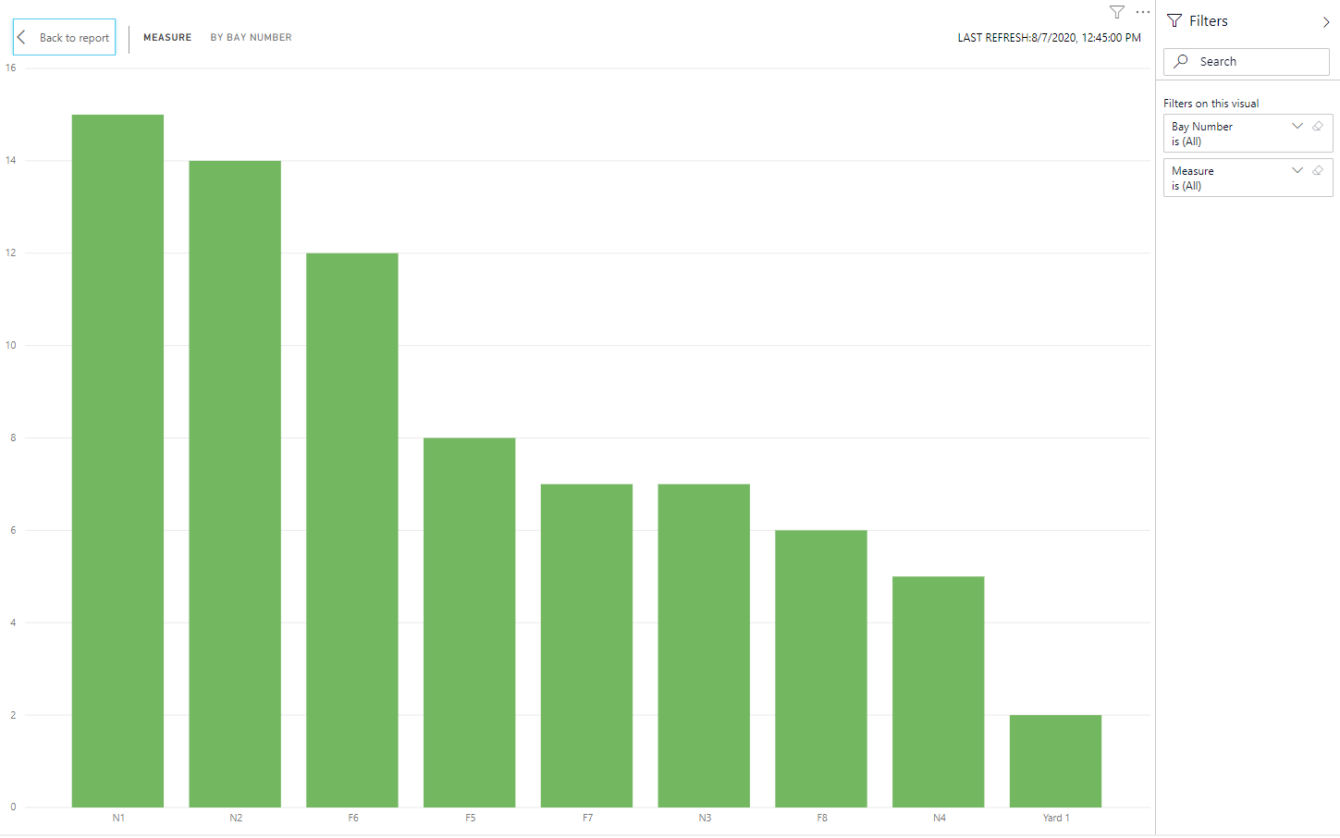
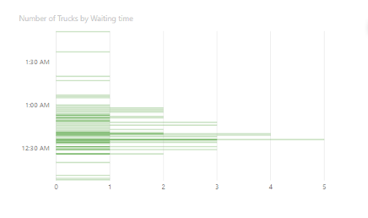
Innovation turns data insights into action
Poor Bay utilisation
High wait times

Slide 11
Building a low investment high return strategy
Find the opportunity in your whitespace
Innovate through failing fast and course correction
Use a platform such as the Power Platform that allows you to act
Innovation finds failures and therefore leads to more opportunities

Slide 12
Thank you! Questions?

