Slide 1
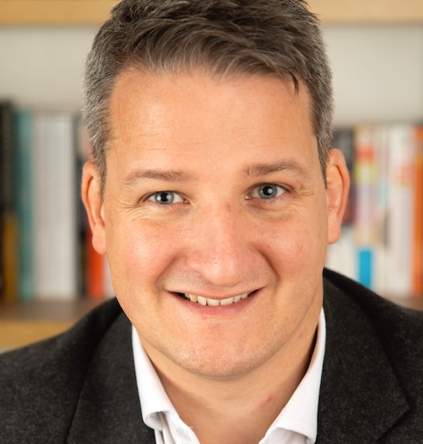
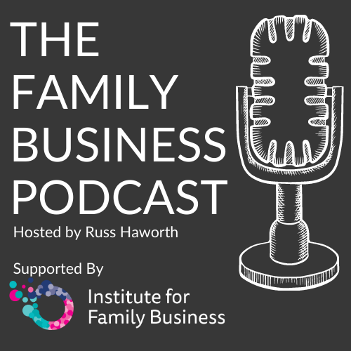
Russ Haworth ACFBA
I am a UK based Family Business Adviser and have been working with families in business for 15 years.
I hold the Advanced Certificate in Family Business Advising, awarded by the Family Firms Institute and recognised globally as one of the leading qualifications for those providing advice to family-owned businesses.
As well as providing dedicated consultancy support to families in business, I am frequent speaker at national and international conferences. I am also the host of The Family Business Podcast, one of the worlds’ leading resources for families in business.

Slide 2
Why are Family Businesses more complex?
Presence of three separate but intertwined ‘systems’
Multiple Roles
Boundaries become blurred
Management of systems key to ‘success’
Notes:
Family owned businesses are asked to manage three separate but interdependent systems.
A change within any of these systems can lead to planned or unintended consequences in the other systems
Boundaries are often blurred between these systems, particularly in the earlier years of a family business
Appreciating and managing these ‘systems’ can lead to better outcomes for families in business.

Slide 3
Impact on Succession
Systems Clash
Multiple roles for people to manage
Family dynamics that need managing
Which ‘hat’ are you wearing?
Barriers to Succession
How will you manage the transition?

Slide 4
Why have a Succession Plan
It will happen!
Having a plan means it happens on your terms
Provides certainty, direction and manages expectations
The earlier you start the more time you have to ensure a smooth transition

Slide 5
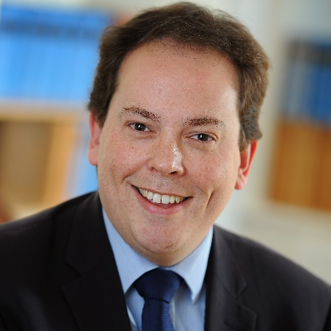
Over to Nick…

Slide 6
What is Succession, really?
SUCCESSION:
The action or process of inheriting a title, office, property, etc.
(source: Oxford Languages)
What does it really mean?
Loss of identity
Sense of Purpose
Big shoes to fill
Trapped in the Family Business
Opportunity
Legacy
Business Continuity
Notes:
Focussing on

Slide 7
The Three Circles of Succession
Focus is often placed on the technical and financial aspects of succession and the emotional issues ignored
Appreciating that there are emotional aspects to address will assist the discussions around succession
Creating an environment of safety for the family to talk and be heard is important

Slide 8
Getting Started
What does ‘success’ look like?
What role does the Family Business play in allowing each family member to live a fulfilled life?
Stakeholder Engagement
‘Zoom out’ from your business
What happens if you do nothing?

Slide 9
What are you passing on?
Ownership
Leadership
Management

Slide 10
Governance as a Tool to assist transitions.
Family Constitution / Charter
Who can own the business
Who can work in the business
What are the ‘rules of entry / exit ’ for the family business
Governance can remove the feeling of being targeted.
Should enhance what you already have in place, is not a brake on behaviour.

Slide 11
Transitions for the Senior Generation…
Prepare for the transition that will happen
What qualities and sense of well-being comes from work, how can this be replaced.
Succession is a process not an event, it is a transition and requires care and planning
Emotional Independence as important as Financial Independence
Preparations should be made for the transition as much as the transaction

Slide 12
Transitions for the Next Generation…
Do they want to join / own the family business?
Understanding what they want to achieve from life
Are they the most suitable candidate for the role?
If not, what can be done to make their transition easier?
Do they have big shoes to fill?
The need for praise
Becoming a responsible owner

Slide 13
Thank You
www.FamilyBusinessPartnership.com
Russ@FamilyBusinessPartnership.com
07939 244160

