Slide 1
Tax efficiency for Family Businesses in an uncertain world
February 2021

Slide 2
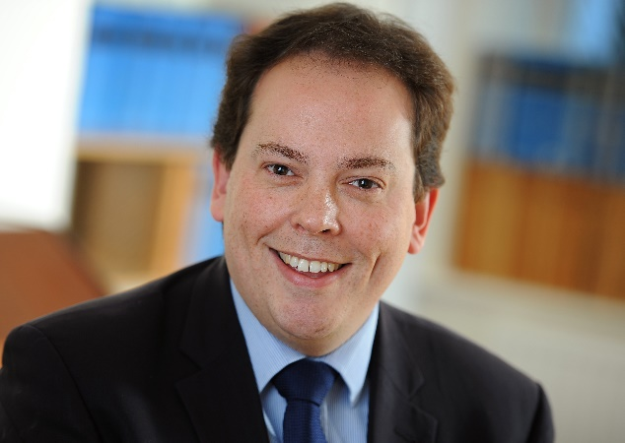
Speaker
Nick Latimer Tax Partner
Cheltenham Office
+44 (0)1242 234421
nick.latimer@crowe.co.uk
Nick leads the Private Client Tax service in the Cheltenham office of national audit, tax and advisory firm Crowe U.K. LLP.
His tax advice helps clients not only to overcome their tax problems, but also to become and remain tax efficient. He advises on all aspects of the tax system but in particular income tax, capital gains tax and inheritance tax, and also advised on property transactions including SDLT. At the moment Nick is advising his clients on the best structure for their property businesses particularly in view of the tax changes for residential property.
As well as acting for clients directly, Nick speaks at seminars to help people better understand changes in the tax rules and to help them spot planning opportunities. Nick is Chartered Tax Adviser and is a fellow of the ICAEW.

Slide 3
Contents - How do Crowe Add Value?
Set up and extraction
Equity for management
Benefits of restructuring
Exit
Post business landscape

Slide 4
Set up and extraction

Slide 5
Equity at inception
Best to get it right from the start
Enterprise Incentive Scheme [EIS / SEIS] where it fits
Ensure no slip ups with ER
Flexibility (loans) vs formality via preference shares for start up capital
Ensure pension planning is brought into consideration
Recruit talent with equity reward [EMI]
Grant funding and R&D funding
Notes:
Early business plan and risk
Early capital structure; family members, trusts
SEIS /EIS conditions and qualifying status [conditions…], New HMRC approach, company age…
ER – need to look at new rules, Pref.s and Ordinary Share Capital
How does ‘uncertainty’ impact this element? 1 Greater need for flexibility (an ‘out’) 2 Watch political risk 3 Build in exchange risk, interest risk

Slide 6
Income extraction – 2020/21 (2019/20)
45% over £150,000
38.1%
over £150,000
£100,000
(£100,000)
Personal allowance reduces by £1 for £2 of income over £100,000
40%
32.5%
£37,500 (£37,500)
20%
7.5%
Non-Dividend income
Dividend income, after £2,000 allowance
£12,500
(£12,500)
0%
0%
Notes:
Dividends – first £2,000 at 0%
Loss of personal allowance over £100,000 - £1 for every £2 of income – high marginal rates 62%!
NI on Earnings Ers 13.8%, Ees 0% to £8,788 (state pension, so pay £8.5k?), 12% to £50,000, 2% unbanded
Dividends – non pensionable; not accepted for mortgage purposes
Dividends – all shareholders (mind that child?) Salary – 14 Yrs old? Wives’ modest payments?

Slide 7
Income extraction
Capital gains – 10% / 20%
18% / 28% for residential property
Business Asset Disposal relief (previously Entrepreneurs’ Relief) – 10% on lifetime £1m (down from £10m in 2019/20)
Director’s loans – tax at 32.5% on company if not repaid within 9 months of year end
Payroll – limited and expensive with Nat Living Wage, employers NI at 13.8%, modest and secure state pension?
Notes:
Discuss ER later but is its time coming to an end? ‘Costs £2.5bn’.
Now need taxable income to safely clear director’s loan account – anti bed ‘n breakfast
Ers NI

Slide 8
Dividends vs other forms of extraction
Corporation tax rate 19% 2020-21 | Self employed % | Salary % | Dividend % | Rent/Interest %
Basic rate band | 29.00 | 40.25 | 25.08 | 20.00
Higher rate | 42.00 | 49.03 | 45.33 | 40.00
Additional rate | 47.00 | 53.43 | 49.86 | 45.00
0% saving rate on £5,000 potentially available
Shares to family members? Consider:
Capital gains tax on transfer (spouse exemption or holdover relief?)
Settlement rules for minor children
Control issues – use of a trust?
Dividend sharing

Slide 9
Dividend sharing (1)
Arctic
Systems
Case
Founder
Spouse
Founder
Dividends paid to each
100%
50%
50%
Family Company
Family Company
Ordinary shares with equivalent income and capital rights
Cleared by courts
Founder
Spouse
Dividend waived by founder
Founder
Buck
Case
100%
99.99%
0.01%
Family Company
Family Company
Ordinary shares with equivalent income and capital rights
Denied by courts

Slide 10
Dividend sharing (2)
Tips/recommendations
Don’t use dividend waivers unless commercial reasons. Must be done before dividend by way of deed
Keep shares vanilla – equivalent rights to income and capital
If using “alphabet” shares…some risk - make sure you have reserves to pay all shareholders
Employee shareholders – employment related securities rules subject value to income tax, and dividend income within scope of PAYE

Slide 11
Equity incentives for management
Notes:
Will these guys get EMI? Ans No as they are USA resident

Slide 12
Management equity
Share options
Enterprise Management Incentive scheme (EMI)
For corporates only
No PAYE / NIC on exercise
Business Asset Disposal Relief on sale (10% tax)
Exit only options possible (10 year window)
Performance conditions can be incorporated
No immediate up-front cash is required
There are conditions and excluded businesses
Management
Notes:
This is all about driving growth for the benefit of all. There are other schemes but EMI is a no-brainer
Unapproved options - PAYE and NIC on exercise + no ER based on grant date
Conditions:
£250k per employee (MV) of options granted
Employee of the company or qualifying subsidiary
Working time requirement – 25 hours or 75% of working time if less
Cannot hold material interest in company – 30% (at date of grant)
Company independence test – cannot be controlled by another company
Gross assets of company <£30m at grant
Max unexercised for company - £3m
Excluded businesses
Dealing in land, commodities
Banking, insurance, money lending, debt factoring
Leasing
Legal or accounting services
Farming and market gardening
Holding, managing or occupying woodland
Operating/managing hotels
Operating/managing nursing homes / residential care homes

Slide 13
Restructuring

Slide 14
Restructuring – common reasons …
1
Separate two businesses with intention to sell one
4
Separation of divisions with different strategies
2
Create platform for succession or future management buy out
5
Split ‘investment’ and ‘trading’ businesses
3
Separate businesses where shareholders have fallen out
6
Preserve reliefs – Business Asset Disposal and Business Relief
Notes:
(1) There must be a commercial reason for the demerger
(5) Family business – aggregates trading business / rental portfolio
(3) Shareholders fall out – nursery business a capital reduction demerger.

Slide 15
Restructuring – some key points….
4
3
1
2
Commercial Reason
Tax reliefs
Timing
HMRC clearances
Must be undertaken for bona fide commercial reasons
.
Demerger and reconstruction tax reliefs available
.
The earlier the reconstruction is undertaken the better
.
Advance clearances can be obtained to provide certainty
.
Notes:
2 year Entrepreneurs’ Relief holding condition

Slide 16
Exit via sale/succession

Slide 17
Third party or share buy-back
Options include
Gifts (which might carry a CGT liability)
Gift and share buyback (nice as uses company funds but watch conditions)
MBO – Need (a) good management (b) a fundable proposition
Third Party Sale - High stress but good outcomes are possible
Liquidation
Notes:
ER features: (a) New anti-dilution options (b)New two-year holding period
Buyback – numerous conditions and needs a good lawyer (and a good tax guy). Needs to be (almost) final
MBOs a good option for a business with issues as management are supposed to know them all !
Third Party Sale – Drain on Management time, distracting to business, formal process? Some offers will be low-ballers / more paper than cash
Liquidation – Can bring a company to a natural end. Capital outcomes possible but watch TiS and anti-phoenix

Slide 18
Succession restructuring – case study
Founder generation no longer contributing to day to day of business. Taking dividend income.
Next generation paid salary – expensive
Restructuring for succession with HMRC clearance – founder generation dispose of shares to newco controlled by next generation for cash, pref shares and debt
Cash extraction from company at 10% rate
Significant tax saving for next generation with more tax efficient cash extraction
Trust holding for grandchildren adds efficiency
IHT for founder generation managed

Slide 19
Succession restructuring – alternatives
Gift of shares and share buyback capital treatment
Buyback for cash
Sufficient reserves
Tradeco shares held > 5 years
Substantial reduction
No longer connected
For benefit of company trade
HMRC clearance available

Slide 20
Pre-sale planning
Company Housekeeping - trace all those contracts… tidy away old companies
Consider EMI
Review Business Asset Disposal Relief availability
Husband and Wife shares ? Maybe but under advice and depends on timing.
Consider shares to adult children
Shares to a trust ? Potentially a good play for BADR, IHT
Notes:
Housekeeping; Employment contracts, equity promises made, tidy up intra-group balances, remove distractions
EMI – seems late in the day but can still get shares to (full time) employees at a good price.
ER – used to be simple but increasingly complex – Share rights, employer / officer. 5%. Ordinary Share Capital and Prefs.
ER – Property outside the business? Property generating rental income?
ER Wife – consider 5% now to accrue ER in plenty of time. Can then engage in last minute H2W gifts. Watch for EMI dilution.
Shares to trust. A ‘business relief’ trust. Can place significant value in a trust structure. Great for wealth planning, IHT.

Slide 21
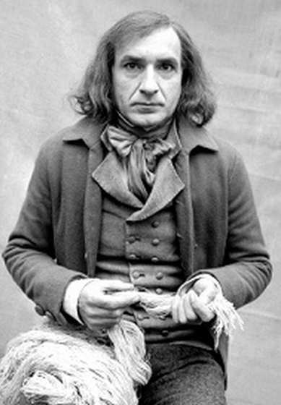
Post-business landscape – inheritance tax!
Notes:
Who this
Ben Kingsly playing Silas Marner.

Slide 22
A balancing act
Inheritance tax
Income Tax
Capital Gains Tax
Corporation Tax
Notes:
It’s probably all a question of timing.
Eg suppress earnings for tax reasons becomes show good earnings for disposal PE multiples
Corporation Tax is reducing (17% wef 1 April next) but for how long…?
Income tax has high marginal rates which leads to increasing use of FICs
Capital Gains – Should ER be viewed as an allowance which everyone should try to utilise?
IHT often portrayed as ‘voluntary’ but capital taxes can be sticky for property. Watch property outside the business – ouch!

Slide 23
Inheritance tax – Business relief … a generous relief …
Other considerations
51% test for trading activities
Binding contracts for sale/liquidation and some SHA prevent relief
Watch for excepted assets – cash, private assets, investment subs.
Prohibited businesses include: dealing in securities; holding investments and property letting
1
100% relief most trading business or unquoted shares
2
Only 50% relief for land, buildings, machinery or plant used in a business
3
Two year holding period
Notes:
Prohibited businesses include dealing in shares, land or holding investments
Letting company would not qualify but Property development OK
Hotel and a B&B should qualify but prob. not FHL
Family medical / pharmacy business – next generation by way of a family trust and BPR.
100% BPR SINCE ?...anyone 1992 (was 50%) – costs £1.2bn per year. Tax free CGT uplift costs another £1.2bn Resolution Foundation is against.
What colour will the next government be? How about 45p over £80k, 50p over £123k, ‘Xp over’ £330k sound + Land Value Tax + No ER + Less IHT reliefs

Slide 24
Family Investment Company
Child 2
Child 3
Child 1
Child 4
Mum
Dad
Family investment Co

Slide 25
Comparison of FICs vs Trust
Tax | Trust | FICs
Income tax | Trustees/beneficiaries taxed on arising basis | Possibly tax free in company for reinvestment and taxed when distributed
Capital gains tax | Taxed at up to 20/28% | Two layers of tax if distributed but short term tax saving (CT at 19/17%)
Inheritance tax | 10 yearly charges, and entry charge over £325k | No 10 year charges, no restriction on amount transferred into FIC
Flexibility of distributions | Discretionary | Harder to make changes in future
Control | Vests in Trustees | Vests in Directors and shareholders
Transparency | Relatively private | More visible unless unlimited

Slide 26
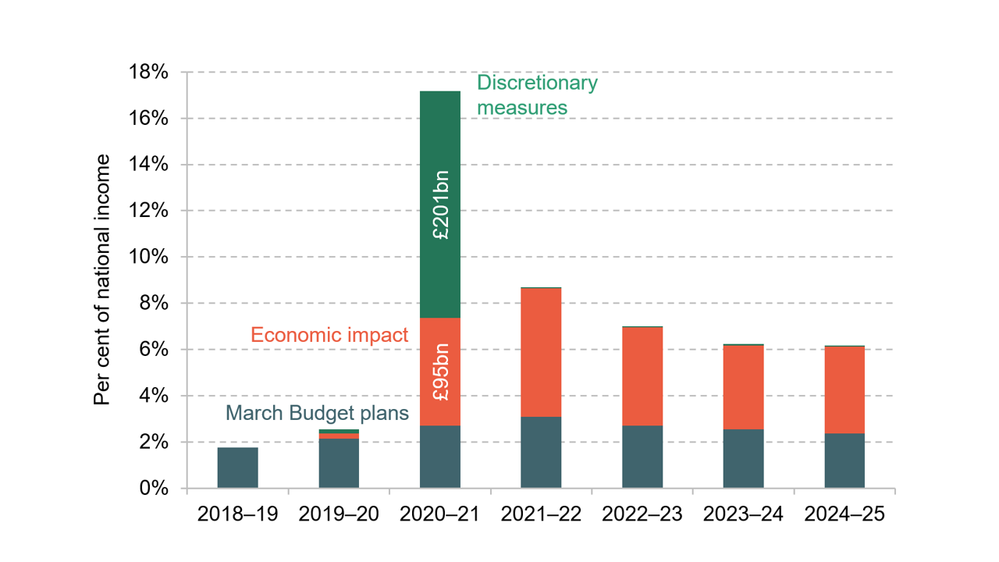
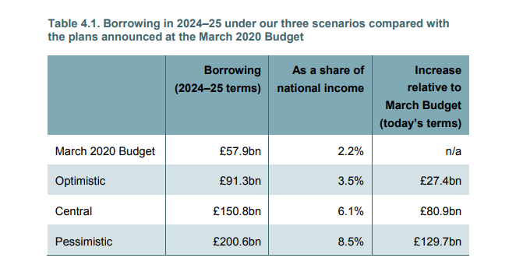
…but where will we be on 3rd March and beyond?
Institute of Fiscal Studies October 2020 outlook
Revenue raising measures on the way

Slide 27
Nick Latimer, Partner
Phone: 01242 234 421
nick.latimer@crowe.co.uk

