Slide 1
Planning for Success!
The Legal Bits
Malcolm Emery, Partner
malcolm.emery@bpe.co.uk

Slide 2
The Succession Plan
Every plan starts with a great idea

Slide 3
The Succession Plan
There is no “one size fits all” plan for succession planning.
Each family’s plan will be different.
Communication between family members is the key to ensure the continuity of a successful business.
A family constitution may help.

Slide 4
Which Will structure is right for you?

Slide 5
Simple Will Structure
First spouse to die Surviving spouse
Everything passes to
the surviving spouse

Slide 6
Will structure involving trusts - position on first spouse’s death
No 1 Trust
No 2 Trust
Discretionary Trust
Business Assets
Life Interest Trust
Non-Business Assets
Everything left to the children

Slide 7
The Jones Family
Bob has twin boys (Reggie & Ronnie aged 21) from a previous marriage. Bob met Sue and after a whirlwind romance they married.
Bob owns 100% of Meds R Us Limited which manufactures pharmaceutical grade drugs. Bob’s other assets include the family home (worth £1.5m) and investments worth £500k. Bob dies suddenly.
Three years after his death Meds R Us Limited was sold for £3m and the proceeds placed on deposit.
Five years after Bob’s death, Sue sadly passed.

Slide 8
Sue’s IHT Position on Death -
Simple Will
Assuming Bob put a simple Will in place, Sue’s IHT position on her death is as follows:
£ £
Value of home 1,500,000
Investments 500,000
Cash 3,000,000
5,000,000
Less: Sue’s Nil Rate Band (325,000)
Bob’s Transferrable Nil Rate Band (325,000) (650,000)
Value of estate chargeable to IHT 4,350,000
IHT Chargeable at 40% 1,740,000

Slide 9
Will Trust
Bob leaves his shares in Meds R Us Ltd into a business trust via his Will with his remaining assets passing to a life interest trust for Sue. Sue’s IHT position on death is as follows:
£ £
Value of family home 1,500,000
Investments 500,000
2,000,000
Less: Sue’s Nil Rate Band (NRB) (325,000)
Bob’s Transferrable Nil Rate Band (325,000)
Sue’s Residential Nil Rate Band (RNRB) (175,000)
Bob’s transferrable RNRB (175,000)
(1,000,000)
Value of estate chargeable to IHT 1,000,000
IHT chargeable at 40% 400,000

Slide 10
Summary of IHT Position
Simple Will Will Trust
£ £
1,740,000 400,000

Slide 11
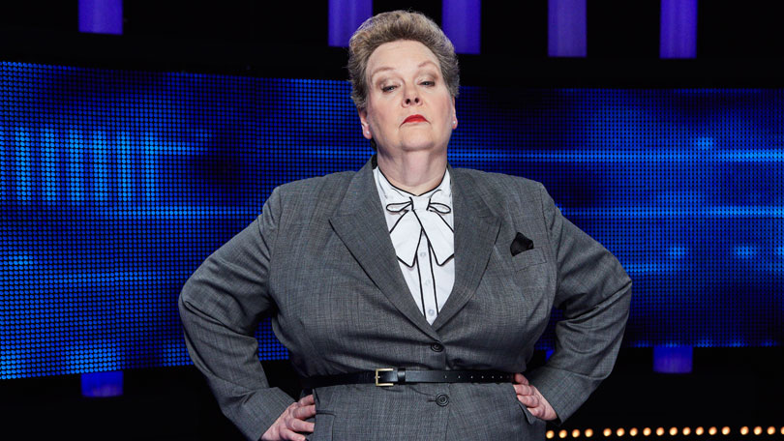
Governance Issues

Slide 12
Businesses have legal documents in place to determine how they should be run. These are known as the governance documents.
General Partnership – Partnership Agreement otherwise partnership governed by the 1890 Partnership Act.
Company - Articles of Association
- Shareholders Agreements

Slide 13
If you are undertaking estate planning involving the disposal of an interest in your business (either by lifetime gifting or via your Will) or perhaps putting Lasting Powers of Attorney in place, you must review your business governance documents to ensure you are allowed to do what you want to do.
If not, it is important that your governance documents are updated to reflect your current intentions.

Slide 14
Lasting Powers of Attorney

Slide 15
Lasting Powers of Attorney
A Lasting Power of Attorney (LPA) allows you to appoint one or more individuals to make decisions for you if you are unable to do this for yourself due to mental or mental or physical incapacity.
Two types of LPAs - Property and Financial Affairs
- Health and Welfare
As a business owner you can have a separate Property and Financial Affairs LPA to cover your business.

Slide 16
It is important to provide detailed guidance to your Attorneys. This can be done via the LPA or through a separate statement of wishes.
If your business is run through a company, you may wish to consider putting three separate Property and Financial Affairs LPAs in place:
One to cover your personal property
One to cover your shareholding
One to cover your role as a Director

