Slide 1
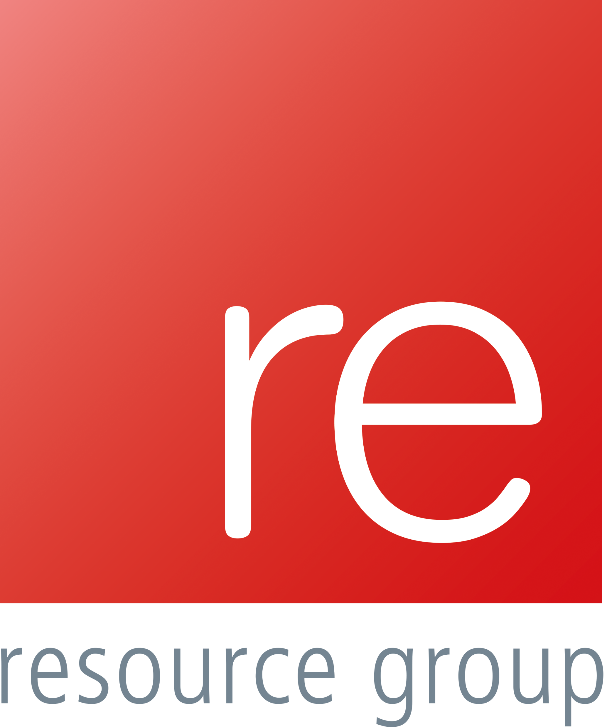
Notes:
Welcome…. introduction

Slide 2
“Job Shortage sees 1,000 people chasing one position”
“I’ve applied for 2,000 jobs with no success”
“Bank to cut 550 jobs in branches”
Notes:
These are just some of the doom and gloom headlines from the BBC news website in the week commencing 24th August…. It’s the BBC, so they must be correct, right?
Or maybe not we thought, being at the forefront of the jobs market, we are seeing different stories emerging that in fact said the opposite, so we thought why not ask people, find out what was happening.

Slide 3
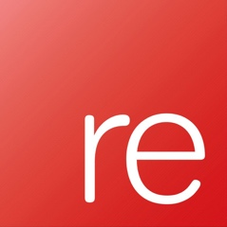
Your Business Your People Survey 2020
The impact of Covid-19
Notes:
During this period of the pandemic the office of national statistics was telling us that vacancies and people in work had fallen and we all knew that the average application to job ratio had increased ….. But what about those businesses that were seeing growth who was reporting those stories.
We ran a survey across our regions to ask business owners, executives, managers what they were seeing…

Slide 4
The Initial Impact
Notes:
And this is what we found…

Slide 5
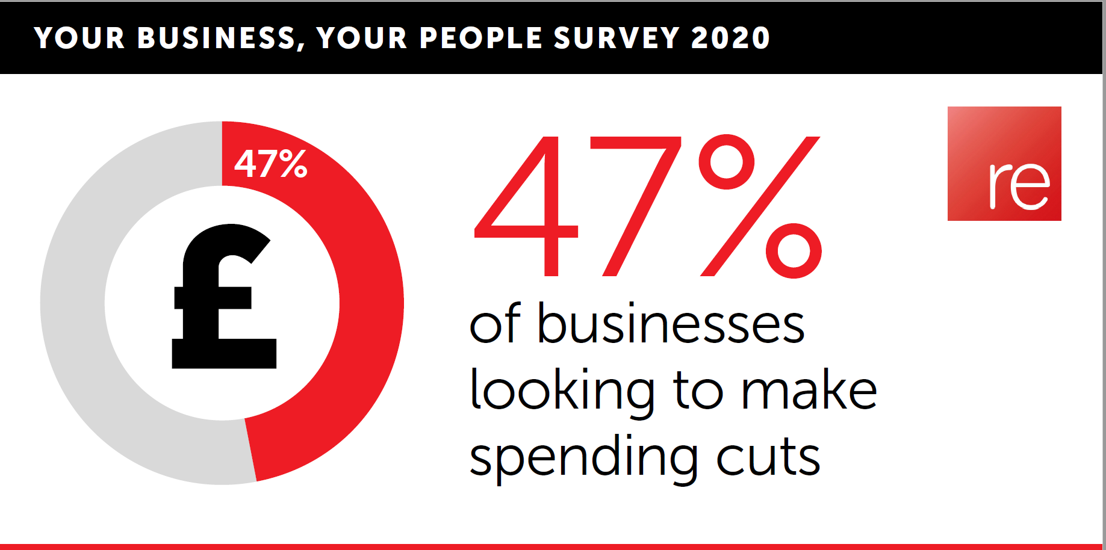
Notes:
Surprisingly 47% said the pandemic had had a disruptive impact and they’re actively looking at making spending cuts.
Training, marketing, office supplies, travel expenses, refining payroll for example, full time to part- time, delaying or cancelling projects, leveraging technology – are just some of the examples.

Slide 6
Notes:
Whilst on the other hand 11% of our regions businesses state they have seen no real difference in their performance.

Slide 7
Notes:
And over a quarter of all respondents say the pandemic has actually had a positive impact.
In fact a report from McKinseys which was published 5 days ago – backs this up, they reported that growth has been seen in manufacturing, green infrastructure, investments in digital, talent reskilling, and high-value food industries.

Slide 8
Out of the Pandemic, new opportunities arise
Notes:
The pandemic has hit every industry in a variety of ways.
The more agile organisations have adapted their businesses to ensure success during testing times or to meet the demand that companies that are already supplying cannot fulfil.

Slide 9
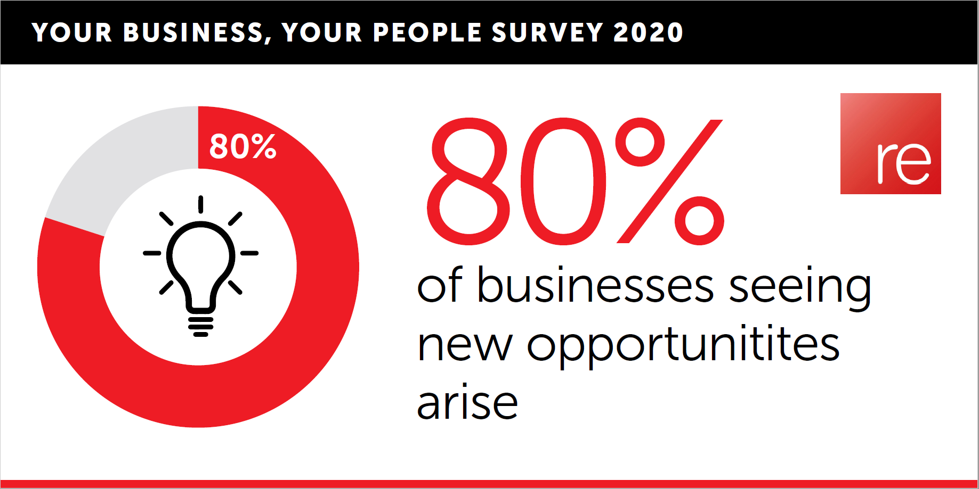
Notes:
There have been a number of examples of sectors and businesses that have seen new opportunities arise which can be loosely or more tangibly linked to the pandemic.
The race for the vaccine by the likes of AstraZeneca is an obvious example but there are many others for example Estate Agencies and Mortgage brokers that have seen applications spike following the lockdown due to the Government lowering the stamp duty tariff and homeowners deciding during lockdown that they need a change of scenery.

Slide 10
Notes:
Almost half of the companies we have surveyed have or are looking to diversify.
Examples locally include Sibling Distillery where prior to the pandemic predominantly produced gin, now do a range of luxury hand sanitisers, this has been replicated by familiar names like Brewdog in their own distilleries.
We have seen it on the high street and in restaurants as well where the likes of Just Eat and Uber Deliver allow you now to enjoy restaurant quality food even when the doors of your favourite eating house are not open.

Slide 11
Notes:
75% have had to change their services they provide, I know at RE we have had to be fluid and moved people around the business to deal with peaks and troughs due to requirements.

Slide 12
To furlough or not to furlough?
Notes:
The furlough scheme was largely successful especially in the early Pandemic days! It was a really difficult decision to furlough some key members of staff due to changes in the volume of work. A lot of companies found themselves in the same boat and its really positive I feel that there was no real stigma attached to those furloughed. I know I feared for the mental wellbeing of some of our team here as it’s a massive change I think it was fortunate for everyone that we had good weather at that stage!

Slide 13
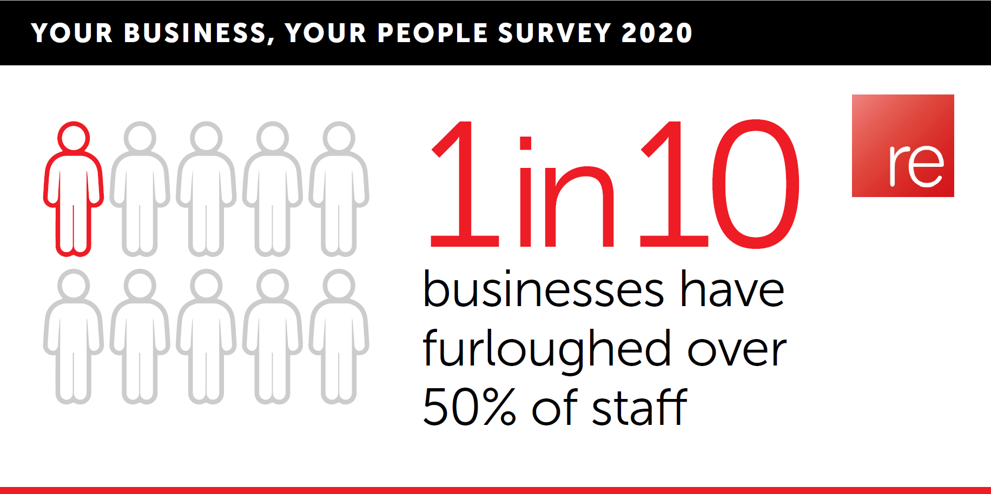
Notes:
Not surprisingly a large number of businesses made use of Rishi Sunaks furlough scheme, around 10% furloughed over half of their staff. I think its important to note here that some of those involved in the survey were from the hospitality industry,

Slide 14
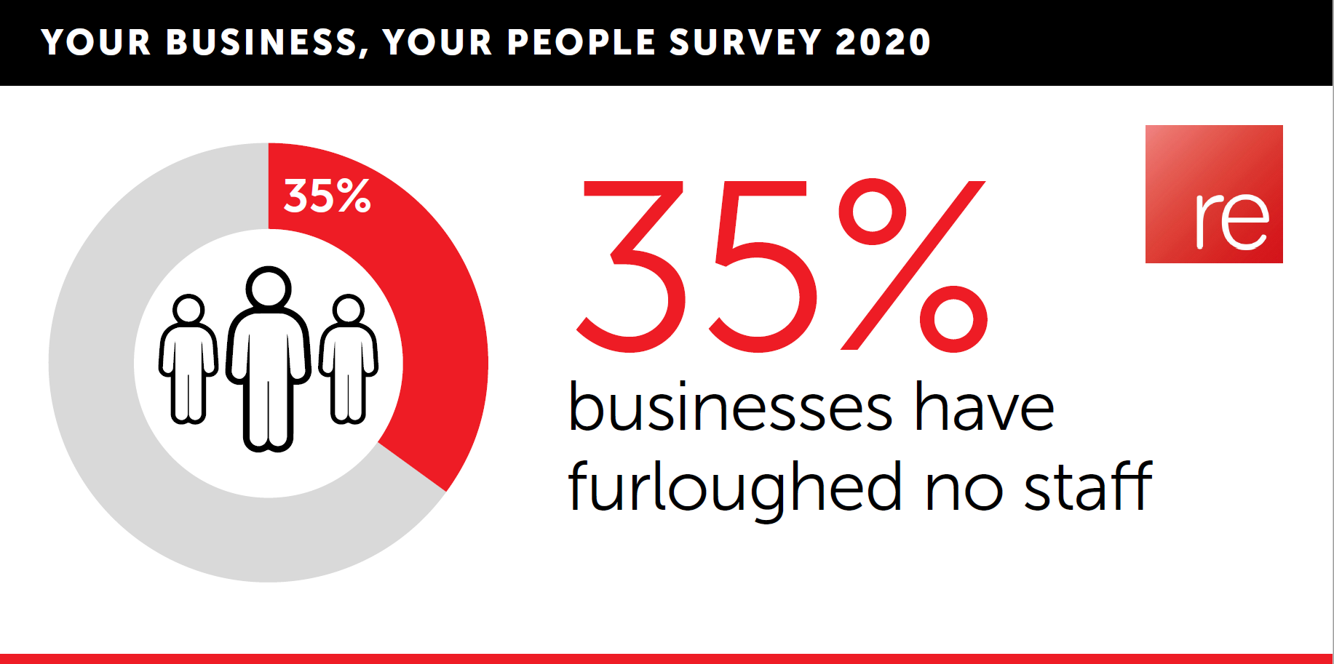
Notes:
35% did not furlough at all, which maintains that we have some really strong success stories through the pandemic period so far and its interesting speaking with some of these businesses the difficult discussions they had back in March.

Slide 15
Notes:
90% were satisfied with the government support (obviously this is at the time of the survey back in July, it may be slightly less now potentially).

Slide 16
Hiring not firing
Notes:
What was the story in terms of recruitment and company head count growth over the last few months, is the market stagnant or are there still businesses going through growth?

Slide 17
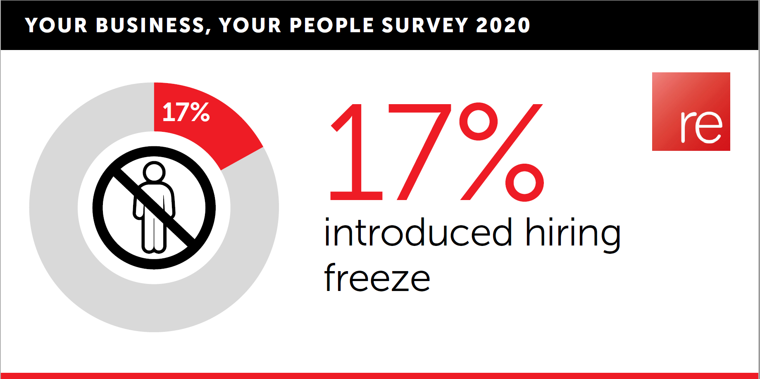
Notes:
A relatively small proportion introduced a hiring freeze, when you compare this to the 65% of companies that have furloughed it is good to see organisations seeking to add new talent to meet business needs. A lot of those companies that introduced hiring freezes were due to the sector they were in being hit massively (like hospitality) or because they saw the opportunity to have a restructure and move existing staff into new challenges which will be beneficial in the future.

Slide 18
Notes:
We have also seen a growth in the temporary and contract need due to the unknown nature of what the next 6-12 months will look like and companies not wanting to gamble on adding any extra heads on a permanent basis. Whilst there is some sense in doing this, it does throw up some challenges:
Risk – of losing a good contractor to a permanent opportunity.
New contractors – a lot of the temps and contractors maybe haven’t worked this way before and it can be a culture shock.
IR35 – this is looming around the corner having been postponed from April 2020 and will have a major impact especially for those who have set themselves up as Ltd contractors.
On the positive side, it can be a great way of introducing somebody from a different industry as a try before you buy, and there are some very talented individuals available currently that are looking for work.

Slide 19
Quality not quantity
Notes:
The unemployment figures have risen by 117% since March, suggesting there is a greater pool of candidates for companies to choose from and certainly the number of applications per job has risen significantly. However candidate quality is key as is the time it takes to find the right person to fill a role.

Slide 20
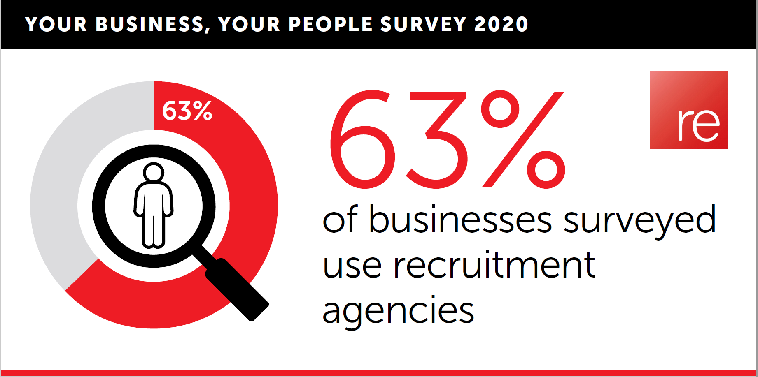
Notes:
63% of businesses surveyed say they use recruitment agencies, with employer branding being ever important these days and website and social media supporting the candidate attraction.

Slide 21
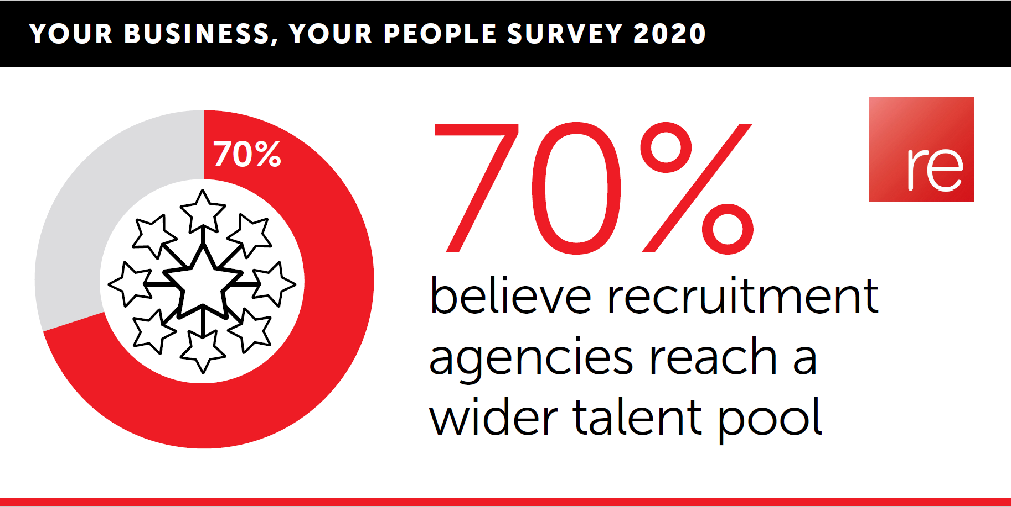
Notes:
71% of respondents told us that the quality of candidates and the agency's understanding of their business as the main reason why they partnered with a recruiter. 7 in 10 believe recruitment agencies reach a wider talent pool and half believe engaging with agencies enables them to identify the right talent.

Slide 22
Notes:
Yet with many offices still closed and social distancing in place, 57% of businesses surveyed say they have had to change their hiring process.
For example 34% would consider virtual onboarding
And over 50% would consider running virtual assessment centres.

Slide 23
Summary
OUR VISION
Notes:
.
Economy research suggested 16m of us tranferable skills that could lead to a new career and
World skills London have suggested that UK adults could have 2nd skills estimated to be worth more than £7.6bn
So in summary, some green shoots of positivity

Slide 24
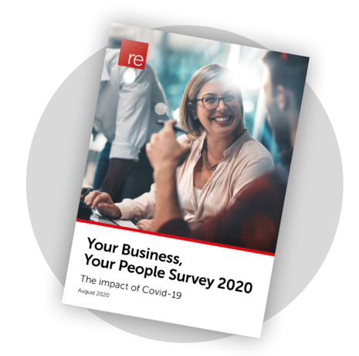
Your Business Your People Survey 2020
Download your copy today…
The impact of Covid-19
Notes:
If you’d like a copy of the findings and our narrative on the results you can find them in a white paper on the RE Resource group website. I will happy send you all a copy after the presentation.

