Slide 1
The Big Conversation Government announcements and finance
Nick Latimer
16 July 2020

Slide 2
Latest from the OBR

Slide 3
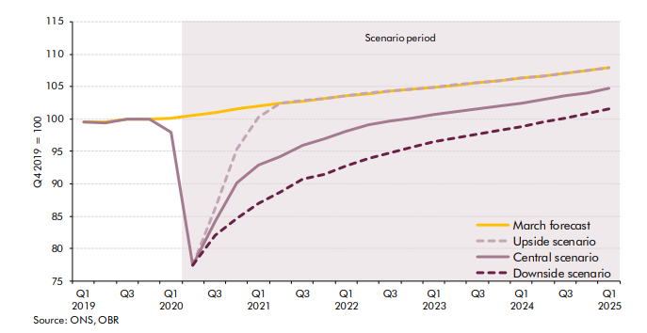
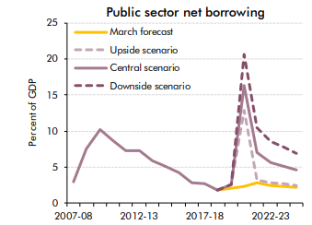
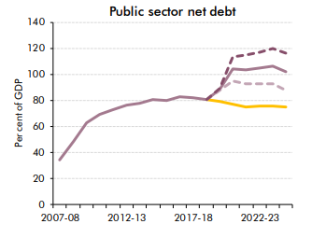
July OBR data – GDP vs Budget scenario – debt to hit £2 Trillion
Central Scenario - receipts £133 billion lower than expected, spend £135 billion higher
Net borrowing in the year £322bn, 16% of GDP, highest in 300 years
…and numbers exclude additional £30bn from 8 July announcements

Slide 4
Helping through COVID in 20-21
Job Retention Scheme – expected cost £47bn
Self-employed income support scheme – expected cost £15bn
Grants and loan guarantees – expected cost £20bn
£46bn (so far) in CBILS and Bounce Back loans, and deferred VAT and income tax payments
Further £30bn on new 8 July “Plan for Jobs” measures including:
Job Retention Bonus – £9.4bn
Kirkstart and workplace schemes - £3.7bn
VAT reduction - £4.1bn
SDLT cut - £3.8bn
Reduced VAT rate for hospitality, accommodation and attractions - £4.1bn
Notes:
https://www.gov.uk/government/collections/hm-treasury-coronavirus-covid-19-business-loan-scheme-statistics#Bounce-Back-Loan-Scheme at 12 July CBILS £11.85bn, CLBILS £2.73bn, BBLS £31.7bn
https://www.gov.uk/government/publications/a-plan-for-jobs-documents/a-plan-for-jobs-2020

Slide 5
Reminder of key measures

Slide 6
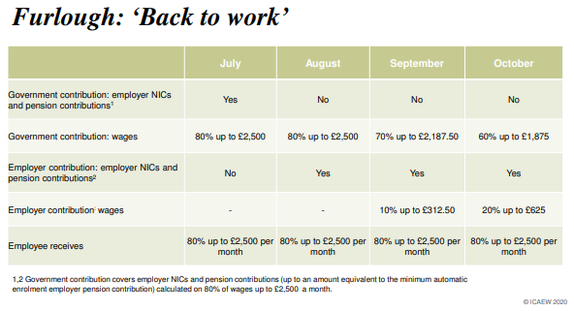
“New” Flexible Furlough - Reminder of Phase Out Plan
Deadline 31 July for claiming on the “old” (pre July) scheme
New “back to work” flexible furlough scheme only available to those with qualifying furlough claim by 30 June. Period can be as short or long required (but calcs complicated):
Notes:
https://www.gov.uk/government/collections/hm-treasury-coronavirus-covid-19-business-loan-scheme-statistics#Bounce-Back-Loan-Scheme at 12 July CBILS £11.85bn, CLBILS £2.73bn, BBLS £31.7bn
https://www.gov.uk/government/publications/a-plan-for-jobs-documents/a-plan-for-jobs-2020

Slide 7
“New” Self Employed Income Support Scheme
Deadline for claiming under the “old” scheme now passed (13th July)
New scheme grant claims open 17 August 2020:
70% of three months trading profit up to £6,570 (previous scheme was 80% up to £7,500)
Self employed individuals can continue to work – grant is a taxable receipt
Eligibility
submitted their self assessment tax return for the tax year 2018/19 by 23 April 2020;
traded in the tax year 2019/20;
intends to continue to trade in the tax year 2020/21;
carries on a trade which has been adversely affected by coronavirus.
“Adversely affected”
For new scheme, the business must be adversely affected after 13 July 2020
Examples include unable to work due to shielding, care responsibilities, scaling down or suspending activities, fewer or no customers, or staff unable to work
Notes:
https://www.gov.uk/government/collections/hm-treasury-coronavirus-covid-19-business-loan-scheme-statistics#Bounce-Back-Loan-Scheme at 12 July CBILS £11.85bn, CLBILS £2.73bn, BBLS £31.7bn
https://www.gov.uk/government/publications/a-plan-for-jobs-documents/a-plan-for-jobs-2020

Slide 8
Reminder of other previously announced measures
Vat payments deferred in period to end of June 2020 to be paid before 31 March 2021. No other deferrals available.
July 2021 self assessment tax instalment payment doesn’t need to be paid until 31 Jan 2021.
CBILS and Bounce Back loan schemes still available until 30 September 2020:
Crowe has 100% success on raising CBILS funding
Bounce Back loans of up to £50k/25% of t/o easy to obtain
Borrowing will get more difficult thereafter…better to have too much cash than too little.
Notes:
https://www.gov.uk/government/collections/hm-treasury-coronavirus-covid-19-business-loan-scheme-statistics#Bounce-Back-Loan-Scheme at 12 July CBILS £11.85bn, CLBILS £2.73bn, BBLS £31.7bn
https://www.gov.uk/government/publications/a-plan-for-jobs-documents/a-plan-for-jobs-2020

Slide 9
8 July:
“Plan for Jobs” measures

Slide 10
For employers
Job Retention Bonus
£1,000 to be paid to UK employers for:
each furloughed employee earning above £520p/m on average between 31 Oct 20 and 31 Jan 21
who is continuously employed until 31 January 2021
Irrespective of current financial performance of business
Payments made from Feb 21
Kickstart scheme
Government covers 6 months wages
For those aged 16-24 on universal credit and deemed to be at risk of long term unemployment
Funding will cover 100% of NMW and associated costs
PLUS funding support for new traineeships of between £1-2k per trainee/apprentice
Notes:
https://www.gov.uk/government/collections/hm-treasury-coronavirus-covid-19-business-loan-scheme-statistics#Bounce-Back-Loan-Scheme at 12 July CBILS £11.85bn, CLBILS £2.73bn, BBLS £31.7bn
https://www.gov.uk/government/publications/a-plan-for-jobs-documents/a-plan-for-jobs-2020

Slide 11
For the hospitality and tourism industry
Cut in VAT to 5%
In force - applies from 15 July to 12 Jan 2021
To eat-in, hot takeaway food, and non-alcoholic drinks
To accommodation and attractions
Rishi’s Eat Out to Help Out
3rd to 31st August
Mon – Wed
50% discount up to £10 per person (food or non-alcoholic drinks)
So far include: Nando’s, Wagamamas, Burger King, Frankie and Benny’s, Harvester, Toby Carvery, Pizza Hut.
Gym’s reopen 25th July!
Notes:
https://www.gov.uk/government/collections/hm-treasury-coronavirus-covid-19-business-loan-scheme-statistics#Bounce-Back-Loan-Scheme at 12 July CBILS £11.85bn, CLBILS £2.73bn, BBLS £31.7bn
https://www.gov.uk/government/publications/a-plan-for-jobs-documents/a-plan-for-jobs-2020

Slide 12
For the property sector
SDLT holiday on first £500,000
In force – applies from 8 July to 31 March 2021
Residential property
Saving of up to £15,000 with cliff edge 1 April 2021
Expected SDLT surcharge on non-residential purchasers from 1 April 2021 as well (not yet confirmed)
Rates below:
Residential rates (main rate and surcharged rate)
< £500,000 | 0% | 3%
£500,001 - £925,000 | 5% | 8%
£925,000 - £1.5million | 10% | 13%
> £1.5m | 12% | 15%
Non residential
< £150,000 | 0%
£150,000 - £250,000 | 2%
> £250,000 | 5%
Notes:
https://www.gov.uk/government/collections/hm-treasury-coronavirus-covid-19-business-loan-scheme-statistics#Bounce-Back-Loan-Scheme at 12 July CBILS £11.85bn, CLBILS £2.73bn, BBLS £31.7bn
https://www.gov.uk/government/publications/a-plan-for-jobs-documents/a-plan-for-jobs-2020

Slide 13
Autumn Budget?

Slide 14
Tax increases on the way?
Taxes are likely to have to go up – but a difficult balance.
Possible targets:
Capital gains tax rates top rate 20% (28% for residential property) versus income tax at up to 45%
Pension grab – reduced rate of pension tax relief on savings, reduction in tax free withdrawal on drawdown?
Increased rates of income tax (50% after 2008 crisis) or lower tax thresholds
Dividend tax rates – particularly for those with “close companies”
National insurance – particularly for the self-employed
VAT – though regressive and already at historic UK high
Replace inheritance tax with a wealth tax?
What’s to come? Vaccine, autumn spike, economic recovery? Tax raising measures in the autumn budget should be expected.

Slide 15
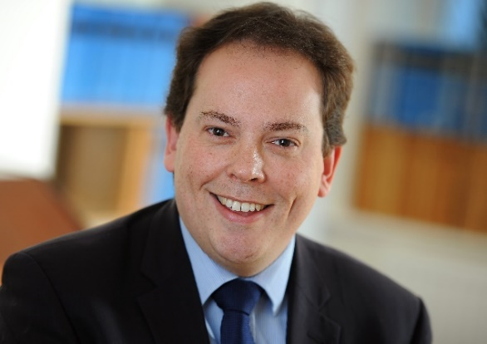
Next Finance Focus – 23rd July 10am – please join us
Nick Latimer Tax Partner
Cheltenham Office
+44 (0)1242 234421
nick.latimer@crowe.co.uk
Nick leads the Private Client Tax service in the Cheltenham office of national audit, tax and advisory firm Crowe U.K. LLP.
His tax advice helps clients not only to overcome their tax problems, but also to become and remain tax efficient. He advises on all aspects of the tax system but in particular income tax, capital gains tax and inheritance tax.
As well as acting for clients directly, Nick speaks at seminars to help people better understand changes in the tax rules and to help them spot planning opportunities.

Slide 16
Questions

